Slide 1
A TMS Selection: best practices for preparing an RFT and latest perspectives
May 22, 2014
Tom Hunt
Director of Treasury Services
The Association for Financial Professionals

Slide 2



Who is AFP?
Global resource and advocate for the finance profession:
The Association for Financial Professionals (AFP) serves a network of more than 16,000 treasury and finance professionals. Headquartered in Bethesda, MD, AFP provides members with breaking news, economic research and data on the evolving world of treasury and finance, as well as world-class treasury certification programs, networking events, financial analytical tools, training, and public policy representation to legislators and regulators. AFP is the daily resource for treasury and finance professionals.

Slide 3
Session Agenda
Treasury Technology Needs
RFT Steps
AFP Member Tips
Federal Reserve and FDIC Tips
For More Information

Slide 4
Treasury Technology Needs

Slide 5
Technology Drivers
Cash Visibility
ERP Installs
Business Growth
Outgrown current solution
Broader IT Policy
Audit/Board Mandate

Slide 6
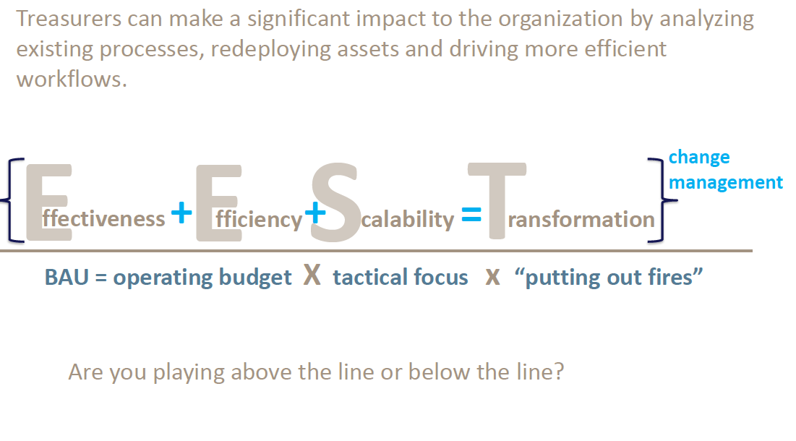
The “Right” Technology
Source: Mark Kirsch, Bank of America presentation to AFP Advisory Group, February 2014

Slide 7
Treasury Challenges = Technology Response
Globalization of business
  Growth increasingly International
Rapidly evolving regulations
  Impact of finance sector regulation, local capital controls, transfer pricing
Stretched supply chains
  Physical and financial supply chains have embedded risks
Volatility in environment
  Economic growth, political risk, FX volatility creates real and opportunity costs
Treasury’s span of control broader and more global
Treasury also taking on more strategic role in supporting and giving value to the operating business
Need to optimize processes to create capacity, become more effective
Companies are using Technology to expand visibility of cash and become more proactive vs. reactive.
Notes:
Questions for the Panel: 1) What roles beyond typical “Treasury” roles as defined in the table are you branching out?
2) How has your role changed in supporting or communicating with the board?

Slide 8
Evolving Treasury
Treasury Leads
Cash Flow Forecasting
Treasury Assists
Working Capital Management
Developing Roles
Leasing
Employee Benefit Management
Bank Relationship Management
Borrowing ST & LT
Investing ST & LT
Global Treasury Management
FP&A
Financial Risk Management
Business Continuity Planning
ERM
Counterparty Risk Analysis
Acct/SEC Compliance
Technology Implementation
M&A
Insurance
Retirement/Pension Mgmt
Investor Relations
Size of Treasury Mandate Relative to Five Years Ago
Broader: 55% About the Same: 40% Narrower: 5%
At least two-thirds of survey respondents indicated that 18 function areas are currently within the scope of their organization’s treasury function
Source: AFP Strategic Role of Treasurer Survey.

Slide 9
RFT Steps

Slide 10
RFT Steps
Needs assessment
  Mirror/match Treasury department
    Tasks, duties, coverage
  Global/Regional/Domestic
  Centralized/Decentralized
  Countries
  Areas to consult:
    Tax, Legal, Accounts Payable, Payroll, Collections, IT (phased), Banks
  Is a SWIFT connection needed?
  Where are the gaps in coverage and service for Treasury?
  Ultimately, what process needs to be more efficient?
  Inventory of all processes in Treasury

Slide 11
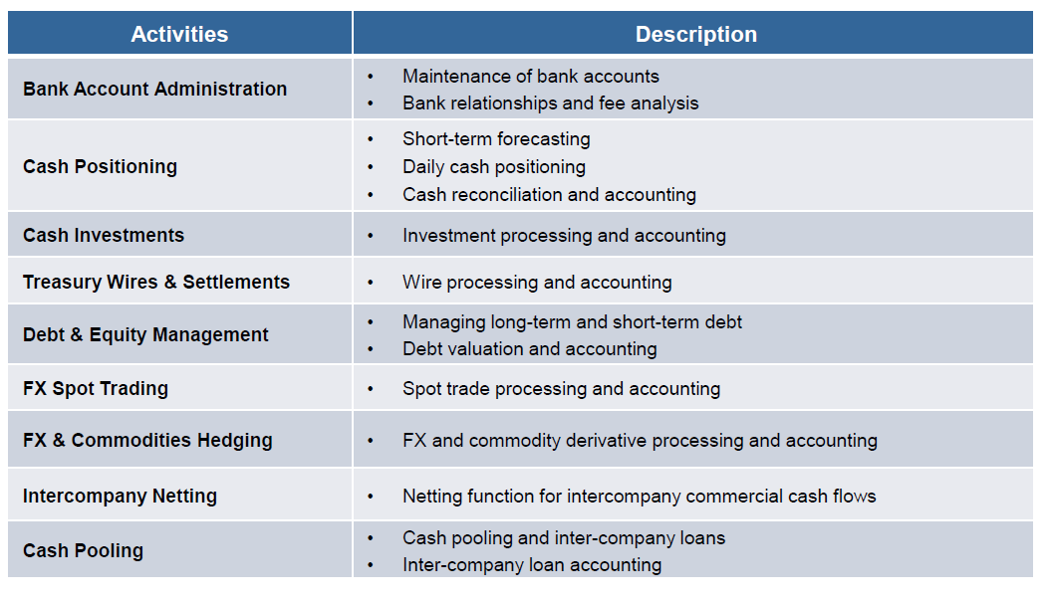
Scope of Technology
Source: Treasury Transformation Session by General Motors, 2013 AFP Annual Conference

Slide 12
RFT Steps (cont’d)
2. Process Maps
  Current process
  Desired process (develop decision criteria)
  All treasury processes
    Cash management (Bank interface, recons, communications)
    Forecasting
    Foreign Exchange, Netting, Pooling, etc.
    Payroll, Accounts Payable, Collections, SSC’s
    All banking areas
    Consider ancillary technology
      Investment portals, Fx Portals, Fx Reporting, Bank Account Reporting, Data feeds, Custody, Bank fees

Slide 13
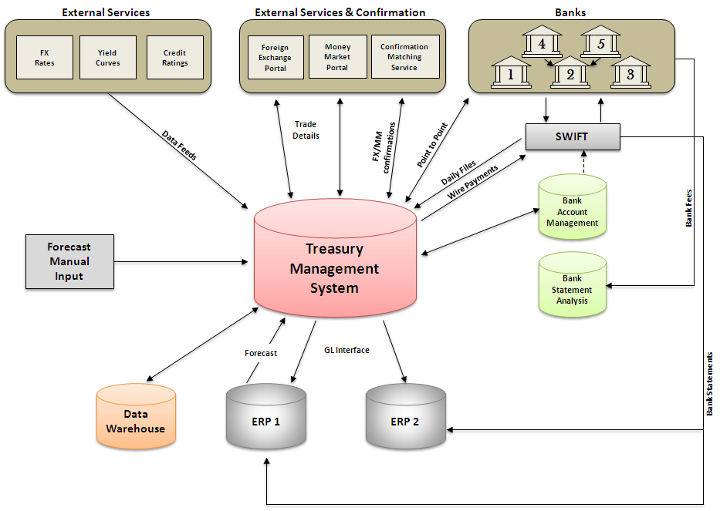
Sample Process Map
Source: AFP Treasury Technology RFP Template

Slide 14
RFT Steps Cont’d
3. Build the Business Case
  Senior management support
  Board approval
  Communicate objectives
  Cost estimates and IT needs
  Identify ideal and practical technology solution
      SaaS, ASP, Hosted, Bank
  Work towards a requirements definition
      Utilize the process inventory
      Process requirements
      Prioritized
      Future proof

Slide 15
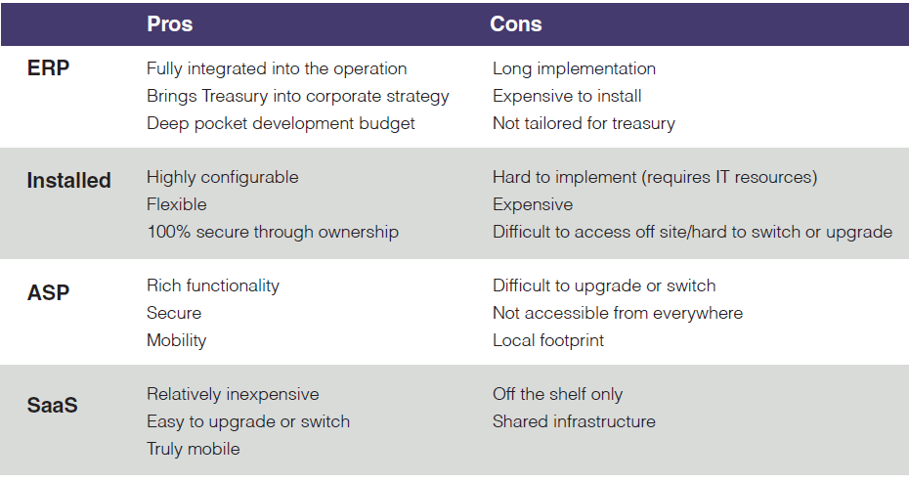
TWS Versions
Source: AFP’s CTC Guide to Treasury Technology

Slide 16
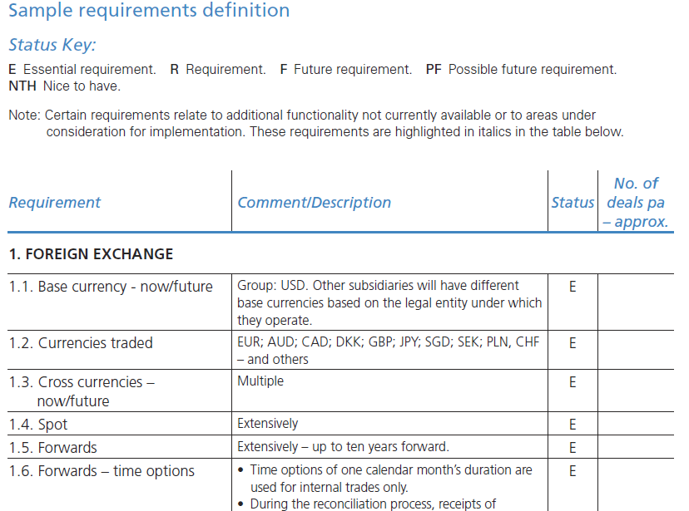

Sample Requirements Definition
Page 77

Slide 17
RFT Steps Cont’d
3. Business Case (cont’d)
Identify key participants
  Project team
  Key departmental contacts
  Key IT contacts
  Accounting/Finance
  Business Unit Personnel
  Audit, Tax
Cost estimates:
  Software, special enhancements, hardware
  Implementation, consultant costs
  Ongoing maintenance
Project savings: FTE’s, lower bank fees, fulfill mandate, controls
Timelines: full and realistic
Success criteria

Slide 18
Success Metrics
Organizations that measure their treasury departments’ success in improving efficiency typically boast treasury departments with fewer FTEs and lower costs for treasury operations (both on a normalized basis) while still matching cycle times achieved by treasury operations that are not held to the same standard.
Source: 2012 AFP Benchmark Survey Results

Slide 19
RFT Steps (Cont’d)
4. Assess the marketplace
  ERP, SaaS, ASP, Hosted, Bank
  Small concentrated marketplace
  Prior relationships with vendors
  Determine best method of delivery
  Places for information
    AFP Annual Conference Exhibitor List
    Trade Shows
    Treasury consultants
    gtnews TMS Buyers Guide

Slide 20
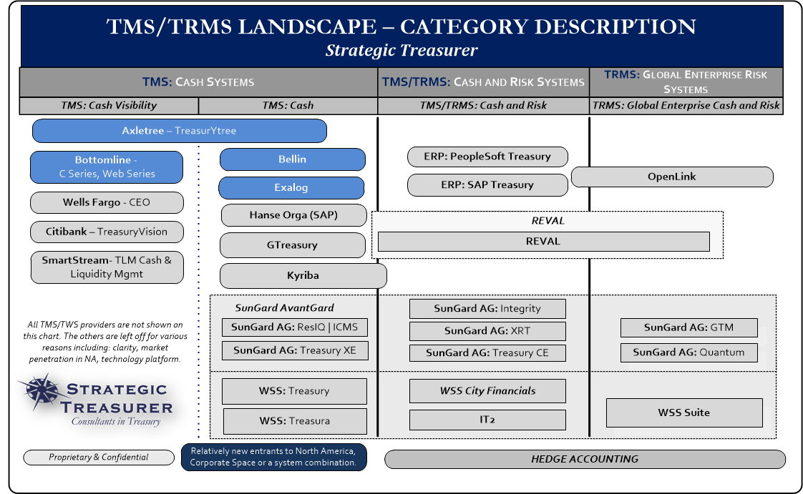
TMS Landscape
These images are property of Strategic Treasurer, LLC and are being used with their permission. The TMS|TRMS Landscape, SaaS Continuum Installed Chart, and New Entrants Landscape are found in Strategic Treasurer’s 2013/2014 TMS|TRMS Summary Analyst report. This report is available for distribution. To contact Strategic Treasurer with any questions or about receiving a copy of this report, please email analystreport@strategictreasurer.com or call their main office at 678.466.2220.

Slide 21
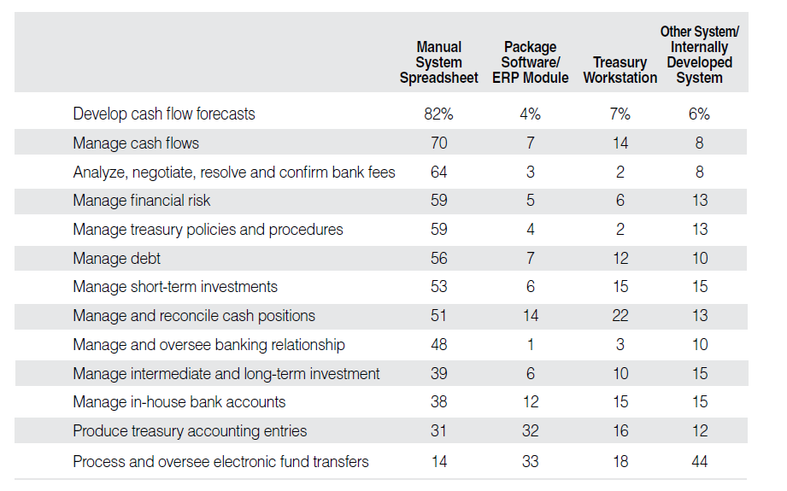
Where Were We 5 years Ago?
Source: 2009 AFP Benchmark Survey Results

Slide 22
RFT Steps (cont’d)
5. Making the Decision
  Customize an RFP specific to you
  Why you are sending out the RFP
  Timelines and next steps for vendors
  Develop, needs, nice to have, critical decision factors
  Hold demonstration workshops
  Ask to test run the system
  Inquire with references
  Due Diligence- ownership, product support, competing products
  Measure against your needs assessment
  Evaluate responses
  Trust but verify!

Slide 23
RFT Steps
6. Implementation
  Contracting process will take longer than anticipated
  Ask for contract terms with RFP
  Assemble the team
  Define the project
  Identify critical roles, dates, deadlines

Slide 24
Tips from AFP Members

Slide 25
Tips From AFP Members
Scope out whether you need a consultant
Get references relevant to your company
Make sure the vendor understands you and your business
Identify staff most resistant to change and put them in charge of the process
Check references
Know your support staff with the RFP process
System interface and personnel support often matter most
Stick to your decision criteria
Consider future proofing and other technology options/modules/data feeds
In person demo’s are key, don’t do them over the web
Source: AFP Guide to Treasury Technology and CTC Treasury Technology: The Emerging Landscape

Slide 26
Additional Tips
Train up front- learn the system first then implement
Have in-house IT support when applicable
Get everyone on board that are affected by the change
Review and improve existing processes
Go through a structured RFP Process
Focus on references and service record
Due your due diligence on your provider

Slide 27
Federal Reserve and FDIC Technology Tips

Slide 28
Fed and FDIC Tips
When contracting consider these:
  IT contracts are 3-5 year term typically
  Explicitly state all charges as part of the invoicing process
  Add in exit clauses such as failure to perform
  Service Level Agreements- SLA’s should be stated
  Set a timeline for contract negotiation
  Obtain a list and contact info for all key personnel of the vendor
  Include escalation clauses
  Insurance coverage clause
  Right to audit- privacy and data control
  Confidentiality and security of data
http://www.fdic.gov/news/news/financial/2014/Tools-to-Manage-Technology-Providers.pdf
http://www.federalreserve.gov/bankinforeg/srletters/sr1319a1.pdf
http://ithandbook.ffiec.gov/it-booklets/outsourcing-technology-services.aspx

Slide 29
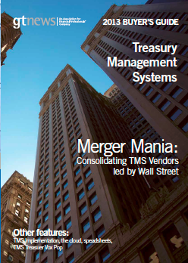

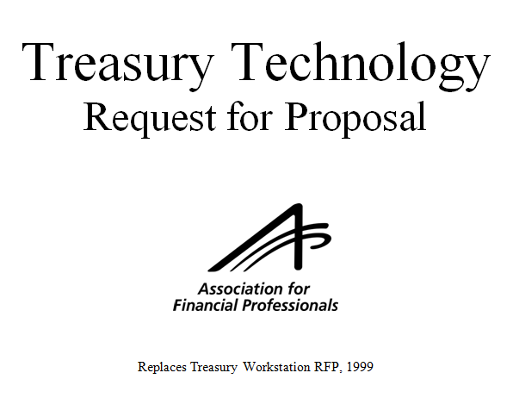
For More Information
http://www.afponline.org/
Tom Hunt
Director of Treasury Services
The Association for Financial Professionals
Phone: (301) 961-8676
Email: thunt@afponline.org

