Slide 1












Benchmarking banks thru score cards
ACTSR, May 2014

Slide 2
Bank Relationship Management – Schools of Thought
    Corporates may think that a banker is a ...................
    ‘a fellow who lends you his umbrella when the sun is shining, but wants it back the minute it begins to rain’. (Mark Twain, early 1900’s)
    Bankers may think that a Treasurer is someone who will............
    ‘give them NOTHING! But take from them EVERYTHING!’ (King Leonidas, 300, 2006)
    But how can you proctively manage the relationship to avoid these two extremes and develop a lasting relationship?
    .

Slide 3
Bank Relationship Model or Policy – sets the framework
Trusted Partner
Consistent
Delivery
Fair Opportunity
Sustainable
Pricing & Service
Targeted Proactivity
Clear Capability
Same model consistently applied for all banks
We are constantly looking at what differentiates one bank from another
3
Notes:
3

Slide 4
Ahold Relationship Group
Group is determined by participation in Revolving Credit Facility (refi 2011)
  ‘if you want to dance, you need to buy a ticket to the ball’
Ancillary business is channelled to the group unless there is a service they cannot provide to the standards we require .
Tier 1 > €90mln
Tier 2 < €50mln

Slide 5
The Relationship Management Tools – Simple but effective
    Bank Meeting Call Reports - banks have them, why shouldn’t a corporate.
      Simple record sheet – who, what, when, any next steps.
      Being relaunched across the team – via our intranet site, everyone has access.
    Formalised Relationship Reviews - using scorecard information
      Spring - RM’s only
      Autumn – RM’s plus key personnel from product teams servicing us
      Annually - Group CFO meets with senior executive from the bank.
    Share of the Wallet (SOW) Analysis – coinciding with relationship meetings
      Revenue based model (not profitability, too many return variations )
      Annually banks asked for their revenue expectations for remaining life of RCF, based on fees from bond issuance mandates
      Run rate calculation done to categorise: Over Fed, On Target or Under Fed
    Bank Performance Scorecard and Heat Map – coinciding with relationship meetings

Slide 6
The Performance Scorecard
    Weighted score card, with weights reflective of the importance of a particular product or service based on needs for foreseeable future. Weights can be changed
    Original version was introduced prior to refinancing RCF in 2011, as a means of determining which banks to keep, and which to let go, and which new banks to introduce
    Performed twice a year prior to the six monthly relationship reviews
      1 week worth of management time for input and review of the scores
    Four teams provided scores – SVP/VP, Front Office – Boston & Geneva, Back Office
      Individuals within team discuss the score and agree prior to input.
      Each assessment category is scored 1 to 5, with pop-up menus to remind the team how to score
      Comments can also be expanded to emphasise a score
    Each team has a specific set of questions to answer
      So Back Office won’t score questions on Debt or Equity Capital Markets

Slide 7
Scorecard – Categories of Assessment
      Objective Assessment: actual products, services banks provide and countries operating in
      Subjective Assessment: quality of the teams that service Treasury
 | What are assessing
History and Support | Longevity of the relationship
Global Position and Strength | No. of countries they service us and ratings of the bank
Committed Credit Support | Amt of credit and the quality of their loan teams
Uncommitted Credit Support | Amt of credit
Corporate Finance & Rating Advisory | Quality of analysis on corporate finance topics
Investment and Liquidity Management | No. of products used and quality of the team
Payments Cash & Card Mgt Services | No.of products and countries and quality of team
Debt Capital Markets (including League Table positions) | No of products, league table position (bloomberg) Quality of the team
Equity Capital Market | No. of products used and quality of the team
Financial Risk Mgt (FX, IRS) | No. of products used and quality of the team
Back Office Operations | Quality of the service, systems and the team
Relationship Management | Qaulity of the relationship team.
Areas
within
our
SOW
Analysis

Slide 8
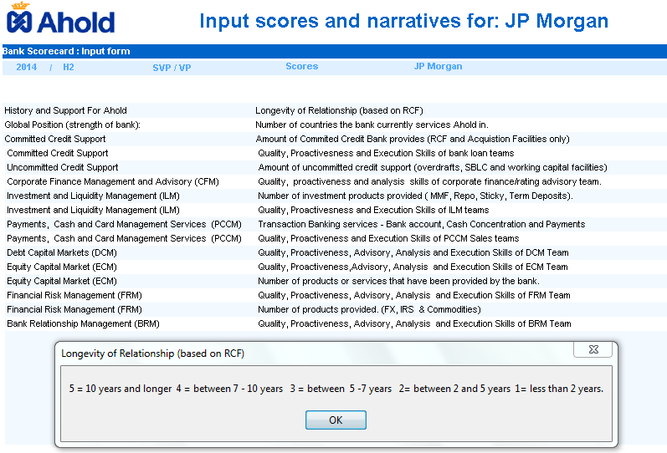
Scorecard – Objective Question Example

Slide 9
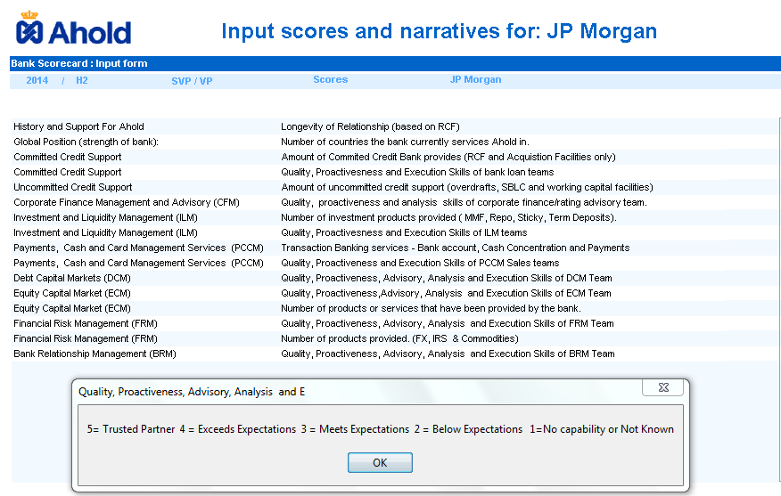
Scorecard – Subjective Question Example

Slide 10
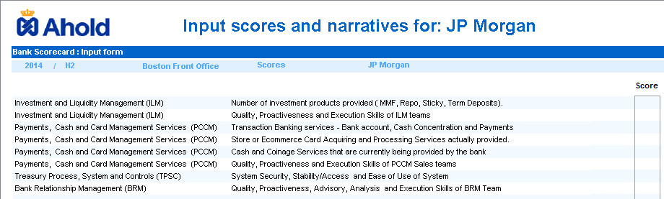
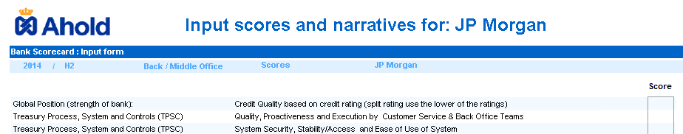
Team Questions - Examples
Front Office Boston – US cash mgt, Global Customer Payment and Investments
Back Office Geneva – Counterparty Risk Mgt, Deal Verification, Settlements, IM

Slide 11
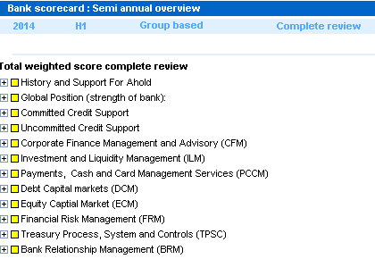
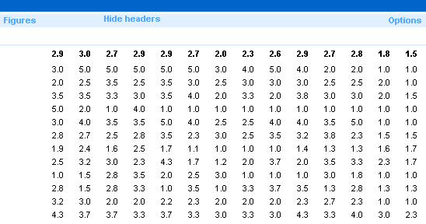
Score Card – Ranking by Score
Flexibility to ranks per individual question, category, by total score, and by our team

Slide 12
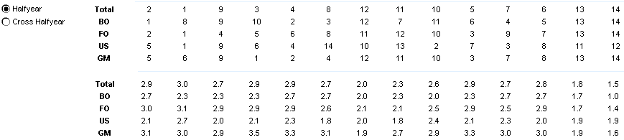
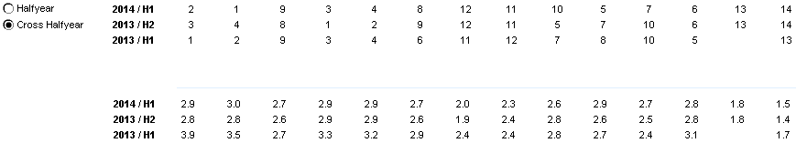
Score Card – Ranking by Score
Flexibility to ranks per individual question, category, by total score, and by our team
We can track ranking over 4 scoring cycles

Slide 13
Scorecard to HeatMap – what the colours mean ?
Trusted Partner
Above 4
Below Expectations
Below 2
No Contact or No Capability
1 or below
Exceeds Expectations
3 to 4
Meets
Exepections
2 to 3
Delivers all aspects of the relationship model
Our ‘go to’ bank or product team
Targeted Proactively - went the extra mile
Listens and Understands our needs
Competent performance
Delivered ‘no more or less’
Performance can be improved
The grey zone
Either no contact or no capability

Slide 14
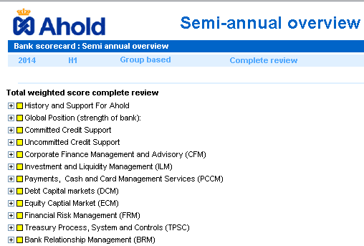
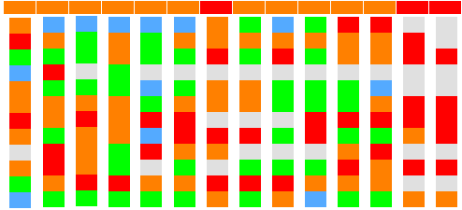
Score Card – Ranking by Heat Map (All questions)

Slide 15
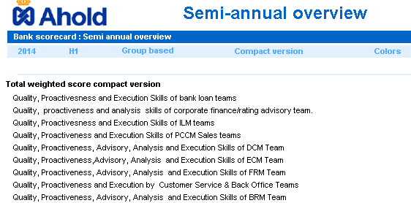
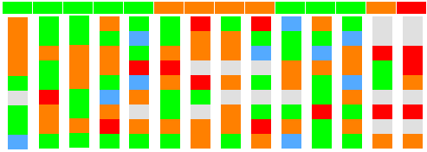
Score Card – Ranking by Heat Map (Quality of team questions)

Slide 16
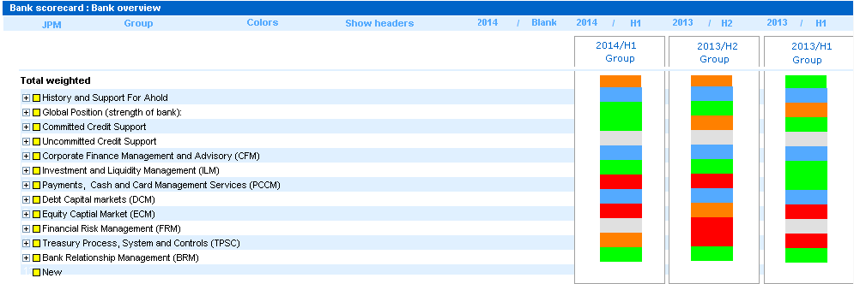
What the Bank Sees - Overall Heat Map
Heat maps share with banks on their performance not relative to whole group
Can show trend over 2 year cycle

Slide 17
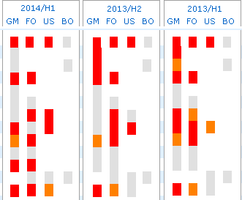
What the Banks sees - Team Heat Map
Banks see how the each Treasury team has rated them

Slide 18
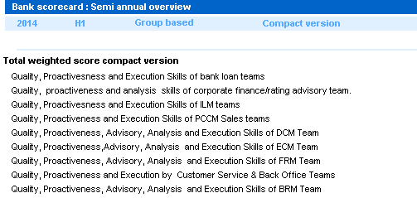


Assessing the Bank Teams
Q3 – Q1
2014
Q1 – Q3
2013

Slide 19
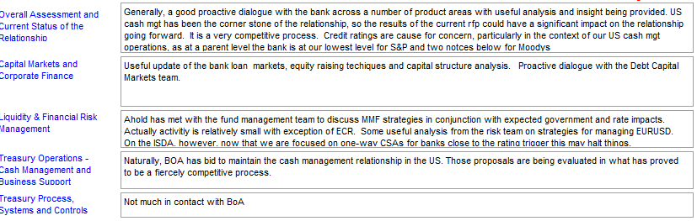
Quick Glance –

Slide 20
Score card – Success and Future Uses
Used in combination with Share of Wallet analysis
    Steer and guide bank performance
    Manages expectations and irrationality of the banks.
    Anticipate bank reactions and plan for it. (exit of Citibank, another bank lined up)
    Fosters an open constructive dialogue with bank teams
    Banks understand the format and are starting to self assess their performance
    Banks successfully used the feedback to build relationships with the team, and win business by presenting relevant products and services
    Scorecard v 3.0 will capture Share of Wallet heatmap

