Slide 1


Treasury Management at the Global Fund: perspectives

Slide 2
Agenda
Introduction to the Global Fund
Challenges for the Treasury
Vision of the Global Fund’s Treasury department
Specificities
Q&A

Slide 3
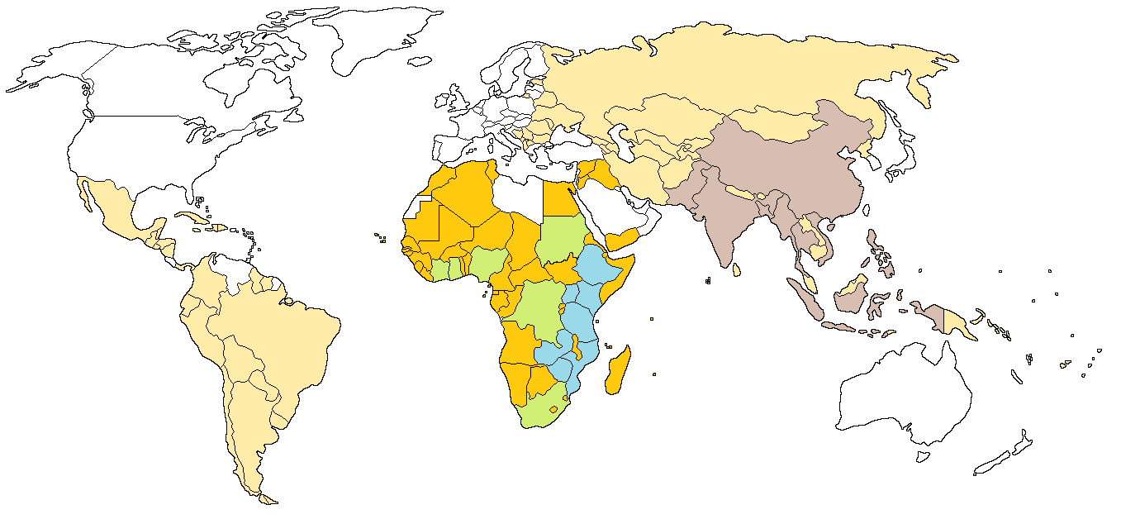
What is the Global Fund?
  The Global Fund is the world’s financing instrument in the fight against AIDS, TB and Malaria, and a key mechanism for achieving the health related Millennium Development Goals.
High Impact Africa 1
High Impact Africa 2
High Impact Asia
Africa and the Middle East
Asia, Europe and LAC
Since its creation in 2002, the Global Fund finances over 1,000 programs in 140 countries with approved funding of US$29.4 billion.
Source: Global Fund Grant Data, end 2013

Slide 4
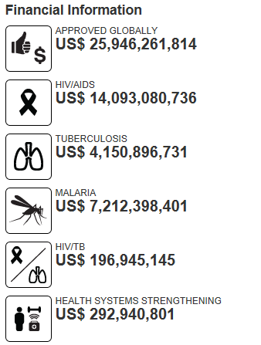
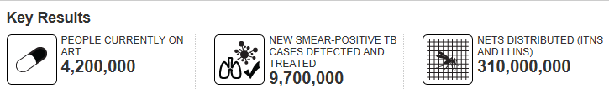
The Global Fund portfolio overview
Total of 759 active grants in 151 countries accross the globe
US$ 20.4 B disbursed to date

Slide 5



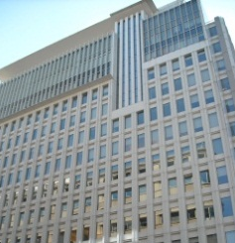




How does the money flow at the Global Fund?
The Global Fund welcomes pledges on a 3-year cycle and commits/disburses grants on a regular basis
3 years
Donors pledge every 3 years at a replenishment conference
Donors convert their pledge into contributions (cash) over the course of the 3 years
Donors
$
€
£
Other
Agreements
Global Fund commits amounts to Principal Recipients on annual basis and disburses grants on a regular basis
Contributions
Transfer instructions
Regu-
larly
Principal Recipients
Trustee
Transfers
$
€

Slide 6
Agenda
Introduction to the Global Fund
Challenges for the Treasury
Vision of the Global Fund’s Treasury department
Specificities
Q&A

Slide 7
…..there was no in-house Treasury department
The main challenge was…
Organization and skills
No in-house Treasury department in place and therefore lack of specialized skills (cash management, FX, banking)
Systems and processes
No dedicated TMS available in-house and reliable forecast data
Only DTA file format being used , no connection to SWIFT
Banking network
Working with only one local bank
World Bank performing most of cash management/FX services
Financial framework & policy
Treasury considerations mostly left out of financial policies

Slide 8
Agenda
Introduction to the Global Fund
Challenges for the Treasury
Vision of the Global Fund’s Treasury department
Specificities
Q&A

Slide 9
Adjust the Financial Framework: Comprehensive Funding Policy
ALM
Dynamic Forecasting of sources of funds and uses of funds over the 3 year replenishment period
Management of fluctuations
Cash Management
Matching of contributions and grant disbursements over 1 year
Liquidity Risk
On going Optimization of cash inflows and outflows
Hedging of the liquidity risk with minimum cash reserve and back up liquidity instruments
3 years (fixed)
1 year (rolling)
On going
Foreign Exchange Risk

Slide 10
Establish a modern and efficient Treasury function
Key streams
Objectives
Achieve fully integrated Global Fund payment process (the Global Fund, Trustee, Banks, Grantees) for higher speed (ease of operations), higher security and control (no manual intervention) and reduced risk of fraud as funds “on demand
Create flexibility in managing the funds (e.g. procurement pool)
Foster transparency and governance (avoid high cash balances )
Cash management
Foreign exchange management
Develop a Global Fund Foreign Exchange (FX) policy to protect and maximize the value of funds:
  The resources provided by donors, protecting against currency fluctuations and financial losses
  The investments (amounts) when transferred to the grantees assuring the assigned funds are protected against FX losses
Add economic value by providing on demand local currency and financial advisory services to the grantee by driving better bank services and fees and counterparty risk analysis
Banks and IO network
Establish a banking footprint and expand cash management and FX services to a set of top tier banks (RFP on Global Banking Services)
Establishment of a strong network with other IO treasuries fostering knowledge sharing

Slide 11
Agenda
Introduction to the Global Fund
Challenges for the Treasury
Vision of the Global Fund’s Treasury department
Specificities
Q&A

Slide 12
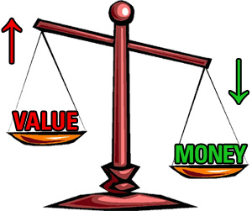
Specificities of Treasury within the Global Fund
Organization and internal culture
Treasury seen as a “process department” , no value added and low empowerment
Generally heavy governance with numerous administrative processes, one board and several committees and a “parliamentarian culture”
Overall high degree of adversity to risk and change
No P&L culture as seen in private sector companies -> not finance oriented, value of money is different (e.g. 10m USD = 100k USD)
Different organizational focus

Slide 13
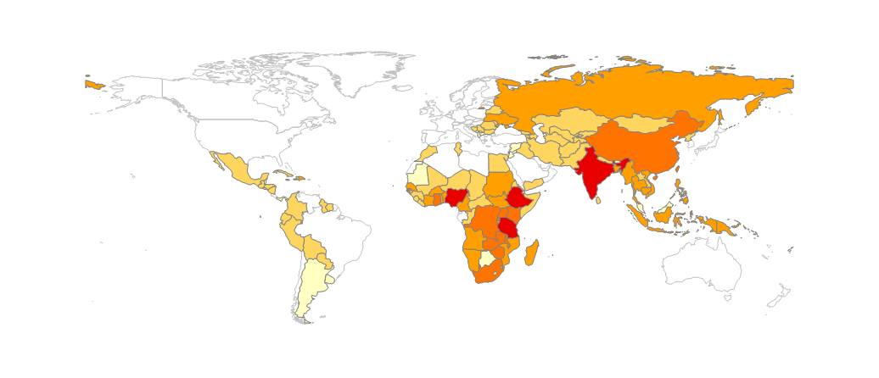
Specificities of Treasury within the Global Fund
Systems, processes and procedures
Risk averse -> no borrowing and very conservative investment management
Different rules for cash management (e.g. advance to procurement agents)
Not rated and no assets (other than cash) , transforming the institution into a “strange beast” to the banks. Collateral requirements need to be defined with a different methodology
Sending funds to 140+ countries which are most quite specific -> “We send the funds when no one else dares to send them”

Slide 14
Agenda
Introduction to the Global Fund
Challenges for the Treasury
Vision of the Global Fund’s Treasury department
Specificities
Q&A

