Slide 1

Swiss Treasurers Forum
What treasurers should know about VAT and bitcoins
11 June 2015

Slide 2
Agenda
Introduction
Making payments in cash
  In local currency
  In foreign currency
Barter transactions
Making e-payments (in bitcoins)
Swiss Treasurers Forum
2

Slide 3
Introduction
1

Slide 4
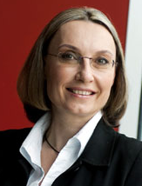
Your speaker
Use the divider control box below to make the slide title appear in your primary TOC and section TOCs.
Please follow these steps:
Type ‘Divider’ in the control box provided below.
Click the Divider command on the Smart ribbon.
Enter the text that you’d like to appear in the TOCs and select a divider level.
Click Update. The slide title should now appear on all TOCs.
To remove the slide title from your TOCs, delete the ‘Divider’ text from the divider control box and hit Update.
Michaela Merz
Partner
Global Indirect Tax Leader at PwC
Tel.: +41 (0)58 792 4429
E-Mail: michaela.merz@ch.pwc.com
Blogs:
http://michaelamerz.org/
http://ebiz.pwc.com/
Swiss Treasurers Forum
4

Slide 5

No point in being a bank robber anymore ... Or you need sophisticated software hacking experience
Use the divider control box below to make the slide title appear in your primary TOC and section TOCs.
Please follow these steps:
Type ‘Divider’ in the control box provided below.
Click the Divider command on the Smart ribbon.
Enter the text that you’d like to appear in the TOCs and select a divider level.
Click Update. The slide title should now appear on all TOCs.
To remove the slide title from your TOCs, delete the ‘Divider’ text from the divider control box and hit Update.
Sweden, Denmark intends to abolish cash (physical notes and coins);
Going forward, all payments will be made electronically.
Swiss Treasurers Forum
5

Slide 6
Making payments in cash
2

Slide 7



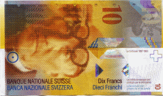

Making payments in cash
In local currency
Use the divider control box below to make the slide title appear in your primary TOC and section TOCs.
Please follow these steps:
Type ‘Divider’ in the control box provided below.
Click the Divider command on the Smart ribbon.
Enter the text that you’d like to appear in the TOCs and select a divider level.
Click Update. The slide title should now appear on all TOCs.
To remove the slide title from your TOCs, delete the ‘Divider’ text from the divider control box and hit Update.
Customer buys goods/services from a Swiss supplier for CHF 108.
Federal Tax Authority
CHF 100 + CHF 8 (VAT)
= CHF 108
CHF 8
Supplier
Invoice
Customer
Customer
Goods/services
Swiss Treasurers Forum
7

Slide 8

Making payments in cash
In local currency
Use the divider control box below to make the slide title appear in your primary TOC and section TOCs.
Please follow these steps:
Type ‘Divider’ in the control box provided below.
Click the Divider command on the Smart ribbon.
Enter the text that you’d like to appear in the TOCs and select a divider level.
Click Update. The slide title should now appear on all TOCs.
To remove the slide title from your TOCs, delete the ‘Divider’ text from the divider control box and hit Update.
What happens if the customer does not pay?
Federal Tax Authority
CHF 100 + CHF 8 (VAT)
= CHF 108
Supplier
Invoice
Customer
CHF 8
VAT of CHF 8
is still due
Goods/services
VAT needs to be
paid to the FTA
Swiss Treasurers Forum
8

Slide 9

Making payments in cash
In local currency
Use the divider control box below to make the slide title appear in your primary TOC and section TOCs.
Please follow these steps:
Type ‘Divider’ in the control box provided below.
Click the Divider command on the Smart ribbon.
Enter the text that you’d like to appear in the TOCs and select a divider level.
Click Update. The slide title should now appear on all TOCs.
To remove the slide title from your TOCs, delete the ‘Divider’ text from the divider control box and hit Update.
What happens if the customer goes bankrupt?
Federal Tax Authority
CHF 100 + CHF 8 (VAT)
= CHF 108
Supplier
Invoice
Customer
CHF 8
VAT of CHF 8
can be recovered from
the FTA if written off
by the supplier
Goods/services
Swiss Treasurers Forum
9

Slide 10

Making payments in cash
In local currency
Use the divider control box below to make the slide title appear in your primary TOC and section TOCs.
Please follow these steps:
Type ‘Divider’ in the control box provided below.
Click the Divider command on the Smart ribbon.
Enter the text that you’d like to appear in the TOCs and select a divider level.
Click Update. The slide title should now appear on all TOCs.
To remove the slide title from your TOCs, delete the ‘Divider’ text from the divider control box and hit Update.
What happens if the customer is not bankrupt but just not willing to pay?
Federal Tax Authority
CHF 100 + CHF 8 (VAT)
= CHF 108
Supplier
Invoice
Customer
CHF 8
VAT of CHF 8
can be recovered from
the FTA if written off
by the supplier
Goods/services
Swiss Treasurers Forum
10

Slide 11
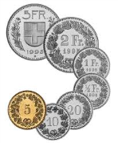
Making payments in cash
In local currency
Use the divider control box below to make the slide title appear in your primary TOC and section TOCs.
Please follow these steps:
Type ‘Divider’ in the control box provided below.
Click the Divider command on the Smart ribbon.
Enter the text that you’d like to appear in the TOCs and select a divider level.
Click Update. The slide title should now appear on all TOCs.
To remove the slide title from your TOCs, delete the ‘Divider’ text from the divider control box and hit Update.
What can the supplier do?
The supplier can sell his receivables of CHF 100 for CHF 7 to the debt collection agency
CHF 7
Debt collection agency
Supplier
Receivable of CHF 100
The biggest mistake!!!
Swiss Treasurers Forum
11

Slide 12

Making payments in cash
In local currency
Use the divider control box below to make the slide title appear in your primary TOC and section TOCs.
Please follow these steps:
Type ‘Divider’ in the control box provided below.
Click the Divider command on the Smart ribbon.
Enter the text that you’d like to appear in the TOCs and select a divider level.
Click Update. The slide title should now appear on all TOCs.
To remove the slide title from your TOCs, delete the ‘Divider’ text from the divider control box and hit Update.
Why is the sale of a receivable the biggest mistake?
VAT of CHF 8 on the value of the receivable (i.e. CHF 100) becomes due again and needs to be paid to the FTA
Federal Tax Authority
CHF 7
Supplier
Debt collection agency
CHF 8
Receivable of CHF 100
Swiss Treasurers Forum
12

Slide 13
Making payments in cash
In local currency
Use the divider control box below to make the slide title appear in your primary TOC and section TOCs.
Please follow these steps:
Type ‘Divider’ in the control box provided below.
Click the Divider command on the Smart ribbon.
Enter the text that you’d like to appear in the TOCs and select a divider level.
Click Update. The slide title should now appear on all TOCs.
To remove the slide title from your TOCs, delete the ‘Divider’ text from the divider control box and hit Update.
Why is the sale of a receivable the biggest mistake?
Total loss of CHF 101
 | CHF
Original VAT liability on the sale | -8
Recovered from FTA (customer’s default) | +8
VAT liability on the sale of the receivable | -8
Received from the debt collection agency | +7
Sub-Total | -1
Value of the lost receivable | -100
Total loss | -101
Swiss Treasurers Forum
13

Slide 14

Making payments in cash
In foreign currency
Use the divider control box below to make the slide title appear in your primary TOC and section TOCs.
Please follow these steps:
Type ‘Divider’ in the control box provided below.
Click the Divider command on the Smart ribbon.
Enter the text that you’d like to appear in the TOCs and select a divider level.
Click Update. The slide title should now appear on all TOCs.
To remove the slide title from your TOCs, delete the ‘Divider’ text from the divider control box and hit Update.
Customer buys goods/services from a Swiss supplier in USD
Where the invoice includes values in CHF and in foreign currency (e.g. USD), it is important how the invoice looks like to determine which currency should be used as a reference for VAT purposes
Supplier
Customer
Goods/services
Swiss Treasurers Forum
14

Slide 15
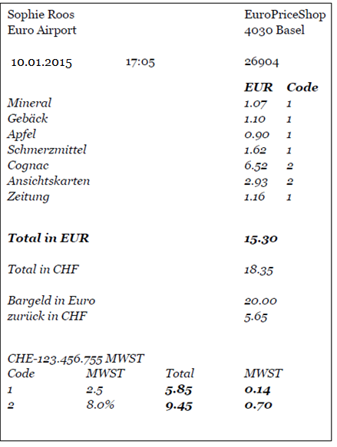
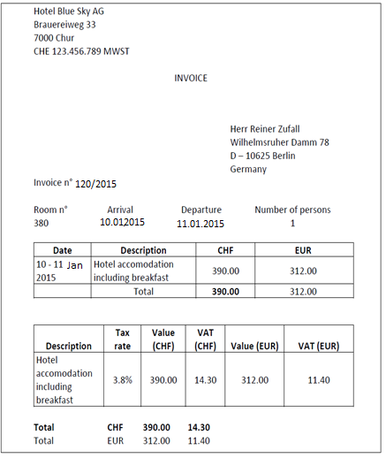
Making payments in cash
In foreign currency (January 2015)
Use the divider control box below to make the slide title appear in your primary TOC and section TOCs.
Please follow these steps:
Type ‘Divider’ in the control box provided below.
Click the Divider command on the Smart ribbon.
Enter the text that you’d like to appear in the TOCs and select a divider level.
Click Update. The slide title should now appear on all TOCs.
To remove the slide title from your TOCs, delete the ‘Divider’ text from the divider control box and hit Update.
Values highlighted in bold are decisive
Values highlighted in bold are decisive
Swiss Treasurers Forum
15

Slide 16

Making payments in cash
In foreign currency
Use the divider control box below to make the slide title appear in your primary TOC and section TOCs.
Please follow these steps:
Type ‘Divider’ in the control box provided below.
Click the Divider command on the Smart ribbon.
Enter the text that you’d like to appear in the TOCs and select a divider level.
Click Update. The slide title should now appear on all TOCs.
To remove the slide title from your TOCs, delete the ‘Divider’ text from the divider control box and hit Update.
The following exchange rates can be used in Switzerland
Monthly average exchange rates published by the FTA
Daily exchanges rates of the national bank
Internal exchange rates of the corporate group (when the tax payer belongs to a corporate group)
In the European Union (examples):
Germany | Denmark | Hungary | France | Poland | Romania
Exchange rate of the Federal Ministry of Finance for the month in which the transaction took place. | Three options: the latest published official rate of the ECB, or the Danish National Bank, or the rate of the Danish tax authorities for the calculation of customs duties. | The latest exchange rate of the Hungarian National Bank, except when the person liable to tax has opted to use the selling rate of another Hungarian bank. The ECB rate can be also used. | The latest exchange rate of the ECB when VAT is due. | Exchange rate of the Polish National Bank or the ECB on the last business day in which the tax point has raised | Exchange rate of the Romanian National Bank or ECB or the exchange rate used by the commercial bank through which the payments are made
Swiss Treasurers Forum
17

Slide 17
Making payments in cash
In foreign currency
Use the divider control box below to make the slide title appear in your primary TOC and section TOCs.
Please follow these steps:
Type ‘Divider’ in the control box provided below.
Click the Divider command on the Smart ribbon.
Enter the text that you’d like to appear in the TOCs and select a divider level.
Click Update. The slide title should now appear on all TOCs.
To remove the slide title from your TOCs, delete the ‘Divider’ text from the divider control box and hit Update.
Overview of the monthly average exchange rates
EUR / CHF
 | Swiss FTA | German Federal Central Tax Office
January 2015 | 1.2146 | 1.0940
February 2015 | 1.1596 | 1.0618
March 2015 | 1.0611 | 1.0608
April 2015 | 1.0780 | 1.0379
May 2015 | 1.0503 | 1.0391
Up until 15 January 2015 was the minimum exchange rate EUR/CHF at 1.2000
Swiss Treasurers Forum
17

Slide 18
Barter transactions
3

Slide 19
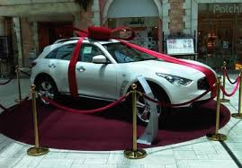
Barter transactions
Use the divider control box below to make the slide title appear in your primary TOC and section TOCs.
Please follow these steps:
Type ‘Divider’ in the control box provided below.
Click the Divider command on the Smart ribbon.
Enter the text that you’d like to appear in the TOCs and select a divider level.
Click Update. The slide title should now appear on all TOCs.
To remove the slide title from your TOCs, delete the ‘Divider’ text from the divider control box and hit Update.
A car in a shopping mall to win as a prize
Car dealer
Car in the value of CHF 22’550 + CHF 1’800 (VAT)
Shopping mall
Advert in the value of CHF 22’550 + CHF 1’800 (VAT)
Output VAT: - CHF 1’800
Input VAT: + CHF 1’800
But, interest of 4% (i.e. CHF 72) and possible penalties
0
Swiss Treasurers Forum
21

Slide 20
Making e-payments (in bitcoins)
4

Slide 21

Making e-payments
Payments in virtual currencies (bitcoins)
Use the divider control box below to make the slide title appear in your primary TOC and section TOCs.
Please follow these steps:
Type ‘Divider’ in the control box provided below.
Click the Divider command on the Smart ribbon.
Enter the text that you’d like to appear in the TOCs and select a divider level.
Click Update. The slide title should now appear on all TOCs.
To remove the slide title from your TOCs, delete the ‘Divider’ text from the divider control box and hit Update.
Digital services
Swiss supplier
Customer
What if the customer pays in a virtual currency (e.g. bitcoins)?
Swiss Treasurers Forum
27

Slide 22
Making e-payments (in bitcoins)
Use the divider control box below to make the slide title appear in your primary TOC and section TOCs.
Please follow these steps:
Type ‘Divider’ in the control box provided below.
Click the Divider command on the Smart ribbon.
Enter the text that you’d like to appear in the TOCs and select a divider level.
Click Update. The slide title should now appear on all TOCs.
To remove the slide title from your TOCs, delete the ‘Divider’ text from the divider control box and hit Update.
The number of virtual currencies are on the rise
700+
today
300
in 2013
vs.
Litecoins, Peercoins, Ripples, Dogecoins, Mastercoins, Nxts, Namecoins, BlackCoins, Bit-Shares-PTS, Quarks, Primecoins, Counterparties, Feathercoins, Marinecoins,
Zetacoins, Vertcoins, Megacoins, DarkCoins, Novacoins, Infinitecoins,
WorldCoins, MaxCoins, YbCoins, FlutterCoins, WhiteCoins,
Ixcoins, Mintcoins, Billioncoins, Auroracoins, Devcoins, Anoncoins,
PotCoins, Faircoins, Terracoins, Zeitcoins, CommunityCoins, Applecoins,
Tickets, GoldCoins, Nases, Digitalcoins, Freicoins, HoboNickels,
Unobtaniums, Particles, NetCoins, ECCoins, USDes, UltraCoins, Myriadcoins,
NobleCoins, UnionCoins, Cryptogenic Bullion, CaiShen, Mona-
Coins, AsiaCoins, SecureCoins, Einsteiniums, Coins 2.0, MicroCoins,
FedoraCoins, BitBars, BBQCoins, Mincoins, Karmacoins, TagCoins,
RedCoins, ReddCoins, Saturncoins, DigiBytes, HunterCoins, Sexcoins,
Heavycoins, Kittehcoins, MemoryCoins, MazaCoins, Bitcoin Scrypts,
Riecoins, Yacoins, Pawncoins, Mooncoins, Execoins, Hirocoins, Top-
Coins, LottoCoins, Fastcoins, DopeCoins, EarthCoins, KlondikeCoins,
Isracoins, FlappyCoins, Deutsche eMarks, 42 Coins, GroestlCoins, Pandacoins,
Diamonds, Blakecoins, TeslaCoins, DNotes, etc.
Swiss Treasurers Forum
28

Slide 23



Virtual Currency Schemes
Use the divider control box below to make the slide title appear in your primary TOC and section TOCs.
Please follow these steps:
Type ‘Divider’ in the control box provided below.
Click the Divider command on the Smart ribbon.
Enter the text that you’d like to appear in the TOCs and select a divider level.
Click Update. The slide title should now appear on all TOCs.
To remove the slide title from your TOCs, delete the ‘Divider’ text from the divider control box and hit Update.
Closed
Real Economy
Legal tender *
Virtual Currency
Uni-directional
Real Economy
Legal tender *
Virtual Currency
Bi-directional
Real Economy
Legal tender *
Virtual Currency
* Bank notes, coins
Swiss Treasurers Forum
25

Slide 24
Making e-payments (in bitcoins)
Use the divider control box below to make the slide title appear in your primary TOC and section TOCs.
Please follow these steps:
Type ‘Divider’ in the control box provided below.
Click the Divider command on the Smart ribbon.
Enter the text that you’d like to appear in the TOCs and select a divider level.
Click Update. The slide title should now appear on all TOCs.
To remove the slide title from your TOCs, delete the ‘Divider’ text from the divider control box and hit Update.
What is a bitcoin? – key characteristics
A peer-to-peer electronic payment system
Can be exchanged for fiat currency, products, services
Cryptocurrency
Without central supervision or a single administrator
Secured by individuals (i.e. miners)
Operated within a peer-to-peer network
Paying with bitcoins is as easy as sending an email
Operated through a specific software (i.e. Bitcoin Core)
Everyone having an internet connection can transact bitcoins
Swiss Treasurers Forum
29

Slide 25



Making e-payments (in bitcoins)
Use the divider control box below to make the slide title appear in your primary TOC and section TOCs.
Please follow these steps:
Type ‘Divider’ in the control box provided below.
Click the Divider command on the Smart ribbon.
Enter the text that you’d like to appear in the TOCs and select a divider level.
Click Update. The slide title should now appear on all TOCs.
To remove the slide title from your TOCs, delete the ‘Divider’ text from the divider control box and hit Update.
How do bitcoins work (traditional vs. bitcoin payments)?
Traditional cross-border payments (correspondent banking)
Swiss customer sends EUR 500 to pay for his purchases
supplier
Bank of the supplier
Bank of the buyer
Transaction and exchange fees charged along the way;
Payments take up to 4 days.
EUR 500
instruction
Correspondent bank
Settles the transaction
Swiss Treasurers Forum
30

Slide 26

Making e-payments (in bitcoins)
How do bitcoins work (traditional vs. bitcoin payments)?
Bitcoins (respondent banking)
Swiss customer sends EUR 500 to pay for his purchases
supplier
“Holders of bitcoins are defined as participants in the emergence of one of the most novel and potentially far-reaching technologies of the 21st century”
Swiss customer transfers bitcoin equivalent of EUR 500
supplier
Direct transfer of the funds (to the seller accepting bitcoins);
Low or no transaction fees;
Payments are settled within 10 minutes;
How does the underlying process look like?
Swiss Treasurers Forum
31

Slide 27

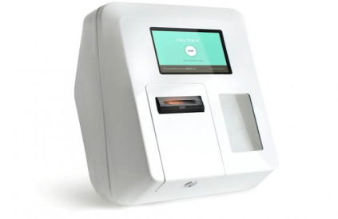


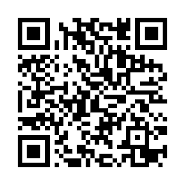
New bitcoins are broadcasted and included in recipient’s wallet
Making payments in bitcoins
Use the divider control box below to make the slide title appear in your primary TOC and section TOCs.
Please follow these steps:
Type ‘Divider’ in the control box provided below.
Click the Divider command on the Smart ribbon.
Enter the text that you’d like to appear in the TOCs and select a divider level.
Click Update. The slide title should now appear on all TOCs.
To remove the slide title from your TOCs, delete the ‘Divider’ text from the divider control box and hit Update.
How do bitcoin payments work?
Bitcoins can be bought on a number of exchanges or ATMs
Record it into the bitcoin public ledger (block chain)
Bitcoins are saved in a digital wallet on a computer/mobile device
Miners validate the transaction and
Wallet’s owner signs the transfer of bitcoins with a secret private key
Bitcoins are sent to a wider bitcoin network (miners)
Swiss Treasurers Forum
32

Slide 28
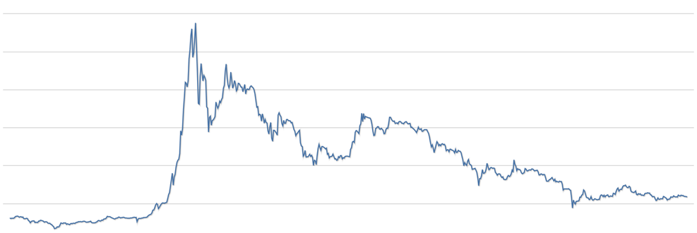
Making payments in bitcoins
Use the divider control box below to make the slide title appear in your primary TOC and section TOCs.
Please follow these steps:
Type ‘Divider’ in the control box provided below.
Click the Divider command on the Smart ribbon.
Enter the text that you’d like to appear in the TOCs and select a divider level.
Click Update. The slide title should now appear on all TOCs.
To remove the slide title from your TOCs, delete the ‘Divider’ text from the divider control box and hit Update.
How did the value develop over time?
1’200
Market Price (USD)
1’000
800
Price
600
400
200
Time in years
Jul 13
Sep 13
Nov 13
Jan 14
Mar 14
May 14
Jan 14
Sep 14
Nov 14
Jan 15
Mar 15
May 15
Swiss Treasurers Forum
33

Slide 29
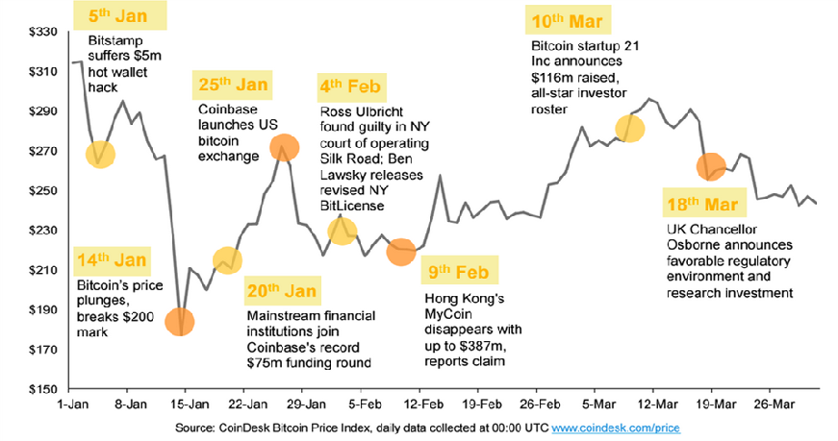
Making payments in bitcoins
Use the divider control box below to make the slide title appear in your primary TOC and section TOCs.
Please follow these steps:
Type ‘Divider’ in the control box provided below.
Click the Divider command on the Smart ribbon.
Enter the text that you’d like to appear in the TOCs and select a divider level.
Click Update. The slide title should now appear on all TOCs.
To remove the slide title from your TOCs, delete the ‘Divider’ text from the divider control box and hit Update.
How did the value develop in Q1 2015?
Swiss Treasurers Forum
34

Slide 30




What is happening at the moment
Use the divider control box below to make the slide title appear in your primary TOC and section TOCs.
Please follow these steps:
Type ‘Divider’ in the control box provided below.
Click the Divider command on the Smart ribbon.
Enter the text that you’d like to appear in the TOCs and select a divider level.
Click Update. The slide title should now appear on all TOCs.
To remove the slide title from your TOCs, delete the ‘Divider’ text from the divider control box and hit Update.
Bitcoin wallett, cold storage companies
«If you cannot prove who you are, we won’t open an account for you, and if you do anything that looks suspicious, we will report you.»
(Wences Casares – founder of XAPO)
Customers → never made a bitcion payment
«96% of the coins that we hold in custody are kept as investment.»
Swiss Treasurers Forum
32

Slide 31

BitLicense
Use the divider control box below to make the slide title appear in your primary TOC and section TOCs.
Please follow these steps:
Type ‘Divider’ in the control box provided below.
Click the Divider command on the Smart ribbon.
Enter the text that you’d like to appear in the TOCs and select a divider level.
Click Update. The slide title should now appear on all TOCs.
To remove the slide title from your TOCs, delete the ‘Divider’ text from the divider control box and hit Update.
New York Department of Financial Services released the final version of regulatory framework of digital currency companies last week.
Consumer protection
Anti-money laundering
Cyber-security
«We are excited about the potential digital currency holds for helping drive long overdue changes in our ossified payments system. We simply want to make sure that we put in place guardrails that protect consumers and route out illicit activity – without stifling beneficial innovation.»
(Benjamin Lawsky – New York State’s first Superintendent of Financial Services and former Acting Superintendent of Banks)
Swiss Treasurers Forum
33

Slide 32
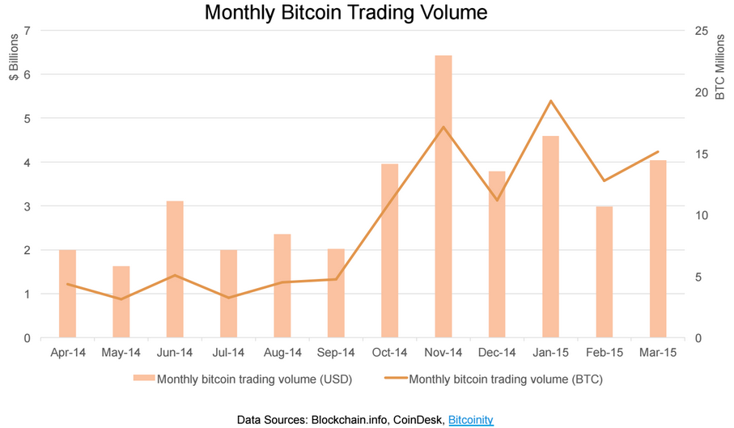
Making payments in bitcoins
Use the divider control box below to make the slide title appear in your primary TOC and section TOCs.
Please follow these steps:
Type ‘Divider’ in the control box provided below.
Click the Divider command on the Smart ribbon.
Enter the text that you’d like to appear in the TOCs and select a divider level.
Click Update. The slide title should now appear on all TOCs.
To remove the slide title from your TOCs, delete the ‘Divider’ text from the divider control box and hit Update.
What volume was traded in the last 12 months?
Swiss Treasurers Forum
35

Slide 33
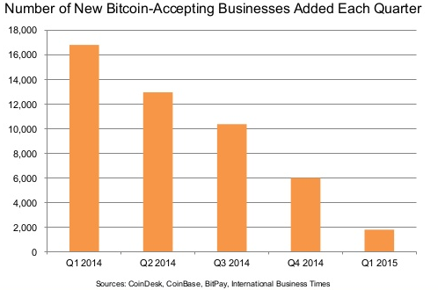
Making e-payments (in bitcoins)
Use the divider control box below to make the slide title appear in your primary TOC and section TOCs.
Please follow these steps:
Type ‘Divider’ in the control box provided below.
Click the Divider command on the Smart ribbon.
Enter the text that you’d like to appear in the TOCs and select a divider level.
Click Update. The slide title should now appear on all TOCs.
To remove the slide title from your TOCs, delete the ‘Divider’ text from the divider control box and hit Update.
New bitcoin-accepting businesses
Swiss Treasurers Forum
36

Slide 34
Virtual Currency Schemes
Use the divider control box below to make the slide title appear in your primary TOC and section TOCs.
Please follow these steps:
Type ‘Divider’ in the control box provided below.
Click the Divider command on the Smart ribbon.
Enter the text that you’d like to appear in the TOCs and select a divider level.
Click Update. The slide title should now appear on all TOCs.
To remove the slide title from your TOCs, delete the ‘Divider’ text from the divider control box and hit Update.
Closed
Real Economy
Legal tender *
Virtual Currency
Out of scope of VAT
Uni-directional
Real Economy
Legal tender *
Virtual Currency
Subject to VAT
(prepayment for services)
Bi-directional
Real Economy
Legal tender *
Virtual Currency
???
* Bank notes, coins
Swiss Treasurers Forum
26

Slide 35
Making e-payments (in bitcoins)
Use the divider control box below to make the slide title appear in your primary TOC and section TOCs.
Please follow these steps:
Type ‘Divider’ in the control box provided below.
Click the Divider command on the Smart ribbon.
Enter the text that you’d like to appear in the TOCs and select a divider level.
Click Update. The slide title should now appear on all TOCs.
To remove the slide title from your TOCs, delete the ‘Divider’ text from the divider control box and hit Update.
Tax framework for bitcoins
confusing
undefined
Why do I say so?
Swiss Treasurers Forum
37

Slide 36


Making e-payments (in bitcoins)
Use the divider control box below to make the slide title appear in your primary TOC and section TOCs.
Please follow these steps:
Type ‘Divider’ in the control box provided below.
Click the Divider command on the Smart ribbon.
Enter the text that you’d like to appear in the TOCs and select a divider level.
Click Update. The slide title should now appear on all TOCs.
To remove the slide title from your TOCs, delete the ‘Divider’ text from the divider control box and hit Update.
VAT issues relating to virtual currencies
VAT considerations
Establishing the nature of the supply – what is it?
Is the supply single or composite?
Who is supplying the services to whom and for what consideration?
Determining the applicable VAT treatment i.e. taxable, exempt or non-business?
What does this mean for VAT recovery?
Swiss Treasurers Forum
38

Slide 37








Making e-payments (in bitcoins)
Use the divider control box below to make the slide title appear in your primary TOC and section TOCs.
Please follow these steps:
Type ‘Divider’ in the control box provided below.
Click the Divider command on the Smart ribbon.
Enter the text that you’d like to appear in the TOCs and select a divider level.
Click Update. The slide title should now appear on all TOCs.
To remove the slide title from your TOCs, delete the ‘Divider’ text from the divider control box and hit Update.
Tax framework for bitcoins in headlines
Swiss Treasurers Forum
39

Slide 38


Making e-payments (in bitcoins)
Use the divider control box below to make the slide title appear in your primary TOC and section TOCs.
Please follow these steps:
Type ‘Divider’ in the control box provided below.
Click the Divider command on the Smart ribbon.
Enter the text that you’d like to appear in the TOCs and select a divider level.
Click Update. The slide title should now appear on all TOCs.
To remove the slide title from your TOCs, delete the ‘Divider’ text from the divider control box and hit Update.
Treatment of bitcoins (examples)
Liberland
The President of Liberland, Vit Jedlicka, has confirmed that Liberland
will not have an official currency nor a printed currency;
The country has bitcoin as national currency;
Ecuador
Everybody has mobile phones – bank accounts only half of them
Ecuador banned bitcoins but rolled out its own electronic money (i.e. Electronic Money System (EMS);
EMS is designed to support its dollar-based monetary system and not to replace it;
Difference to bitcoins: EMS is controlled by the government and tied directly to the local currency (i.e. dollar);
Three-phases-implementation:
  Users created their EMS accounts and made changes to their credentials (December 2014 – February 2015);
  Users able to pay for select services and send money between individuals (from February 2015);
  Users allowed to pay for public services (e.g. taxes) from late 2015.
Swiss Treasurers Forum
40

Slide 39

Making e-payments (in bitcoins)
Use the divider control box below to make the slide title appear in your primary TOC and section TOCs.
Please follow these steps:
Type ‘Divider’ in the control box provided below.
Click the Divider command on the Smart ribbon.
Enter the text that you’d like to appear in the TOCs and select a divider level.
Click Update. The slide title should now appear on all TOCs.
To remove the slide title from your TOCs, delete the ‘Divider’ text from the divider control box and hit Update.
Treatment of bitcoins (examples)
Australia
Bitcoins and other cryptocurrencies are seen as (Capital Gain Tax) assets for tax purposes;
Income from mining bitcoin (provided that the taxpayer is in the bitcoin mining business) is included in the taxpayer’s assessable income. The expenses incurred in respect of the mining are deductible;
The mining income is likely to be subject to GST;
Bitcoins are treated as a trading stock where they are held for the purpose of sale or exchange in the ordinary course of a business;
The treatment of bitcoins used for personal purposes (e.g. for acquiring goods and services) is similar to the treatment of other assets, where any capital gain or loss from disposal of the bitcoin is disregarded provided that the cost of the bitcoin is AUD 10’000 or less;
Salary and wages paid in bitcoin will be treated as a fringe benefit and subject to the Fringe Benefits Tax.
Payments in bitcoins are akin to barter transactions and trigger GST liability.
Swiss Treasurers Forum
41

Slide 40
Making e-payments (in bitcoins)
Use the divider control box below to make the slide title appear in your primary TOC and section TOCs.
Please follow these steps:
Type ‘Divider’ in the control box provided below.
Click the Divider command on the Smart ribbon.
Enter the text that you’d like to appear in the TOCs and select a divider level.
Click Update. The slide title should now appear on all TOCs.
To remove the slide title from your TOCs, delete the ‘Divider’ text from the divider control box and hit Update.
Different tax categories of bitcoins across the world
Tax category | Examples of countries
Currency (legal tender) | Belgium, United Kingdom
Barter | Austria, Germany, Spain, Australia, Singapore
Electronic service | Denmark, Poland, Norway
Alternative payment instrument | Finland
Commodity (noble metal) | Japan, Argentina
Intangible property | Canada, USA
Lots of countries do not have any tax regulations on bitcoins at all; e.g. Luxembourg, France, Ireland, Italy, Netherlands, Portugal, China, etc.
Swiss Treasurers Forum
42

Slide 41
Making e-payments (in bitcoins)
Use the divider control box below to make the slide title appear in your primary TOC and section TOCs.
Please follow these steps:
Type ‘Divider’ in the control box provided below.
Click the Divider command on the Smart ribbon.
Enter the text that you’d like to appear in the TOCs and select a divider level.
Click Update. The slide title should now appear on all TOCs.
To remove the slide title from your TOCs, delete the ‘Divider’ text from the divider control box and hit Update.
Each of the tax categories has significant VAT consequences
Tax category | VAT treatment
Currency (legal tender), alternative payment instrument | Exempt from VAT
intangible property | Not subject to US sales tax
Digital services
+ VAT
supplier
customer
Output VAT due
on the value of the digital service
No VAT
No output VAT due on the value of the bitcoins
Swiss Treasurers Forum
43

Slide 42
Making e-payments (in bitcoins)
Use the divider control box below to make the slide title appear in your primary TOC and section TOCs.
Please follow these steps:
Type ‘Divider’ in the control box provided below.
Click the Divider command on the Smart ribbon.
Enter the text that you’d like to appear in the TOCs and select a divider level.
Click Update. The slide title should now appear on all TOCs.
To remove the slide title from your TOCs, delete the ‘Divider’ text from the divider control box and hit Update.
Each of the tax categories has significant VAT consequences
Tax category | VAT treatment
Barter, Commodity (noble metals) , electronic services, intangible property* | Subject to VAT
* Canada
Digital services
+ VAT
supplier
customer
Output VAT due
on the value of the digital service
Output VAT due on the value of the bitcoins
+ VAT
Swiss Treasurers Forum
44

Slide 43

Making e-payments (in bitcoins)
Use the divider control box below to make the slide title appear in your primary TOC and section TOCs.
Please follow these steps:
Type ‘Divider’ in the control box provided below.
Click the Divider command on the Smart ribbon.
Enter the text that you’d like to appear in the TOCs and select a divider level.
Click Update. The slide title should now appear on all TOCs.
To remove the slide title from your TOCs, delete the ‘Divider’ text from the divider control box and hit Update.
And…if the different tax categories were not confusing enough….
Sweden asked the Court of Justice of the European Union (CJEU) to rule whether people who exchange cryptocurrency for fiat currency provide a VAT relevant service and if they do, whether the exchange service (including the fees) should be exempt from VAT
Decision that could change everything….is due in late 2015
Swiss Treasurers Forum
45

Slide 44
How to kill an innovation?
Use the divider control box below to make the slide title appear in your primary TOC and section TOCs.
Please follow these steps:
Type ‘Divider’ in the control box provided below.
Click the Divider command on the Smart ribbon.
Enter the text that you’d like to appear in the TOCs and select a divider level.
Click Update. The slide title should now appear on all TOCs.
To remove the slide title from your TOCs, delete the ‘Divider’ text from the divider control box and hit Update.
Taxes on altcoin (“bitcoin alternative”) mining in the US
As per the guidance of IRS (December 2014), convertible virtual currencies are treated as property for US federal tax purposes.
Consequences:
1) as soon as a coin is mined into existence, income must be tracked, accounted for and
reported to IRS resulting in income tax liability (and high electricity bills to be paid);
2) once the coins are sold for a dollar-exchangeable coin – capital gains tax is due
(higher short-term capital asset tax);
3) once the converted bitcoins are sold for a fiat currency – capital gains tax is due again.
4) additional layer of tax if the value of the bitcoins used for goods/services changed
since the time when the bitcoin was acquired.
Swiss Treasurers Forum
46

Slide 45
Questions?
Use the divider control box below to make the slide title appear in your primary TOC and section TOCs.
Please follow these steps:
Type ‘Divider’ in the control box provided below.
Click the Divider command on the Smart ribbon.
Enter the text that you’d like to appear in the TOCs and select a divider level.
Click Update. The slide title should now appear on all TOCs.
To remove the slide title from your TOCs, delete the ‘Divider’ text from the divider control box and hit Update.
Swiss Treasurers Forum
47

