Slide 1

ACTSR MEMBERS GENERAL MEETING
9 JUIN 2016

Slide 2
AGENDA
Chair’s Welcome
2015 Review
Financial report 2015
Board Endorsement
Budget 2016
Elections, as appointed by the Board (anonymous, by majority simple)
  New Board Members: Tobias Thiessen & Fabrice Moore
  Resignations: Nadine Grevaz, Roberto Palacios & Thierry Cairus
2016 Events
Working Groups
2017 AG & Forum: 8th of June

Slide 3
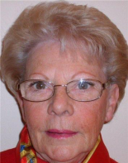
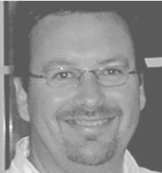

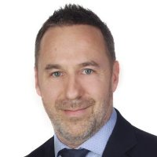
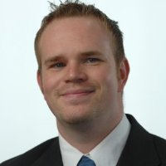

2015 REVIEW
Members
71 Corporates and Intl.Organizations représentions 105 members.
8 Corporates left and 3 new joined us.
Board
Guillermo de la FUENTE– Chairman
Sylvie NOVEL
Jacques BILLY
Eric FELLI
Fabrice MOORE (Sept.2015)
Tobias THIESSEN (Sept.2015)

Slide 4
2015 EVENTS
28th January
Basseruche – Snow shoes outing 17 participants
29th January
Regulatory Impact on the European Treasury Landscape by CITIBANK 17 participants
26th March
Credit Management by VfCMS, BASF and JTI 34 participants
14th April
Global Sovereign Trends by S & P 15 participants
11th June
AG & Swiss Treasurer Forum 52 participants
17th November
FinFrag – Workshop with DELOITTE 39 participants
10th December
Fabrizio Quirighetti – Do not fear the spectre of higher rates –
007 reasons why bonds are forever
13th March
Economic Roundtable – Pierre Danthine – VP BNS invitation by BARCLAYS
19th November
BNS Monetary Market & Coktail invitation by BNS
25th November
The Swiss Financel Market Infrastructure invitation by LENZ & STAEHELIN
29th September
LIBOR roundtable by ICE and BNS in Zurich
2nd October
EACT board meeting in Paris
15th March
EACT board Meeting in Brussels

Slide 5
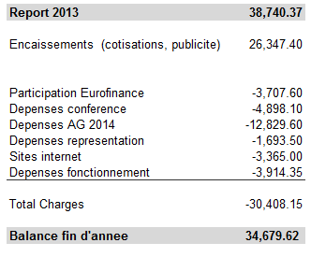
2014 FINANCIAL REPORT

Slide 6
2015 FINANCIAL REPORT
Report 2014 |  |  |  | 34'679.60
Encaissements (cotisations, publicité) |  |  |  | 22'848.35
Participation Eurofinance |  |  |  | 2'795.00
 |  |  |  | 25'643.35
Sponsoring EACT |  |  |  | -1'570.00
Dépenses conférences |  |  |  | -5'642.00
Dépenses AG 2015 |  |  |  | -8'516.00
Dépenses représentation |  |  |  | -3'014.60
Site internet |  |  |  | -3'365.00
Dépenses fonctionnement |  |  |  | -2'368.30
Total Charges |  |  |  | -24'475.90
Balance en fin d'année |  |  |  | 35'847.05

Slide 7
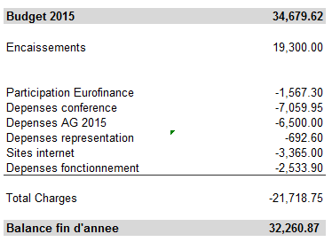
2015 BUDGET

Slide 8
2016 BUDGET
Report 2015 |  |  |  | 35'847.05
Encaissements (cotisations, publicité) |  |  |  | 19'400.00
Participation Eurofinance |  |  |  | 2'970.00
 |  |  |  | 22'370.00
Sponsoring EACT |  |  |  | -1'650.00
Dépenses conférences |  |  |  | -5'000.00
Dépenses AG 2016 |  |  |  | -6'500.00
Dépenses représentation |  |  |  | -3'000.00
Maintenance site internet |  |  |  | -1'800.00
Dépenses fonctionnement |  |  |  | -2'000.00
Total Charges |  |  |  | -19'950.00
Balance en fin d'année |  |  |  | 38'267.05

Slide 9
ELECTIONS
  Resignation of 2 Board Members: Thierry Cairus & Roberto Palacios
  Board’s Appointment:
  Board Member: Fabrice Moore
  Board Member: Tobias Thiessen

Slide 10
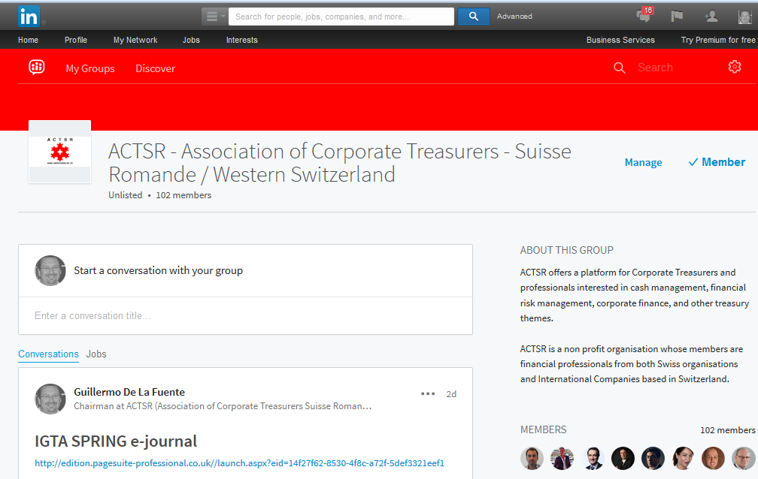

Site Internet

Slide 11
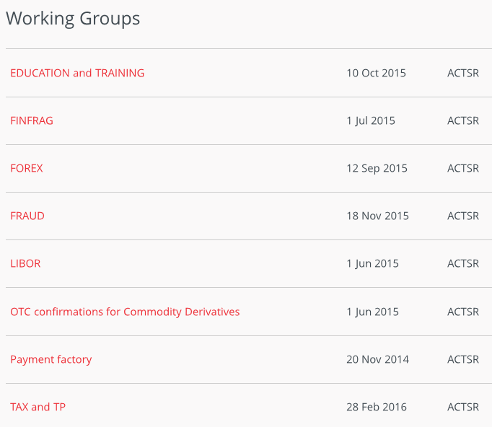

Slide 12
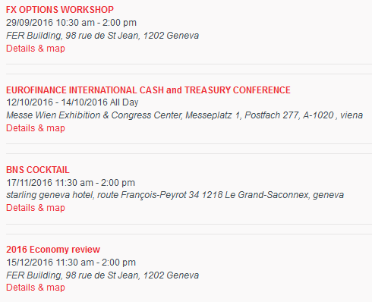
2016 EVENTS & PROJECTS
  EVENTS in 2017
  Swiss Forum 10 juin
  Evénement commun avec SwissAct in 2017

