Slide 1

ACTSR MEMBERS GENERAL MEETING
8 JUIN 2017
BOBST factory: Mex, Laussane

Slide 2
AGENDA
Chair’s Welcome
Financials and budget approval
Board Endorsement and Discharge. 2016 Minutes approval.
2016 Review
2017 Events
2018 AG & Forum: 7th of June

Slide 3
2016 FINANCIALS
Comptes annuels du 1er janvier au 31 décembre 2016
Report 2015 |  |  |  | 35,847.05
Encaissements (cotisations membres) |  |  |  | 19,400.00
Participation Eurofinance + publicite |  |  |  | 4,405.00
 |  |  |  | 23,805.00
Sponsoring EACT |  |  |  | -848.00
Dépenses conférences |  |  |  | -5,110.20
Dépenses AG 2016 |  |  |  | -6,568.00
Dépenses représentation |  |  |  | -5,817.60
Maintenance site internet |  |  |  | -2,860.00
Dépenses fonctionnement |  |  |  | -2,583.00
Total Charges |  |  |  | -23,786.80
Balance en fin d'année |  |  |  | 35,865.25

Slide 4
2017 BUDGET
Report 2016 |  |  |  | 35,865.25
Encaissements (cotisations membres) |  |  |  | 21,000.00
Participation Eurofinance + publicite |  |  |  | 2,970.00
 |  |  |  | 23,970.00
Sponsoring EACT |  |  |  | -1,500.00
Dépenses conférences |  |  |  | -5,000.00
Dépenses AG 2016 |  |  |  | -4,000.00
Dépenses représentation |  |  |  | -5,000.00
Maintenance site internet |  |  |  | -1,800.00
Dépenses fonctionnement |  |  |  | -4,000.00
Total Charges |  |  |  | -21,300.00
Balance en fin d'année |  |  |  | 38,535.25

Slide 5
FINANCIAL REPORTS and 2017 BUDGET
 | 2015 | 2016 | 2016B | 2017B
Revenues from Members | 20,348 | 19,400 | 19400 | 21,000
Other Revenues | 3,295 | 4,405 | 2970 | 2,970
TOTAL REVENUES (A) | 23,643 | 23,805 | 22,370 | 23,970
EACT sponsor | (1,570) | (848) | (1,650) | (1,500)
Conferences | (5,642) | (6,344) | (5,000) | (5,000)
AG 2015 | (6,516) | (6,545) | (6,500) | (4,000)
Representation | (3,015) | (4,606) | (3,000) | (5,000)
Internet | (3,365) | (2,860) | (1,800) | (1,800)
Other expenses | (2,368) | (2,583) | (2,000) | (4,000)
TOTAL EXPENSES (B) | (22,476) | (23,787) | (19,950) | (21,300)
NET (A-B) | 1,167 | 18 | 2,420 | 2,670
INITIAL CASH (C) | 34,680 | 35,847 |  | 35,865
ENDING CASH (A-B+C) | 35,847 | 35,865 |  | 38,535

Slide 6
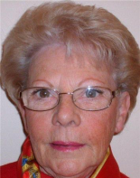
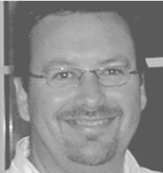

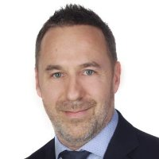
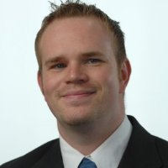

2016 BOARD DISCHARGE
Members
71 Corporates and Intl.Organizations représentions 119 members.
3 Members left and 10 new joined us.
Board
Guillermo de la FUENTE– Chairman
Sylvie NOVEL
Jacques BILLY
Eric FELLI
Fabrice MOORE
Tobias THIESSEN

Slide 7
2016 EVENTS
28th January
Basseruche – Snow shoes outing 17 participants
28th April
Jean-Pierre Roth- «Le plancher pour l’Euro un Bien pour un Mal» 34 participants
9th June
AG & III Swiss Treasurer Forum 52 participants
29th September
Jacques Vo Thanh – Workshop on FX options 9 participants
15th December
Fabrizio Quirighetti – «Un cycle sans fin» 17 participants
31st August
ISAG invitation
17th November
ACI SNB Monetary Market & Coktail invitation by BNS
15th December
Geneva Bank Treasurers
26,29 September
SIBOS in Geneva
16-17 September
EACT and IGTA board meeting in Dublin
12-14th October
EUROFINANCE International conference in Viena

Slide 8
2017 EVENTS & PROJECTS
  SAVE THE DATE !!!!
  Joint event with SwissAct in October 30th 2017 in SGS offices in Geneva:
  16h00 "Welcome and Introduction" by SGS CFO and Group Treasurer
  16h15 "BNS intervention" by Ms Maechler: topic to be determined
  17h00 "Cash Flow at risk" by Tetra Laval Group Treasurer :
  18h00 "Cocktail & snacks"
  23 Novembre – Invitation cocktail ACI & BNS
  Décembre - Fabrizio Quiriguetti, Economist
  4-6 October EUROFINANCE in Barcelona.

Slide 9



Slide 10
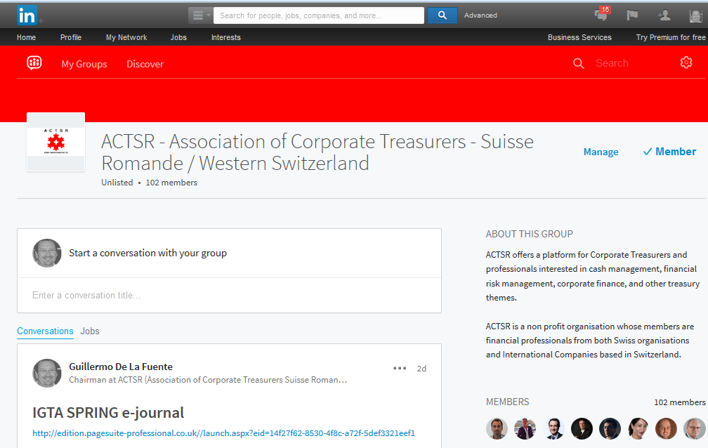

Site Internet

