Slide 1
ING Virtual Cash Management increase your cash visibility, access and control

Slide 2
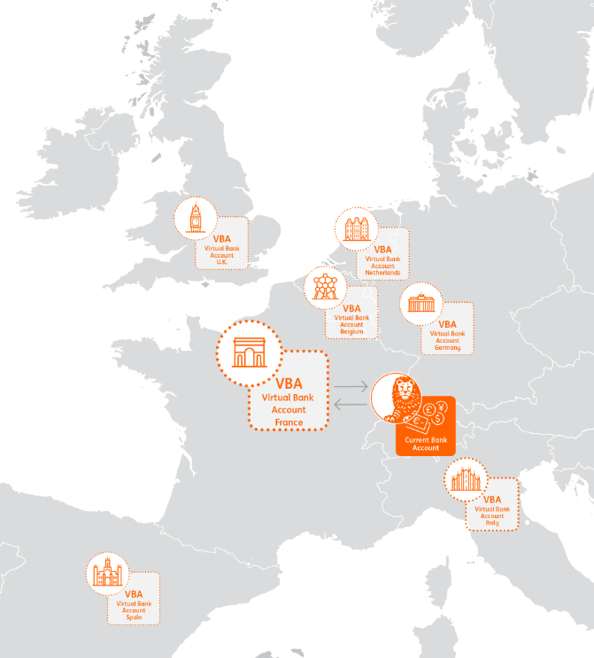
ING Virtual Cash Management – Virtual Bank Accounts
Increase your cash visibility, acces & control
Virtual Bank Accounts (VBA)
Cross border (with local IBANs)
Both payments & collections
Optimize the number of physical accounts
Concentrate cash & centralize transactions (POBO/COBO)
Unique IBAN per department, client or supplier

Slide 3
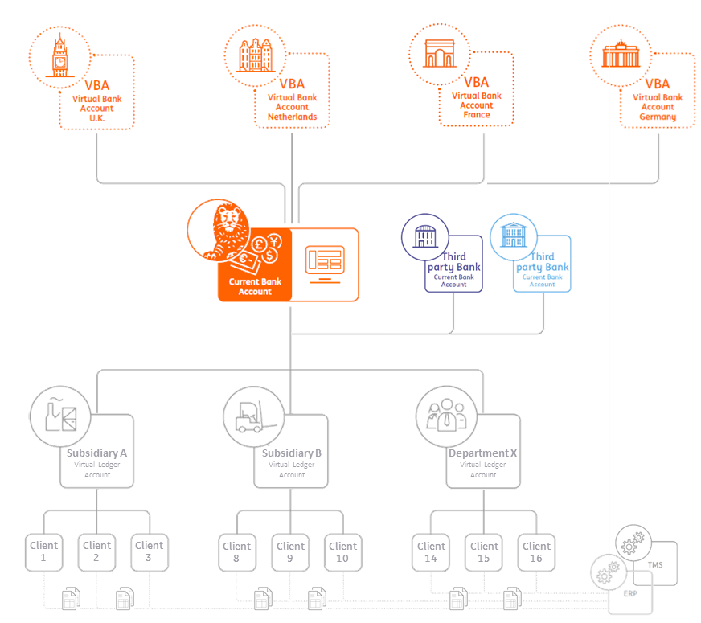
ING Virtual Cash Management – Virtual Ledger Accounts
Increase your cash visibility, acces & control
Virtual Ledger Accounts (VLA)
Real-time overview of cash positions, payments & collections
Multi-currency & cross border
Multi-bank
Invoice matching & enhanced reporting
Fully automated matching of payments with your internal ledger
Intercompany loan administration
Optimized cash flow forecast
Cost-effective set-up of an in-house bank

