Slide 1




How can Virtual IBAN support the treasurers?
Reconciliation support
Centralisation support
KPI tracking across business units, departments, products,…
Observation:
Identification of payers is not always correct
Quality of remittance information is often poor
Information to identify the final beneficiary is not available
The creation of intra-company accounting entries is not possible
Difficult to consolidate internal reporting due to multiple systems
Need to provide visibility to a particular department
With Virtual IBAN:
Straight-Through-Reconciliation rates are greatly increased
100 % identification of payer
Reduction of operational and processing costs
Simplification of bank account structure
Automatically identify the (ultimate) beneficiary
Reduction of operational and processing costs
Improved visibility on the performance of business units
More accurate treasury forecast & credit risk monitoring

Slide 2
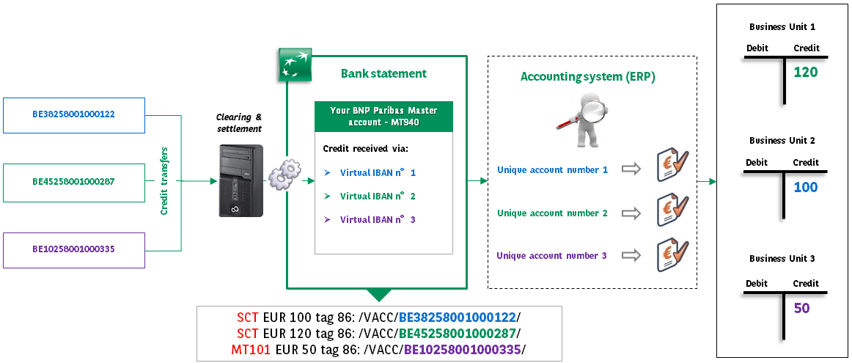
Virtual IBAN reconciliation – How does it work?
A unique virtual IBAN reference is allocated to EACH of your payers
All your incoming credit transfers are directly booked on your physical bank account
Leverage on the unique virtual IBAN reference as an end-to-end reference for reconciliation
Create automatic intra-company accounting entries to book funds to the final beneficiary

