Slide 1
SWISS TREASURER FORUM
How to read a bank’s balance sheet
Philip Adler, EMD Global Head of Treasury & Trading, UBP
Franklin Meimoun, SMD Head of Global Treasury & ALM, UBP
8th of June 2017

Slide 2
Agenda
UBP at a Glance
The Bank : UBS
The Balance Sheet
The Income Statement
Main Financial and Regulatory Ratios
Key Takeaways
Q&A

Slide 3
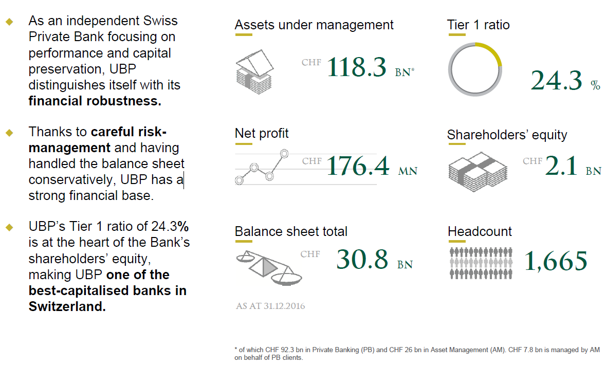
UBP at a Glance: Strong financial foundations

Slide 4
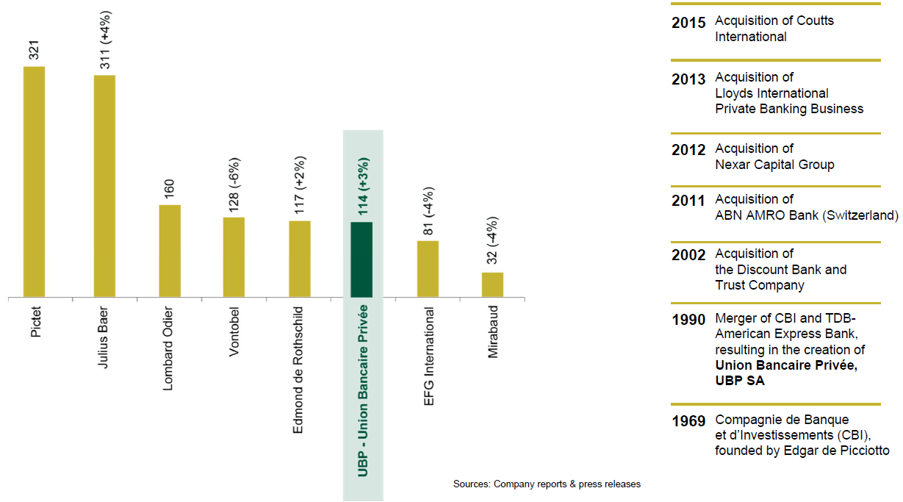
UBP at a Glance: A major player in Switzerland
Assets under management (as at 30 June 2016)

Slide 5
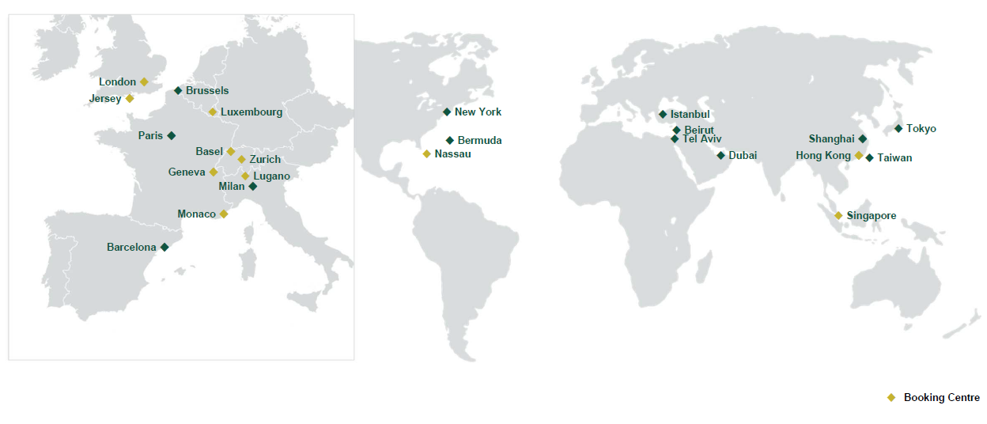
UBP at a Glance: An international network
With over 20 entities around the world, UBP draws on the strengths of its entire network to combine global expertise with local know-how

Slide 6
Our example: UBS
We chose a bank like UBS in order to illustrate our financial statements and ratios explanations using a universal bank.
On a the left hand side, we are showing a brief description of UBS.
On the right hand side, we are showing the most common credit indicators available in BB Terminals such as Credit ratings, BB Rating Model, CDS, and BB Default Probabilities.

Slide 7
The Balance Sheet
This balance sheet is a short summary of the detailed balance sheet published by UBS. A more detailed balance sheet would have been more difficult to comment in ½ hour.
This summary displays balance sheet items from a liquidity & funding perspective which are the most critical aspects when analysing a balance sheet in addition of capitalisation aspects.
To the exclusion of Loans and Deposits, BS items are grouped into LT and ST Assets and Liabilities in order to assess the balance sheet structure in an easy manner.

Slide 8
The Income Statement
This Income Statement is a short summary of the detailed Income Statement published by UBS. Again a more detailed Income Statement would have been more difficult to comment in ½ hour
This summary shows the Net Interest Income and the Total Revenue which includes fees from other activities.
Regarding Credit aspects, we continue to strip off the provisions for loan losses in order to be able to assess the asset quality trend and the management activity.

Slide 9
Main Financial and Regulatory Ratios

Slide 10
Key Takeaways
Financial Statements:
Structure of the Balance Sheet : STA vs STL & LTA vs LTL
Quality of Assets and Management Style: NPL vs NPL Coverage
Capital: Tier 1 Ratio and Leverage Ratio (Fully Loaded)
Liquidity: LCR & NSFR >100%
Earnings vs Capital Usage: Return on Risk Weighted Assets (RORWA)
Complementary Tools: DRSK & Default Probabilities, Credit Ratings, CDS
Impact on your relation:
Universal Banks are more sensitive to deposit tenors. Longer tenors are better treated.
Universal Banks are more sensitive to size of deposits due to Leverage Regulatory Constraints
Opportunities:
Think about other players which are less capital and liquidity constrained. i.e. Private Banks
Think about other solutions such as Repos and Reverse Repos with a Tri Party Agent. i.e. Euroclear

Slide 11
Q & A
Q & A

Slide 12
Thank You!
Thank You!

