Slide 1

Treasury PROCESSES IN MOTION
Heinz Bähni - SVP Group Treasurer

Slide 2
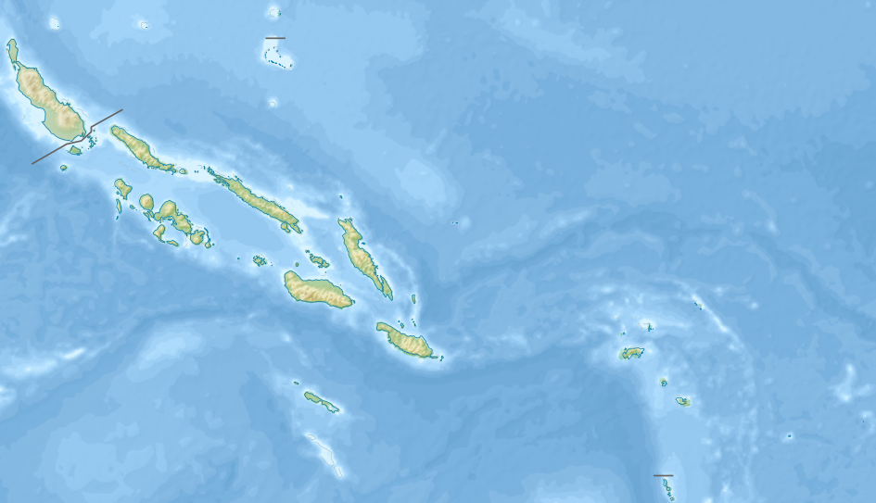
Treasury

Slide 3
Treasury
Wikipedia:
The Treasury-Islands is small archipelago in the northwest of the Pacific Solomon-Islands. The Islands are politically attached to the Western Province of the Solomon Island State.

Slide 4

My comments are influenced from the perspective of an international group with several subsidiaries abroad.

Slide 5

Treasury processes in Motion …

Slide 6
Treasury processes in Motion …
... AND HOW SGS OVERCAME THESE CHALLENGES

Slide 7
ABOUT US
World’s leading inspection, verification, testing and certification company
Founded in 1878 as a grain inspection company
OUR VISION
We aim to be the most competitive and the most productive service organisation in the world.
Experts at:
Providing competitive advantage
Driving sustainability
Delivering trust
Working across industries
and geographies
Expanded beyond agriculture in early and mid 20th century to:
Minerals
Oil, gas and chemicals
Consumer goods
Industrial sector
Listed in 1981
Growth and diversification continued throughout last half of the century
Current structure of ten business units initiated in 2001
Our core competencies in inspection, verification, testing and certification are being continuously improved to be best-in-class. They are at the heart of what we are.
Our chosen markets will be solely determined by our ability to be the most competitive and to consistently deliver unequalled service to our customers all over the world.
SGS HISTORY

Slide 8

GLOBAL REACH AND LOCAL SUPPORT
AMERICAS
440 Offices & Laboratories
17,700 Employees
EUROPE , AFRICA &
MIDDLE EAST
825 Offices, Labs & Multi-labs
32,000 Employees
ASIA PACIFIC
385 Offices, Labs & Multi-labs
30,300 Employees
80,000 employees
Over 1,650 offices and laboratories operating all over the world.
Notes:
8

Slide 9

CHALLENGES

Slide 10
…SOME (Treasury) CHALLENGES
Diversity
  SGS is represented in over 140 countries
  A large number of thin capitalisation, transfer pricing regulations and exchange controls are to be observed
  We actively manage over 90 currencies
  Establish Treasury knowledge in all countries is difficult
  We need, in most countries, a bank with a branch network which means that we manage over 200 bank accounts in the Group
Cost pressure
  Treasury is not a core competence at SGS

Slide 11
How do we solve the challenges
Legal- and Compliance
  SGS is active in over 140 countries, which represents major requirement for us to obey the laws and regulations (thin-capitalisation & transfer pricing regulations, exchange controls)

Slide 12
How do we solve the challenges
Legal- and Compliance
  SGS is active in over 140 countries, which represents major requirement for us to obey the laws and regulations (thin-capitalisation & transfer pricing regulations, exchange controls)
  SGS solution
  When awarding a loan in "difficult" countries some information (no legal opinion) is obtained by an external consultant
  Interest payments must always be made which gives a certain security from the perspective of foreign exchange controls, which has been awarded in accordance with local credit regulations

Slide 13
challenges
Diversity
  We actively manage over 90 currencies

Slide 14
CHALLENGES
Diversity
  We actively manage over 90 currencies
  SGS solution
  We require that all companies do a continuous and rigorous assessment of currency risks
  Simple rules (Hedging policy)
  Simple instruments (assets / loans / spot & forwards)

Slide 15
challenges
Diversity
  Our country organizations are often very small in poorly developed financial markets (Illiquid, no financial instruments, etc.)
  Establish Treasury knowledge in all countries is therefore very difficult

Slide 16
CHALLENGES
Diversity
  Our country organizations are often very small in poorly developed financial markets (Illiquid, no financial instruments, etc,)
  Establish Treasury knowledge in all countries is therefore very difficult
  SGS solution
  We have developed the concept of the Regional Treasury Manager (RTM)

Slide 17
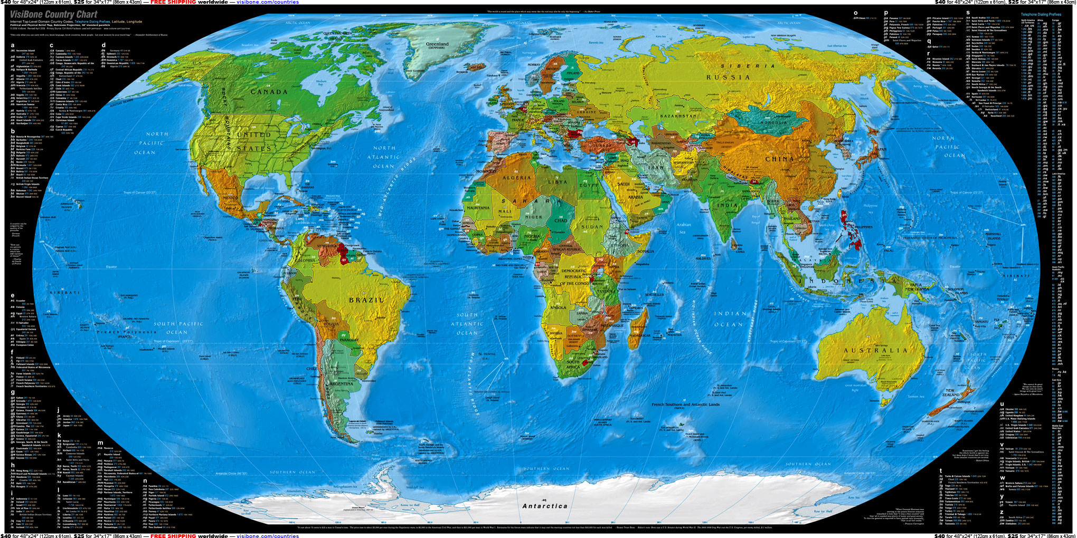

Slide 18
North Americas
Rutherford / USA

Slide 19
North Americas
Rutherford / USA
South America
Neuchâtel / CH

Slide 20
Europe
Geneva / CH
Easter Europe and Middle East
Geneva CH
North Americas
Rutherford / USA
South Eastern Europe
Geneva / CH
Africa
Geneva / CH
South America
Neuchâtel / CH

Slide 21
Europe
Geneva / CH
Easter Europe and Middle East
Geneva CH
North Americas
Rutherford / US
South Eastern Europe
Geneva / CH
Africa
Geneva / CH
South East Asia Pacific / East Asia / China / Hong Kong
Singapore
South America
Neuchâtel / CH

Slide 22
Tasks of the RTM
Assist and actively advise the individual subsidiaries in the region with an efficient liquidity and currency management.
  Minimizing currency risk and improving liquidity management to improve affiliate and Group net result
The RTM’s responsibility include the following areas:
  Daily monitoring of the affiliate’s currency risks
  Conduct foreign exchange hedges on behalf of the affiliate
  Support for the accounting of financial transactions
  Assessments of ST and LT financing needs
  Support concerning Group projects

Slide 23
CHALLENGES
Diversity
  We need, in most countries, a bank with a branch network which means that we need to manage more than 200 bank relationships and over 1,300 accounts in the Group

Slide 24
CHALLENGES
Diversity
  We need, in most countries, a bank with a branch network which means that we need to manage more than 200 bank relationships and over 1,300 accounts in the Group
  SGS solution

Slide 25
CHALLENGES
Diversity
  Treasury is not a core competency at SGS. That’s why it is "difficult"
    to find and remunerate qualified staff
    to make investment in Treasury Management Software
  SGS solution
  As SGS in other areas had made very good experience with outsourcing, it was decided in 2002, to outsource also the non-strategic parts of the Treasury Function

Slide 26
What have we outsourced?
WITHIN CLEAR DEFINED OPERATIONAL
GUIDELINES
Risk management (Forex and Interest)
Our model of outsourcing is a Business Service Provider (BSP)
OUTSOURCED
Cash-management
(Loans and deposits with subsidiaries and banks, cash-pools, netting)
Back-Office
(Payments, confirmations, accounting
Middle Office
(Reports, analyses)

Slide 27
In-House Bank
Policies
Guidelines
Limits
Instructions
Daily reporting
GROUP CONTROL
GROUP TAXATION
BANKS
GROUP
TREASURY
OUTSOURCER
Business support
New Bank relations
Parental support
(Guarantees, Letter of support, etc.)
New Funding
Treasury Controlling
Foreign exchange
Loans within agreed limits
and structures
Deposits
Netting
Settlement
Cash-Pool management
Netting process
Payment process
SUBSIDIARY
Payments
LOCAL BANK

Slide 28
What should not be outsourced
Policies
Bank relations
Negotiations re terms and conditions
NOT BE OUTSOURCED
Treasury Controlling
Defining credit lines for subsidiaries

Slide 29
Experiences
As a Group Treasurer
I can use
my time differently
Communication
The Outsourcer is “my” Front- Middle and Back-Office
EXPERIENCES
It is important that the Outsourcer “thinks and feels” like a Corporate Treasurer
I have the same control of Treasury activities as with my own organisation

Slide 30
treasury DEVELOPMENT SGS
Past (from approx. 1970 – 1980)
Today
Future
Compliance
Telephone and telex trade
“Simple" financial instruments
Cash management products in the initial phase
Comprehensive regulations in most emerging and developing countries
Electronic trading platforms
Efficient cash management products
Reduced regulation
Compliance
"Complicated" financial products
Centralization of treasury activities
STP
Visibility
E-invoicing
Swift Net
Supply chain funding
Mobil phone Treasury

Slide 31
treasury DEVELOPMENT SGS
decentralized Treasury
Centralized Treasury
Future
In-House Bank
Outsourcing
Regional Treasury Manager model
Partial Visibility
In-House Bank
Mobile Payments
higher Automation
Global Credit card payments
Visibility
Payment Factory
Past (from approx. 1970 – 1980)
Today
Future
Compliance
Telephone and telex trade
“Simple" financial instruments
Cash management products in the initial phase
Comprehensive regulations in most emerging and developing countries
Electronic trading platforms
Efficient cash management products
Reduced regulation
Compliance
"Complicated" financial products
Centralization of treasury activities
STP
Visibility
E-invoicing
Swift Net
Supply chain funding
Mobil phone Treasury

Slide 32
concluding Observations
Many treasury departments (also in multinationals) have in today's changing environment only incomplete information and control of positions and risks.
Of course, this applies particularly for smaller companies, where usually lacking technology, people and resources to Treasury optimization.
In my view, these gaps in today's environment especially dangerous. The interest rate and foreign exchange markets will remain volatile, credit markets remain challenging, globalization will increase and thus accelerate the pace of the economy. This in turn leads to potentially higher financial risks.

Slide 33
Academic world
Companies must review their Treasury departments on organizational structures, processes, policies and technologies more than ever.
Unfortunately, the field of treasury management has received relatively few attention to academic level in comparison to finance and accounting.
It would be nice if this would change in the future and with the IFZ and the Swiss Certified Treasurer a suitable platform is certainly there.

Slide 34
concluding remarks
SGS is not claiming to have “the best Treasury model in the world”.
It has developed a model, which suits SGS best in the current environment (e.g. risk appetite of the Shareholders).
Improvements of the model is possible (and needed) but you might know, that this is a “never ending story” .......
Our next big challenges are the choice of a pan-European cash management bank and POBO (Payments on behalf...)
COBO (Collections on behalf is not yet as developed as we would wish and therefore it is a project for 2017.

