Slide 1
Interest Rate Reform (Libor) - An Insider View June 14, 2018
Sacha Guillemin, ACTSR

Slide 2
Agenda
Problematic
Potential issues for Treasurers
International update
The SNB and the National Working Group
Identified issues
Recommendations for Treasurers

Slide 3
Problematic
On 27 July 2017, Andrew Bailey, Chief Executive of the Financial Conduct Authority (FCA), gave a speech highlighting:
Limitations to LIBOR reform
Not robust enough
Panel banks no longer obligated to submit to LIBOR
work must begin on planning the transition to alternative reference rates (RFR) based firmly on transactions
In November 2017, the FCA confirmed that LIBOR panel banks have agreed to continue submitting to LIBOR until end-2021
It is now uncertain if Libor will continue post 2021
Actions should be taken now to mitigate risk
It might remain but in a different format

Slide 4
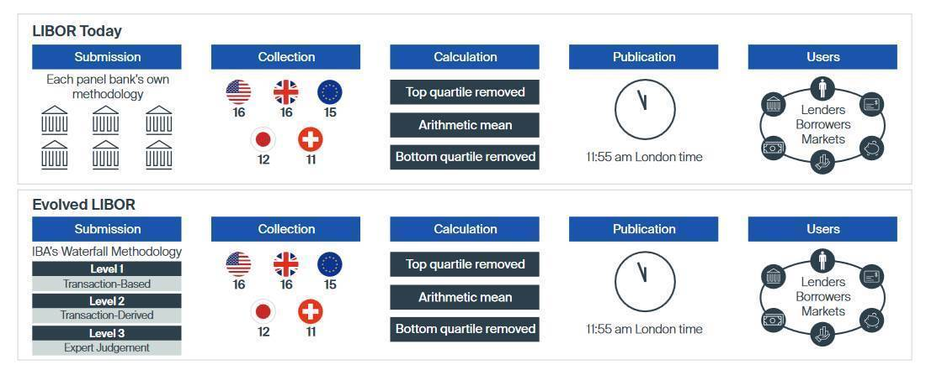
Libor Calculations Today

Slide 5
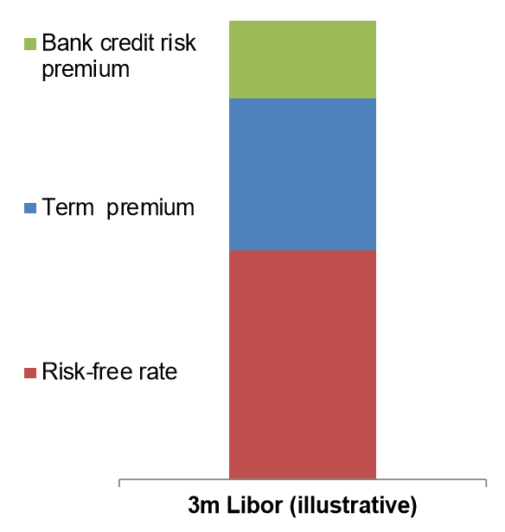
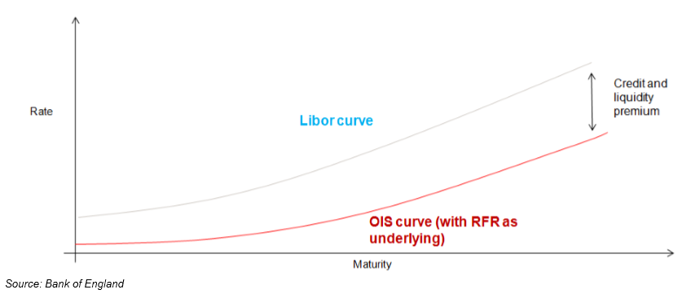
LIBOR vs Reference Rate
LIBOR includes:
Term premium
Credit risk premium
Reference rates don’t
Does RFR need a term and credit risk premium?
How do we adapt to the current model?

Slide 6
Potential Impact for Treasurers
Cash and liquidity management / bank account management
pricing methods for intercompany loans and cash pool agreements
re-negotiate group external contracts, e.g. with banks such as ISDA contracts, contracts for funding or cash pooling contracts (regarding the interest paid or received). In general, every contract containing areas linked to IBORs needs to be considered
Corporate finance
Consider the treatment of IBOR based bonds or promissory notes with maturity beyond 2021
Define financing strategy for new debt until IBOR replacement
Evaluate impacts on supplier finance agreements (e.g. factoring, reverse factoring, dynamic discounting)
Financial risk management
Changes in hedging strategies will be required
Reconsider and update pricing and valuation models of financial instruments linked to IBOR (e.g. IRS/CCS, FX swaps/forwards)
Ensure accurate sourcing of market data for further processing (e.g. for current account interest rates, deal valuations or reporting)
Ensure availability of historical data sets for valuations etc.
Treasury technology
Consider and adjust a broad range of impacted systems requiring technology changes
Tax, valuation, and accounting
Consider and adhere impacts on transfer pricing approaches
Analyze impact on and adjust (hedge) accounting and the yield curves in the respective ERP or TMS system

Slide 7
International Update

Slide 8
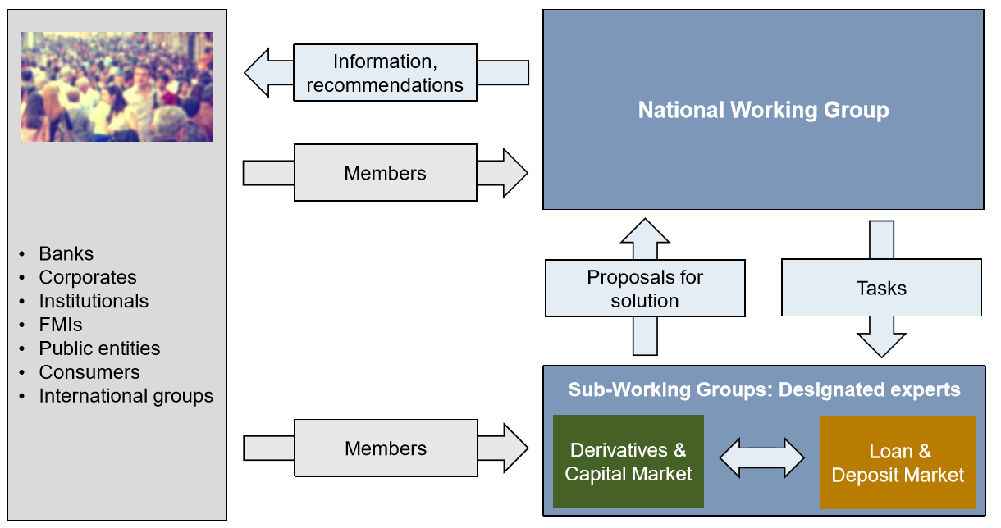
The SNB and the NWG
https://www.snb.ch/en/ifor/finmkt/fnmkt_benchm/id/finmkt_reformrates

Slide 9
Role of the ACTSR
Member of the SWG «Loan & Deposit»
3 delegates
Franck Paniandi, Maus Frères
Guillermo de la Fuente, SITA
Sacha Guillemin
Participate in meetings of the SWG and provide input about corporate needs or issues with the ongoing reform
Obtain feedback from corporates
Coordinate and discuss with other Associations

Slide 10
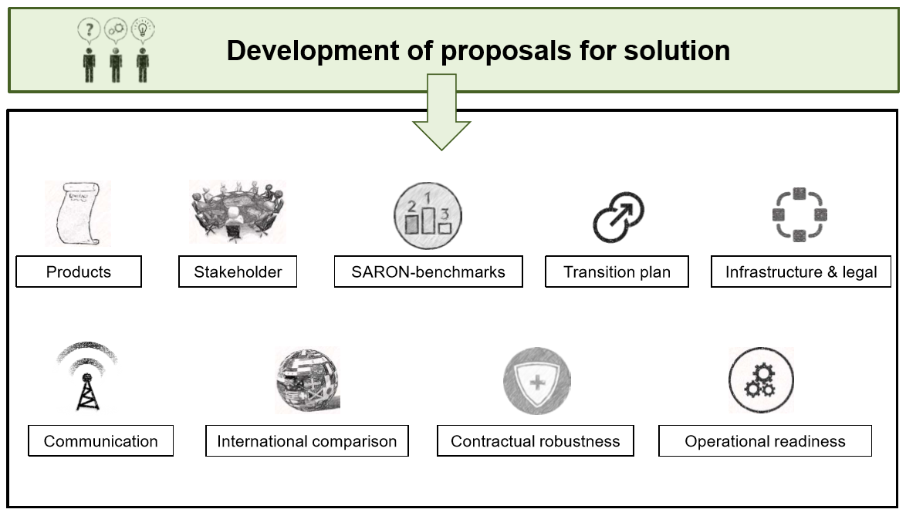
Terms of Reference for Sub Working Groups

Slide 11
Product Scope
Loan and Deposit Market Group |  | Derivatives and Capital Market Group
Loans | Syndicated loans | Bonds | Floating rate notes (FRN)
 | Corporate loans (bilateral) | Securitization | RMBS
 | SME loans (domestic) |  | CMBS
 | Commercial mortgages |  | ABS
 | Retail mortgages |  | CLO
 | Lombard | OTC Derivatives | IR Swaps
 | Credit cards |  | FRAs
 | Auto loans |  | IR Options
 | Consumer loans |  | Basis Swap
 | Student loans |  | CCY swaps
Deposits | Retail deposits |  | Constant maturity swaps (CMS)
 | SME deposits | ETD | IR Options
 | Corporate deposits |  | IR Futures
Other | Guarantees | Mutual Funds | Money market funds
 |  |  | Bank loan funds
 |  | Secured funding transactions | Repos / Reverse repos
 |  | Structured notes

Slide 12
What about Switzerland?
NWG has been operating for several years
Defined SARON as new reference rate in October 2017
Coordinates with all stakeholders
Expect to launch SARON futures in the short term

Slide 13
Current Identified Issues
International comparison
Portfolio and fallback language standards
Term rate fixings
Systems

Slide 14
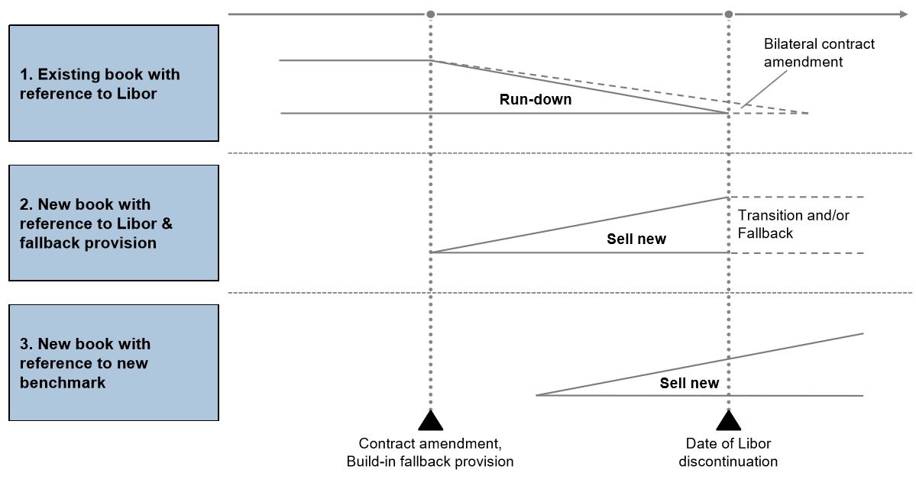
Product Portfolio
Existing book: Get transparency on current volumes, currencies and maturity profile of book
New book with LIBOR reference: Review / adapt contracts with regard to a permanent LIBOR discontinuation
New book with new reference rate: Get high-level understanding of technical implications

Slide 15
Fallback Language
Need to develop a standard fallback language for Libor based contracts
LMA:
The LMA published a revised version of its existing Replacement of Screen Rate clause
Facilitates further flexibility than the existing clause
Allows amendments to be made to facilitate inclusion of a replacement benchmark which:
is formally selected as a replacement for LIBOR by the LIBOR administrator or by an appropriate regulator; or
is otherwise accepted by the relevant markets; or
is deemed appropriate by the requisite majority of lenders and the obligors
The clause can either apply at any time or upon a “Screen Rate Replacement Event”
Drafting is mindful of the draft of the ISDA Benchmark Supplement
ISDA:
Preparing amendments to the ISDA 2006 Definitions
Developing a plan to amend legacy contract, via a protocol
Define the triggers events
Define the alternative risk free rates as fallbacks
Define credit spread to apply to risk free rates
Address the term fixing issue

Slide 16
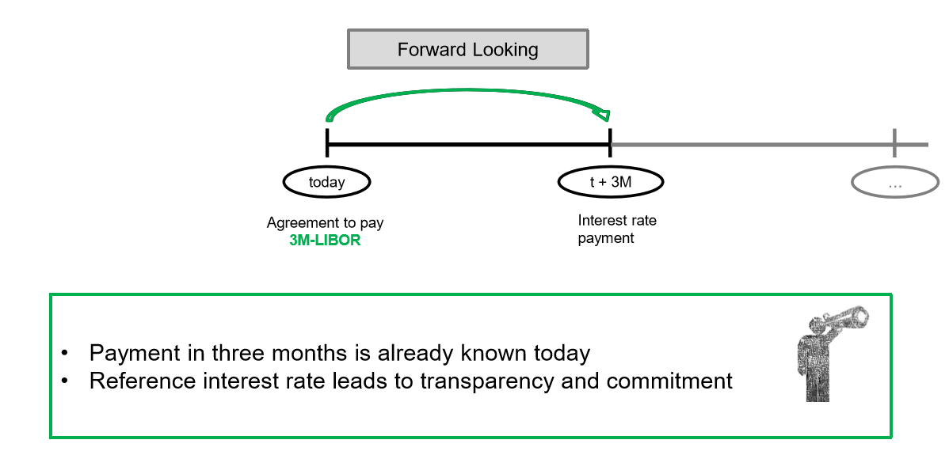
Term Rates - Today

Slide 17
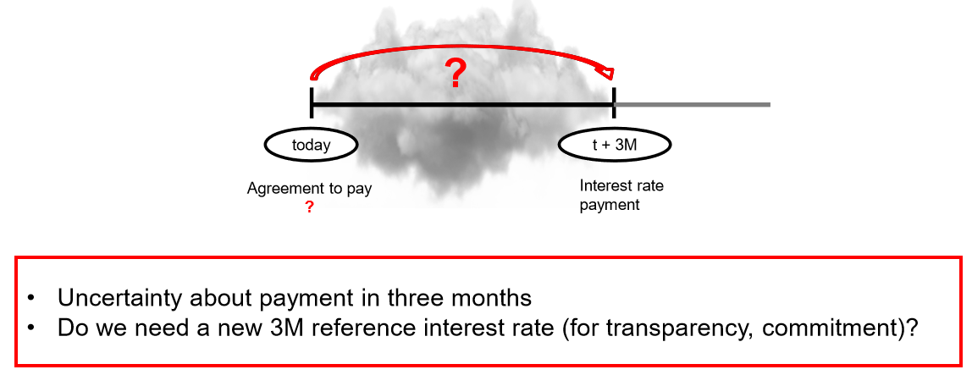
Term Rates – Without LIBOR?

Slide 18
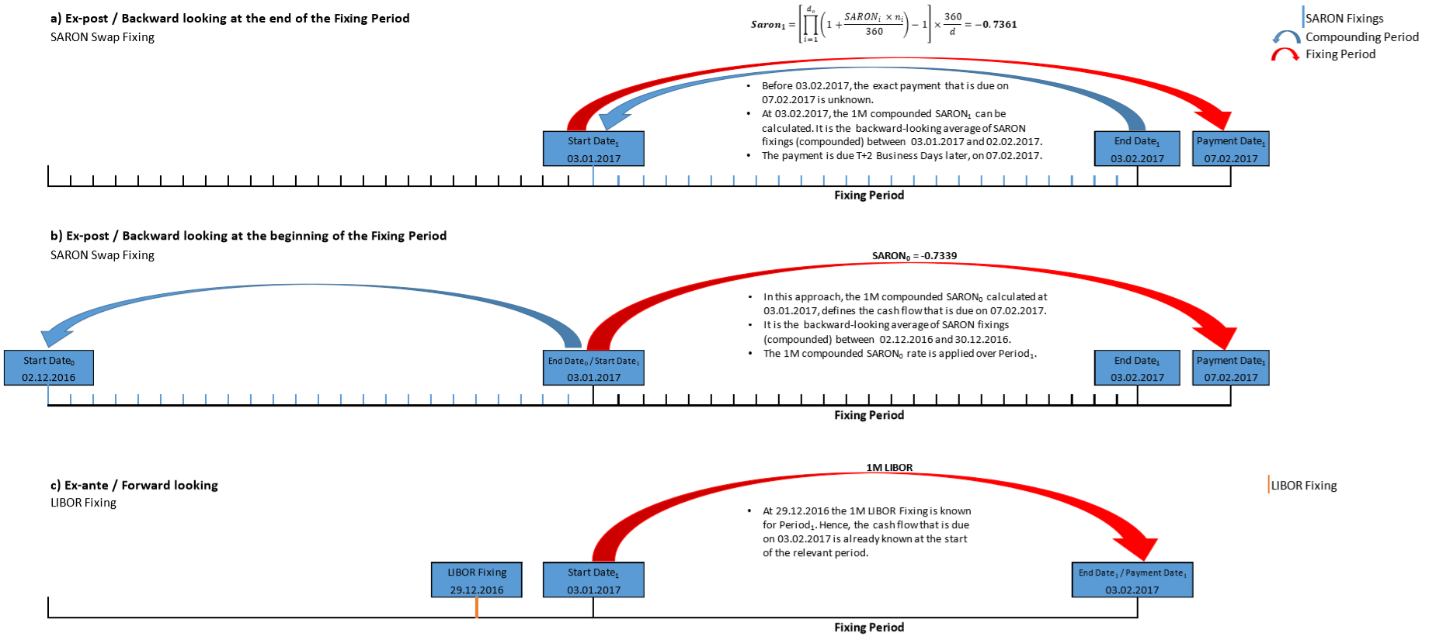
Term Rates - Alternatives

Slide 19
Corporate Outreach
The sub working group developed a questionnaire to understand:
Necessity of a term rate fixing
Market impact if no robust term rate alternative can be established
Impact of the transition from Libor to an alternative reference rate
Impact on different corporate segment
Structure of the questionnaire:
Company profile
Current usage of Libor fixings
Need of term fixing and usage of SARON
Transitional issues
Format
Workshop
Publication on SNB website
Distribution by associations

Slide 20
Recommendations
Prepare for an expected transition:
Get transparency on current volumes, currencies and maturity profile of existing book (e.g. loans, derivatives,…)
Review / adapt new loan and deposit contracts with regard to permanent LIBOR discontinuation
Engage with ISDA in order to be kept informed of new developments
Get high level understanding of technical implications and time-to-market
Raise awareness on senior management level

