Slide 1

GENERAL ASSEMBLY
June 14, 2018
ICRC – Avenue de la Paix - Geneva

Slide 2
AGENDA
Chair’s Welcome
2017 Events Review
2018 Events
Financials and budget approval
Board Endorsement and 3 years Elections.
2019 AG & Forum: 13th of June
Survey results

Slide 3
2017 EVENTS
26th of January
Design de services de trésorerie 18 Participant
M. Emmanuel Fragnières HES-So
16th of January
Design de services de trésorerie 18 Participant
M. Emmanuel Fragnières HES-So
8th of June
General Assembly and Swiss Treasurer’s forum
In the premises of Bobst 52 participants
28th of September
Interest Rates Management 8 participants
M. Michael Jaquet
30th of October 65 participants ACTSR/SwissAct event
in the premises of SGS with Mrs Andrea Michaela MAECHLER
member of the BNS Board
14th of December
2018 : LE PIRE CONTRE-ATTAQUE ! 18 participants
Fabrizio Quirighetti

Slide 4
Other 2017 EVENTS
Ski shoes outting.
EACT Treasury Summit in Brussels
INTL TREASURERS CONFERENCE in Barcelona
4 ACTSR Board Meetings
2 EACT Board Meetings
1 IGTA Board Meeting

Slide 5
2018 EVENTS & Projects
26th of January 21 participants
How Swift GPI can benefit treasurers
A game changer for cross-border payments
Mrs Marianna Janssen, Swift GPI expert /Brussels Office
Mr Florent Canizares / Zürich Office
Invitee: Mrs Elena Maran _ China Construction Bank Zürich Branch
31st of january
Excel Workshop /Best Practive for Excel for Treasurers 11 participants
Prof. Dr Hugues Pirotte
Finmetrics SA
Registration fee fixed at CHF 300
16th / 17th of March
EACT Board Meeting in Brussels
15th of May
Global FX code of Conduc t with ACI
14th of june
General Assembly and Swiss Treasurer Forum
October 9th
Workshop on Pension fund
November BNS Cocktail – December 13th ,our Economist Fabrizio Quirighetti

Slide 6
FINANCIAL REPORTS and 2018 BUDGET

Slide 7
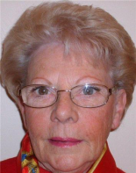


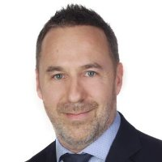
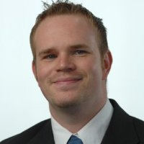

2017 BOARD DISCHARGE
Members
72 Corporates and Intl.Organizations representing 126 members.
Board
Guillermo de la FUENTE– Chairman
Sylvie NOVEL
Jacques BILLY
Eric FELLI
Fabrice MOORE
Tobias THIESSEN

Slide 8



Slide 9
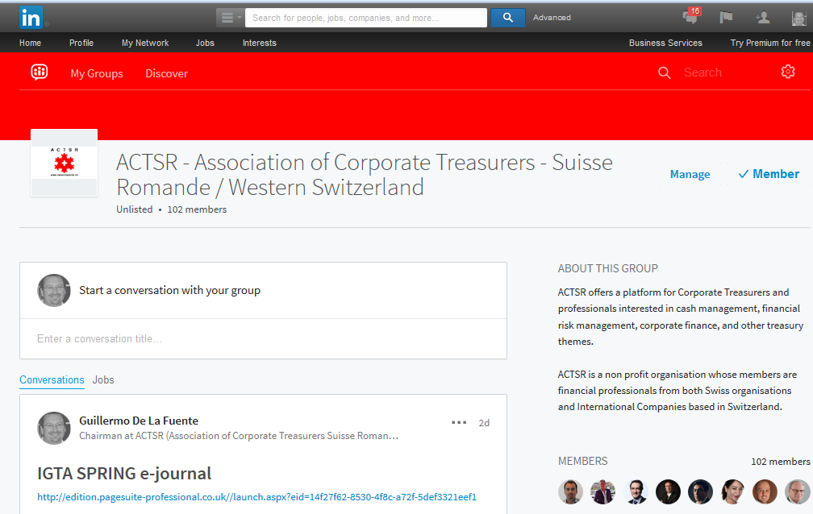
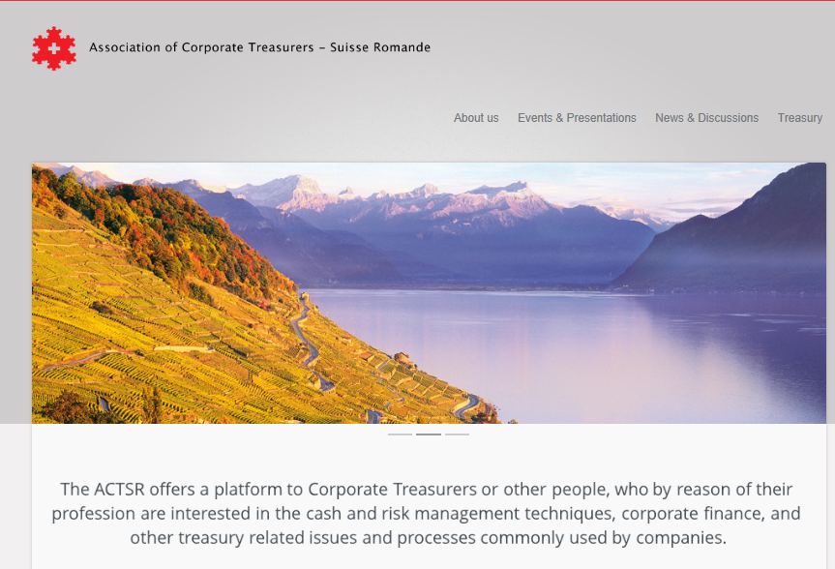
Site Internet

