Slide 1


An in-house solution to cash flow at risk
Vincent Delort
Japan Tobacco International
June 14th, 2018

Slide 2
The JT Group
Our parent company

Slide 3



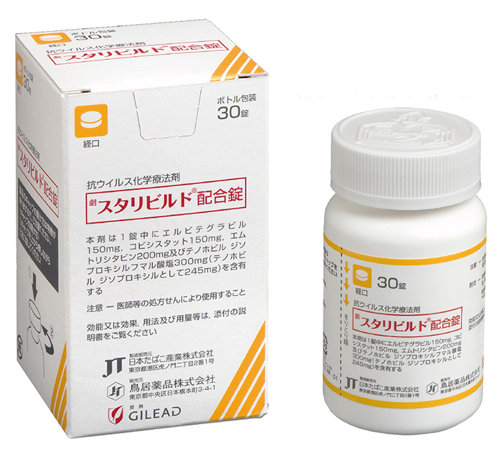

The JT Group
Our parent company
  JT was established in 1985
  In 1999 JT becomes global with the purchase of the international operations of R.J. Reynolds
  JT Group includes Japan’s domestic tobacco market, as well as seasonings, processed foods and pharmaceutical businesses
  JT Group has 44,667 employees worldwide,
  including JTI
  Around 33% owned by the Japanese government,
  making it the largest shareholder
Japanese domestic tobacco
Processed foods
Pharmaceuticals

Slide 4
Our international business

Slide 5
JTI today
  JTI is the JT Group’s international tobacco business
  We employ people in 72 countries around the world
  We are a leading international tobacco product company created in 1999
  We sold 398.7 billion cigarettes¹
  The Company’s core revenue was USD 10,490 million¹
399
offices
25
factories
Approximately
27,000
employees
9
research & development centers
5
tobacco processing
facilities
1 Jan–Dec 2016
Figures as of December 2016

Slide 6
Our Global Flagship Brand portfolio
Our world renowned Flagship Brands accounted for over 71% of tobacco sales volume

Slide 7





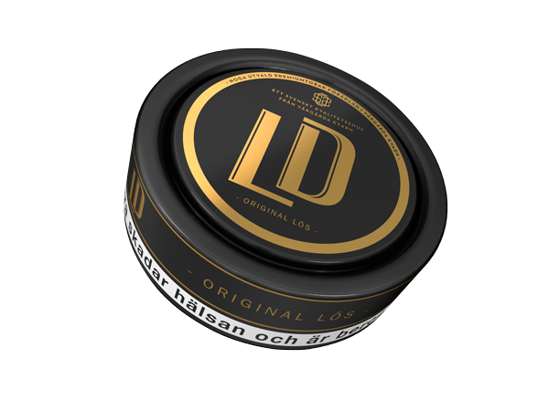
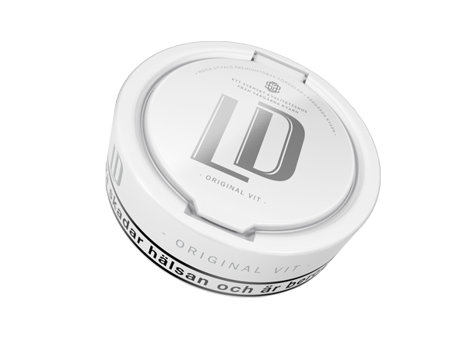




Our ‘Other Tobacco Products’ and ‘Next-Generation Products’
Roll-your-own, make-your-own
Cigars
Snus
Shisha
E-cigarettes
Tobacco Vapor
  Rechargeable and
  tank-style
  e-cigarettes

Slide 8





HR practices recognized globally
Global Top Employer
  JTI was certified Global Top Employer by the Top Employers Institute
  Awarded for the third consecutive year
  In 33 countries in 2017
  Our international headquarters also recognized as the number one employer in Switzerland.
Investors in people
  Accredited locally in a number of countries.

Slide 9

How much can I lose due to FX?
Notes:
I like this picture to represent a risk.
When I chose this appealing photo (no pun intended), I searched on google what was the probability to slip on a banana peel during one’s lifetime… I was disappointed not to find the answer, but I found something interesting on the subject nonetheless. In 2014 Ignobel prize (Parody of the nobel prize The Ig Nobel Prizes honor achievements that first make people laugh, and then make them think.) was awarded to a team that decided to find out just how slippery a banana peel really is.
Anyway, It turns out that banana skins are, indeed, very slippery. The average coefficient of friction of a banana on linoleum was 0.066.
It is actually very low, as ice on ice friction coefficient is around 0.05. Source : https://physics.info/friction/
Coming back to the original subject, you are in a room with a banana peel on the floor. You know that one day you will slip on the banana peel, just the same way that one day you will be impacted by FX movement. What you want to know is “how much will the fall hurt?” And what if I wear protective gear?

Slide 10

Cash Flow at Risk:
Measure of the potential maximum loss in the value of expected cash flows resulting from an adverse market move, within a given confidence level for the given time horizon.
Notes:
It is always good to start with a definition. Don’t worry this is the slide with the most text on it!
So Cash Flow at Risk: is a Measure of the potential maximum loss in the value of expected cash flows resulting from an adverse market move, within a given confidence level for the given time horizon.
The success of CFaR is based on the fact that it is one single number, easy to understand and can be implemented with a reasonable effort.

Slide 11

Basic example
  USD functional company
  1 MM EUR inflow in 6 months
Statement
Expected cash flow : $2.06 MM
  50 MM RUB inflow in 6 months
  EURUSD rate 1.19
  USDRUB rate 57.48
Notes:
To help understand better we will go through an example :
A USD functional company with two flows that will happen in 6 months.

Slide 12


How to calculate CFaR?
Common methods
Historical Method
Parametric Method
Monte Carlo Method
Notes:
We will calculate the CFaR in three different ways :
Historical
Look at the past to forecast the future
Parametric
use probability theory to compute a maximum loss
Monte Carlo
Simulate market movements with random variables.

Slide 13
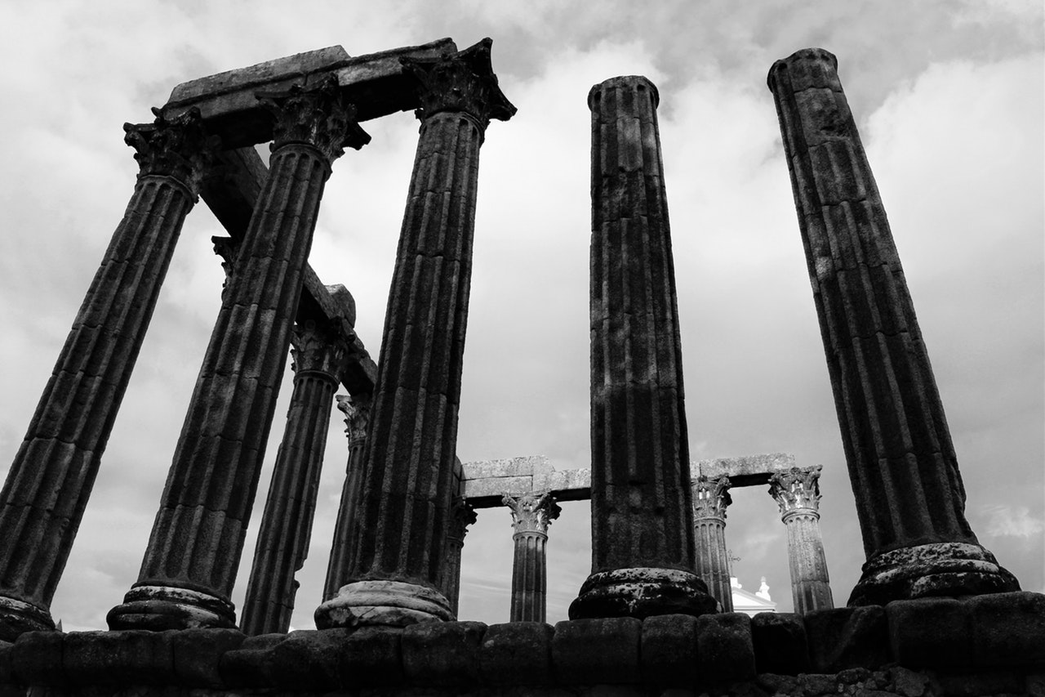
Historical method:
Look at the past to forecast the future.
Notes:
The Historical method is based on a strong assumption : what happened in the past will happen again in the future.
If we keep the banana peel comparison, it is like if you look at all hospital records about injuries caused by slipping on a banana peel.

Slide 14
Historical method
Observed past returns
62.94
58.09
57.48
57.82
55.90
52.59
6 months
Notes:
These are the observed returns on 6 months from the past years. These 5 paths represent the returns from January 1st to June 30th for the past 5 years.
These are only 5 paths but there are many more : from January 5th to July 4th 2012 is another path for example. Or from May 1st to September 30th 2015

Slide 15
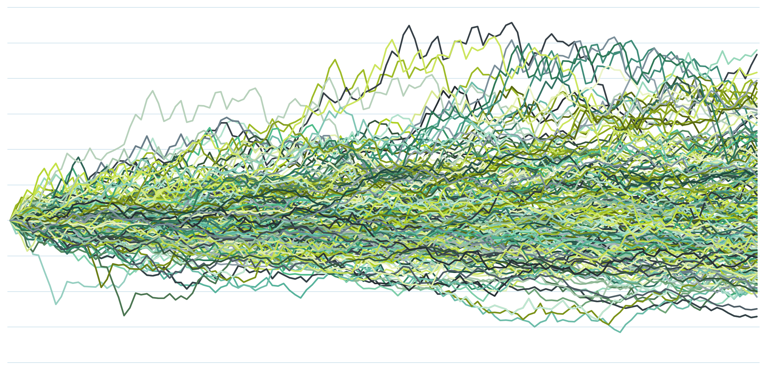
Historical method
71.28
66.68
57.48
49.43
Notes:
This summarizes 255 paths that occurred in the last 10 years.
This is only the limitation of excel, the actual simulation is on more than 3000 paths.
The graph shows that based on today’s USDRUB spot, we can reach anywhere between 49 and 71. But the level that interests us is the 5th % lowest value, in other words 67 on these 255 simulations.

Slide 16
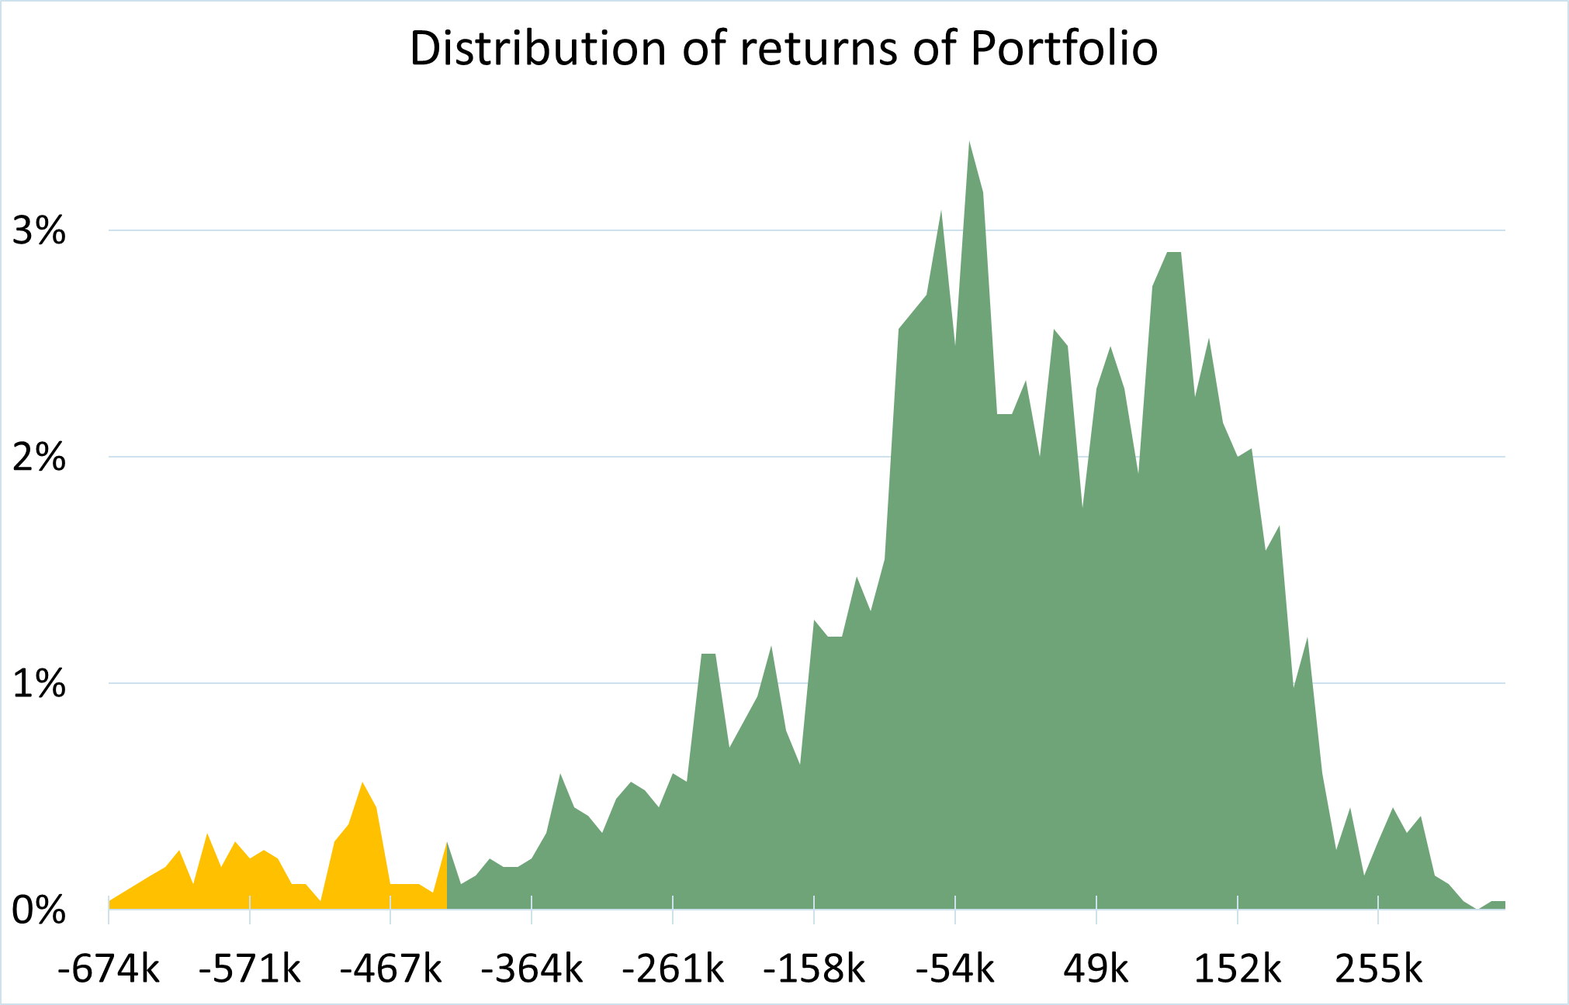
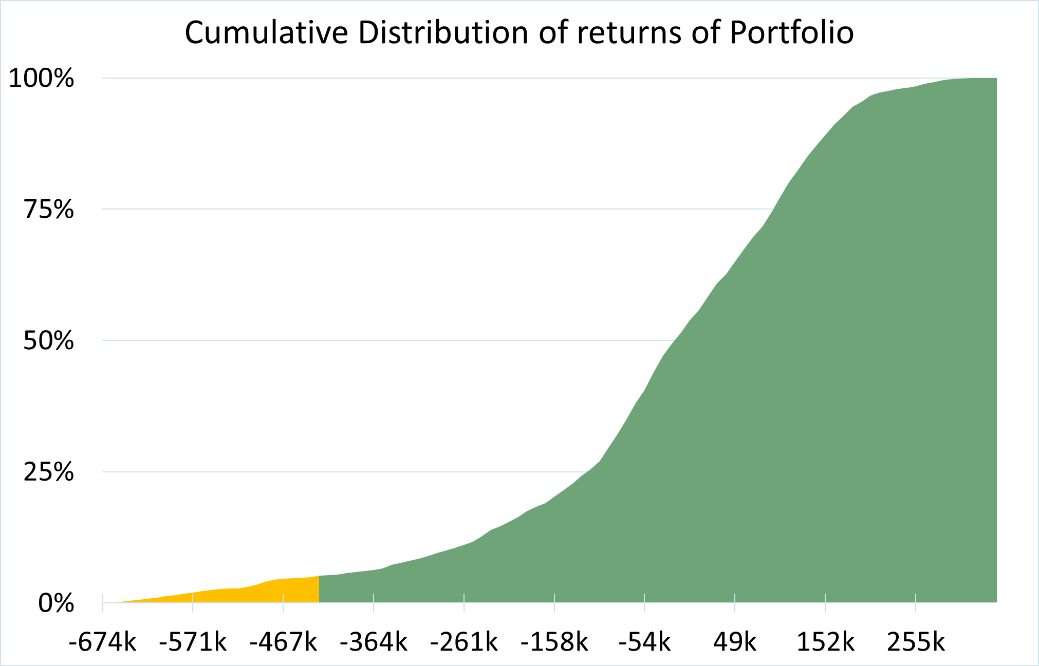
Historical method - results
10 years of history
-430k
-430k
Notes:
So on 10 years history (more than 3000 6 months paths) this is the result that we get.
We have the distribution of returns, and then we take the 5 percent on the left, and that is our CFAR.
In this case with the two flows, we get a potential loss of -430k.

Slide 17
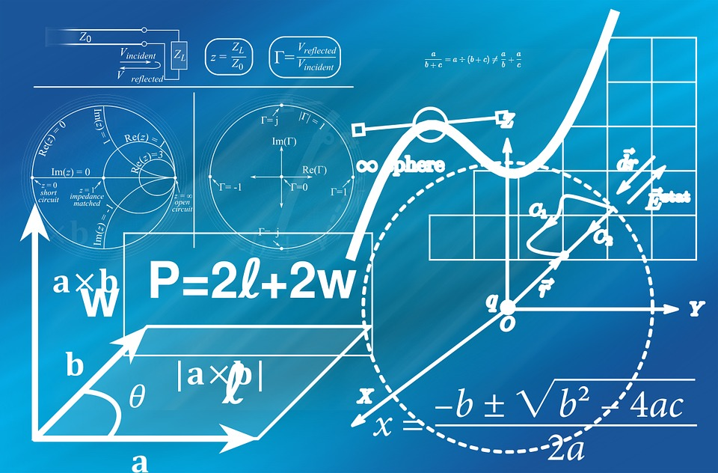
Parametric method:
Use probability theory to compute a portfolio's maximum loss.
Notes:
Also known as Variance-Covariance Method.
The variance-covariance method for the value at risk calculates the standard deviation of price movements of an investment or security. Assuming stock price returns and volatility follow a normal distribution, the maximum loss within the specified confidence level is calculated.
In banana terms it is like calculating based on my weight, height and gravity, the impact of falling after slipping on a banana.

Slide 18
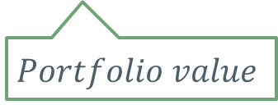

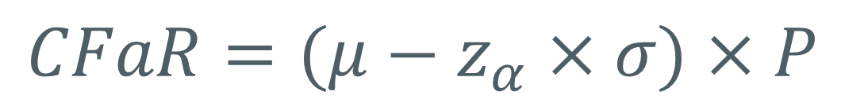
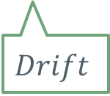
Parametric method
Formula and concept
Assume the currency pairs returns follow a normal distribution.
𝑡ℎ𝑒 𝑙𝑒𝑓𝑡 𝑡𝑎𝑖𝑙 𝛼−𝑝𝑒𝑟𝑐𝑒𝑛𝑡𝑖𝑙𝑒 𝑜𝑓 𝑎 𝑠𝑡𝑎𝑛𝑑𝑎𝑟𝑑 𝑛𝑜𝑟𝑚𝑎𝑙 𝑑𝑖𝑠𝑡𝑟𝑖𝑏𝑢𝑡𝑖𝑜𝑛
$$Volatility$$
$$CFaR=(μ−z_{α}×σ)×P$$
$$Drift$$
$$Portfolio value$$
Notes:
We assume the currency pair returns follow a normal distribution.
Then the Cfar is given by this formula.
Where the drift is the average return
Volatility is the standard deviation
If 90% CFaR => z = 1.282
If 95% CFaR => z = 1.645
If 99% CFaR => z = 2.326

Slide 19

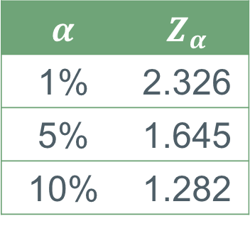





Parametric method
Formula and concept
$$α$$ | $$Z_{α}$$
1% | 2.326
5% | 1.645
10% | 1.282
$$α=5\%$$
$$σ=6.9\%$$
$$−z_{α}σ$$
-270k
$$α/2$$
$$CFaR$$
$$μ$$
-37k
Notes:
It is maybe easier to explain this in a graphical way.
We start from our assumption that the returns follow a normal distribution.
The distribution is then centered around the average return (drift).
If we are looking for a 5% CFaR, then we are looking at the orange area that represents 2.5% of the distribution. On the x axis this corresponds to the CFaR, and the distance to the mean is given by the volatility.
If we take our values, the result is -270k.
Now why is that result different from before? It is because the actual returns don’t follow 100% a normal distribution. This is what we call ‘fat-tail’. In reality, extreme scenarios happen much more often than in the models. And because we are looking at the smallest values, we are in a way overestimating the risk compared to the parametric method.

Slide 20

Monte Carlo method:
computational algorithms that rely on repeated random sampling to obtain numerical results.
Notes:
I did not take this picture only because Monte Carlo is linked to the casinos, but also because one of the easiest way to explain monte carlo methods is to take three dice. What is the probability that the three dice output the same result? One way to calculate this expectation is to throw the dice many times and count the number of times that the three dice have the same result. And when you have done 100k simulations, you can get pretty sure that you have a good estimate of the probability.
In banana term, it is like taking a doll representing myself, making it slip 10000 times on a banana peel, and look at the damage caused.

Slide 21
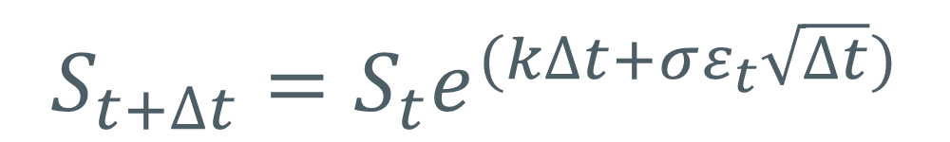

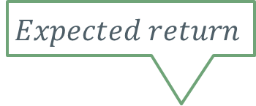



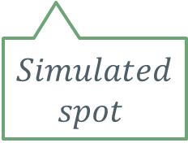

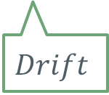
Monte Carlo method
Formula and concept
Assume asset prices follow a geometric Brownian motion.
$$Volatility$$
$$Expected return$$
$$Volatility$$
$$S_{t+∆t}=S_{t}e^{(k∆t+σε_{t}\sqrt{∆t})}$$
$$k=μ−\frac{σ^{2}}{2}$$
$$Simulated$$
$$spot$$
$$Spot$$
$$Random element$$
$$Drift$$
Notes:
In most finance studies, we assume that asset prices, though largely unpredictable, follow a special type of stochastic process known as geometric Brownian motion, described by the following equation:
This assumptions is for example used in the Black Scholes formula.
So here let’s assumer that Delta T is one day. We are calculating the spot of tomorrow based on the spot of today, the drift, the volatility and a random element.

Slide 22
Monte Carlo method
Generate future returns
66.19
57.48
6 months
Notes:
Once again, let’s go through graphically.
We start from the USDRUB spot of today (57), and then we calculate the spot of tomorrow, and from tomorrow we calculate the spot of the next day, and so on, and so on. Until we get one possible path of 6 months. This is one simulation.
Then we do it again, and again, and again, and many times.
We are creating thousands of possible scenarios of what can happen in the future. And from these thousands of scenarios, you take the one that give the 5% smalles value.

Slide 23
Monte Carlo method
Results with 10000 simulations
-270k
-37k
Notes:
Here are the results based on 10000 simulations.
We find the same results as the parametric method (because the same parameters were used and the scenario was very simple).

Slide 24




Method
Pros
Cons
Simple
Fact-based
Will history repeat?
Simple
One formula
Limited to linear returns
Path-independent
Powerful
Can model scenarios
Difficult to implement
Resource heavy
Notes:
Now that we have looked at the three methods, we can make a quick summary and look at the pros and cons.
For Historical Method, it is very simple to put in place (easy to get the data) and it is fact based. Something that really happened, so nobody can contest your data and market movements. However it is based on a very strong hypothesis, which is that the history will repeat.
The Parametric method is very simple too and consists in a single formula. So you don’t need any computing power. However, because of its simplicity, it can’t simulate non linear return scenarios (for instance if you hedge your exposures with options). And it is path independent, meaning that there is absolutely no link between two different calculations you do (5month cfar and 6 months cfar).
The Monte Carlo Method is very powerful and can model very complex scenarios, but it is quite difficult to implement and is resource heavy. This is the one we implemented at JTI, and with many currency pairs, exposures, etc, the simulation time is counted in hours.

Slide 25

Appendix
Notes:
The title of my presentation is how to implement it in house, so I will bring you through the implementation process in excel. I will keep it very simple, with only two slides, but they should give you all you need in order to make the calculations and implement it at home.
This was implemented in 2013 in JTI, our model was confirmed by expert financial practicioners, and we still use it, to calculate different measures, like the CFaR on our exposures, the CFaR on our exposures and hedges, to look at the efficiency of our hedging program, but because we implemented the Monte Carlo Method we can also make scenarios, so we could simulate a RUB devaluation for example.

Slide 26





Low cost solution
Inputs
FX returns
$$Return r_{t+∆t}=\frac{S_{t+∆t}−S_{t}}{S_{t}}$$
Drift
$Average return on the period$
$μ=\sqrt[n]{\prod_{1}^{n}{{(r}_{i}+1)}}−1$
$Standard deviation of returns$
$σ=\sqrt{\frac{1}{n−1}\sum_{1}^{n}{{(r_{i}−μ)}^{2}}}$
Volatility
Notes:
I assume you already have an history of FX rates
This is the low cost version, possible to have implied volatilities from Bloomberg for example.
Here are the formulas I use to calculate the returns, the drift and the volatility.
For the drift, this big scary equation is actually very simple. This big Pi sign is called a product. It means you multiply n times the term that is inside. Then you take the nth root. And that is your average return.
It means that if you apply n times this return to your initial value, you will get the latest value of your history. This is why it is the average return.
The volatility is the standard deviation of the returns, so from the definition we have this formula.

Slide 27
Low cost solution
In Excel
FX returns
In cell B2 : “=(A2-A1)/A1”
Drag formula until B10
Drift
In cell C2 : “=B2+1” and drag to C10
In cell E2 : “=PRODUCT(C2:C10)^(1/COUNT(C2:C10))-1
In cell D2 : “=(C2-$E$2)^2” and drag to D10
In cell F2 =“SQRT(SUM(D2:D10)/(COUNT(D2:D10)-1))
Volatility
Notes:
Now how to translate this into excel :
If we have the returns in cells A1:A10
The return is given by the formula (A2-A1)/A1
Then once you have all your returns, you can calculate the drift, or average return. To do this you have to calculate the nth root of a product of n terms. This is done very easily in excel with the product function and the ^.
Now with all this you can calculate the volatility given by the equation we saw before.
You create only an intermediate step where you calculate the inner term of the sum, and then you can in one easy formula calculate the square root of the sum, divided by the number of terms.
Or user AVERAGE and STDEV functions provided by excel.
With these 3 elements (returns, drift and volatility) you can calculate the parametric method and the Monte Carlo Method.
So I hope you are a bit less afraid about the CFaR, that you get a better understanding about what it is, how to calculate it and more importantly that you can calculate it yourself. Please let me know if you have any questions?
I hope now you won’t be afraid to slip on banana peels anymore. Thank you !

Slide 28


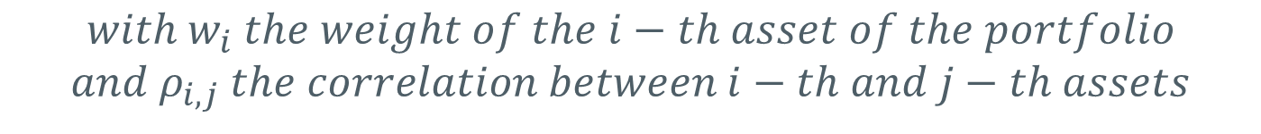
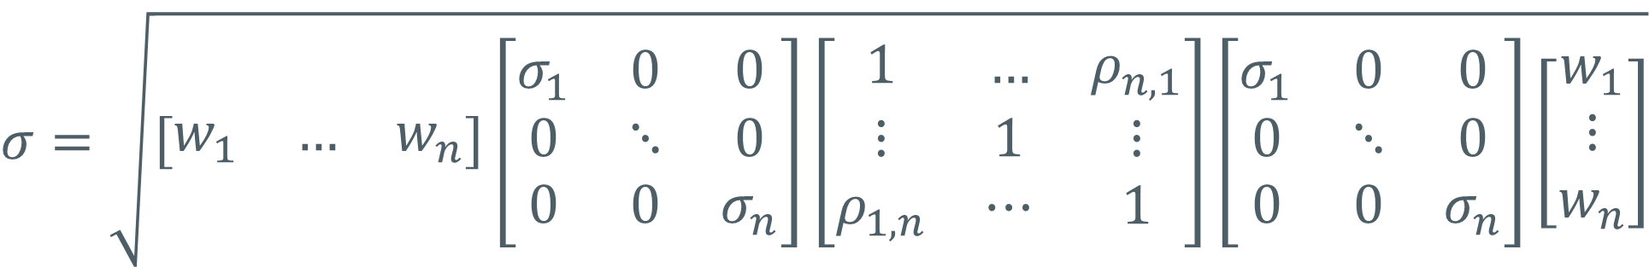
Parametric method
Multi asset portfolio
$$μ= \sum{w_{i}μ_{i}}$$
$$CFaR=(μ−z_{α}×σ)×P$$
$$σ=\sqrt{\left[\begin{matrix}w_{1} & … & w_{n}\end{matrix}\right]\left[\begin{matrix}σ_{1} & 0 & 0 \\ 0 & ⋱ & 0 \\ 0 & 0 & σ_{n}\end{matrix}\right]\left[\begin{matrix}1 & … & ρ_{n,1} \\ ⋮ & 1 & ⋮ \\ ρ_{1,n} & ⋯ & 1\end{matrix}\right]\left[\begin{matrix}σ_{1} & 0 & 0 \\ 0 & ⋱ & 0 \\ 0 & 0 & σ_{n}\end{matrix}\right]\left[\begin{matrix}w_{1} \\ ⋮ \\ w_{n}\end{matrix}\right]}$$
$$with w_{i} the weight of the i−th asset of the portfolio$$
$$and ρ_{i,j} the correlation between i−th and j−th assets$$

Slide 29


Monte Carlo method
$$S_{t+∆t}=S_{t}e^{(k+σε_{t})}$$
Multi asset portfolio
$$Cholesky decomposition of Correlation Matrix M=LL^{∗}$$
$$M=LL^{∗}⇔\left[\begin{matrix}1 & … & ρ_{n,1} \\ ⋮ & 1 & ⋮ \\ ρ_{1,n} & ⋯ & 1\end{matrix}\right]=\left[\begin{matrix}L_{1,1} & 0 & 0 \\ ⋮ & L_{i,i} & 0 \\ L_{n,1} & ⋯ & L_{n,n}\end{matrix}\right]\left[\begin{matrix}L_{1,1} & ⋯ & L_{n,1} \\ 0 & L_{i,i} & ⋮ \\ 0 & 0 & L_{n,n}\end{matrix}\right]$$
$$ε_{t}=\left[\begin{matrix}ε_{EUR,t} & … & ε_{USD,t}\end{matrix}\right]=\left[\begin{matrix}α_{1} & … & α_{n}\end{matrix}\right]L$$
$$with α_{i}=NORMINV\left(RAND(),0,1\right)$$
$$S_{t+∆t}=S_{t}e^{(μ−\frac{σ^{2}}{2}+σε_{currency,t})}$$
Notes:
Matrix multiplication can be done with formula : MMULT

Slide 30
Enterprising
Open
Challenging

