Slide 1
ACTSR Conference – Blockchain et trésorerie
Geneva, 3. November 2018
Crypto Assets–
Opportunities and challenges for institutional investors Jan Brzezek CEO & Co-Founder

Slide 2
Introduction Jan Brzezek
Various positions at UBS Asset Management, Wealth Management & Investment Bank
Group Innovation Expert at UBS
Worked on the impact of new technologies on the UBS business model
Several years in derivatives and fixed income sales and trading for UBS in Zurich, Singapore, and Hong Kong
Derivatives expert at the SIX Swiss Exchange

Slide 3



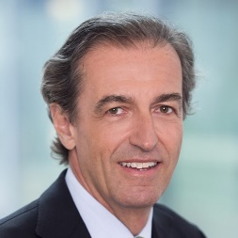
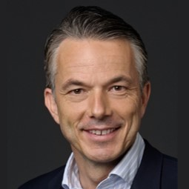

CRYPTO FINANCE GROUP
CRYPTO FINANCE AG
BOARD OF
DIRECTORS
Dr. Tobias Reichmuth
Jan Brzezek
Marc P. Bernegger
Raymond J. Baer
Pascal Forster
Dr. Philipp Cottier
Crypto Finance AG is a financial technology holding company founded in June 2017.
Crypto Fund AG is the first asset manager for crypto assets authorised by FINMA under the Swiss Collective Investment Schemes Act.
Crypto Broker AG provides professional access to the crypto asset market through its industry leading trading infrastructure.
Crypto Storage AG provides leading edge infrastructure solutions and services to securely store blockchain-based assets.
Currently, over 40 highly qualified internal and 13 external professionals are working within the group.
3

Slide 4
WE STAND ON THE BRINK OF A TECHNOLOGICAL REVOLUTION
4. Industrial Revolution
based on Cyber-Physical Systems
3. Industrial Revolution
2. Industrial Revolution
uses electronics and IT to achieve further automation of manufacturing
Complexity
follows introduction of electrically-powered mass production based on the division of labour
1. Industrial Revolution
follows introduction of water-and steam-powered mechanical manufacturing facilities
End of 18th century
Start of 20th century
Start of 1970s
Today
Time

Slide 5

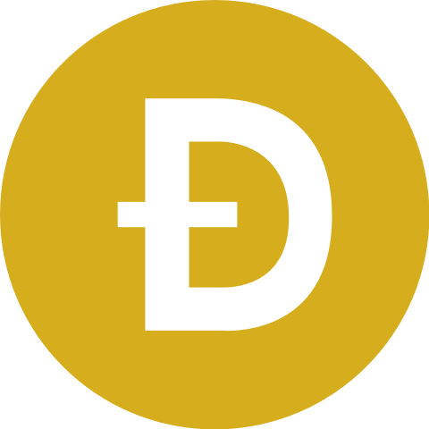
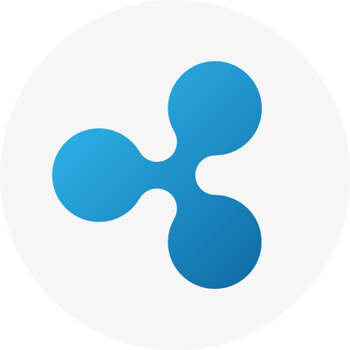



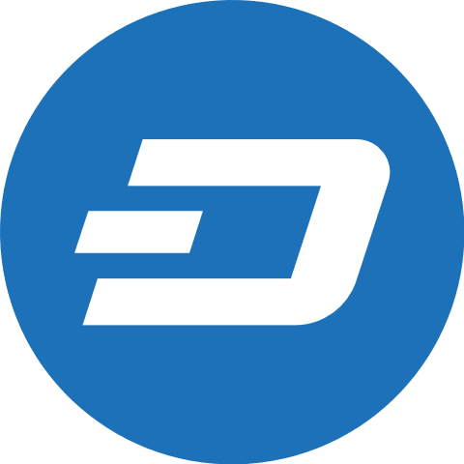
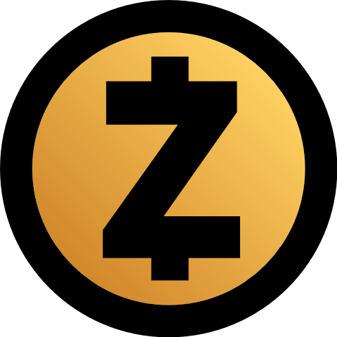


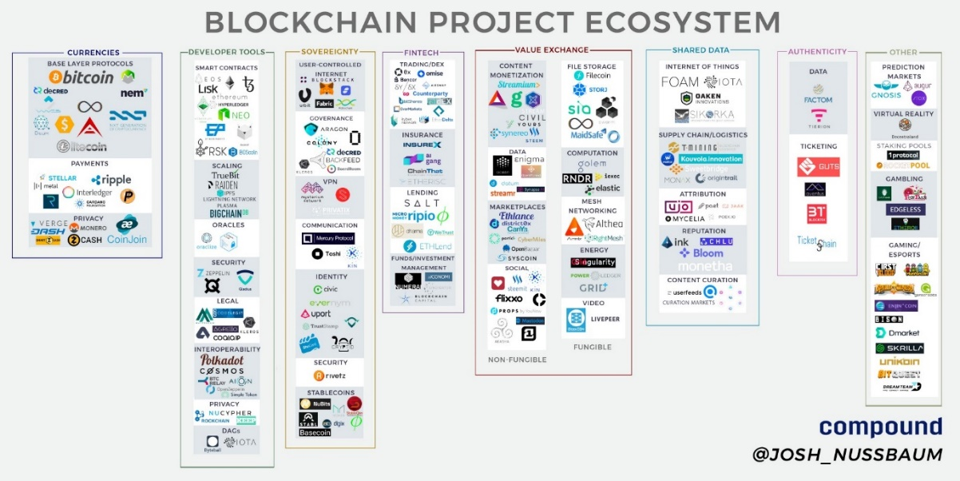
















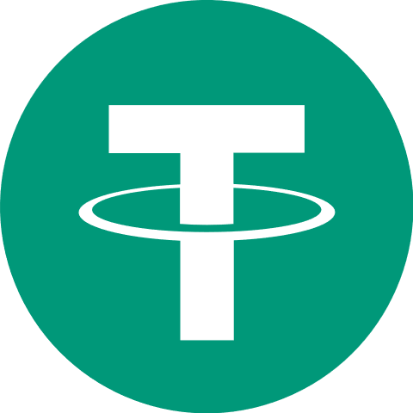








CRYPTO ASSETS vs. CRYPTO CURRENCIES
For the first time in the history of the world, anyone can now send or receive any amount of money with anyone else, anywhere, instantly, basically for free, and it is impossible for anyone to stop them. (Roger Ver)
Major Crypto Assets And Tokens Categories
Currencies/Payment/Store Of Value Crypto Assets
Payments
Transactions
Anonymity
App/Platform Crypto Assets
Utility Crypto Assets

Slide 6
CRYPTO ASSETS ARE AN EMERGING ASSET CLASS
At present, the total notional amount outstanding in the Global OTC derivatives market is ~$532t, suggesting crypto assets have room to grow
The total market capitalization of all crypto assets today amounts to , which is close to the total notional amount outstanding in the Global OTC derivatives market back in the late-1980s
263x Increase
Total notional amount outstanding in the Global OTC derivatives market
Crypto market capitalization

Slide 7
BITCOIN PRICE HISTORY VS NASDAQ TECH BUBBLE
$6,000
NASDAQ
$25,000
Bitcoin
$5,000
$20,000
NASDAQ Price
$4,000
Bitcoin Price
$15,000
$3,000
$10,000
$2,000
$5,000
$1,000
$0
$0
NASDAQ
Bitcoin
Jun-94 | Jul-95 | Jun-96 | Apr-97 | Mar-98 | Dec-98 | Oct-99 | Dec-00 | Oct-01 | Dec-02
Jan-17 | Mar-17 | Apr-17 | Jul-17 | Aug-17 | Oc-17 | Nov-17 | Feb-18 | Apr-18 | Jun-18

Slide 8
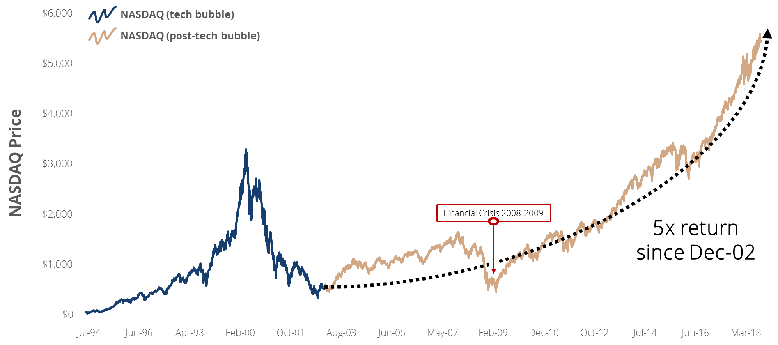
NASDAQ PRICE EVOLUTION POST-TECH BUBBLE

Slide 9
PAIRWISE CORRELATIONS (180-DAY)
 | S&P 500 | US 10Y | Bitcoin | Gold | Crude Oil (WTI) | EM Bond Index | EM Currency Index
S&P 500 | -
US 10Y | -0.29 | -
Bitcoin | 0.16 | -0.07 | -
Gold | -0.02 | 0.10 | 0.00 | -
Crude Oil (WTI) | 0.21 | -0.13 | -0.06 | 0.20 | -
EM Bond Index | 0.19 | 0.29 | 0.02 | 0.14 | 0.06 | -
EM Currency Index | 0.29 | 0.13 | 0.06 | 0.43 | 0.05 | 0.37 | -

Slide 10
CHALLENGES OF CRYPTO ASSETS

Slide 11
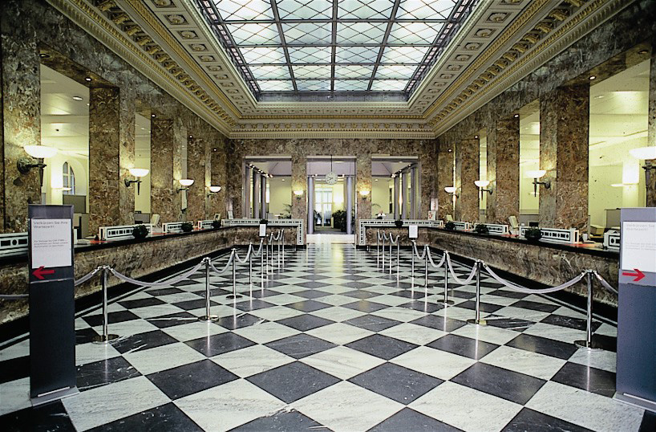
ACCESS
Banks

Slide 12
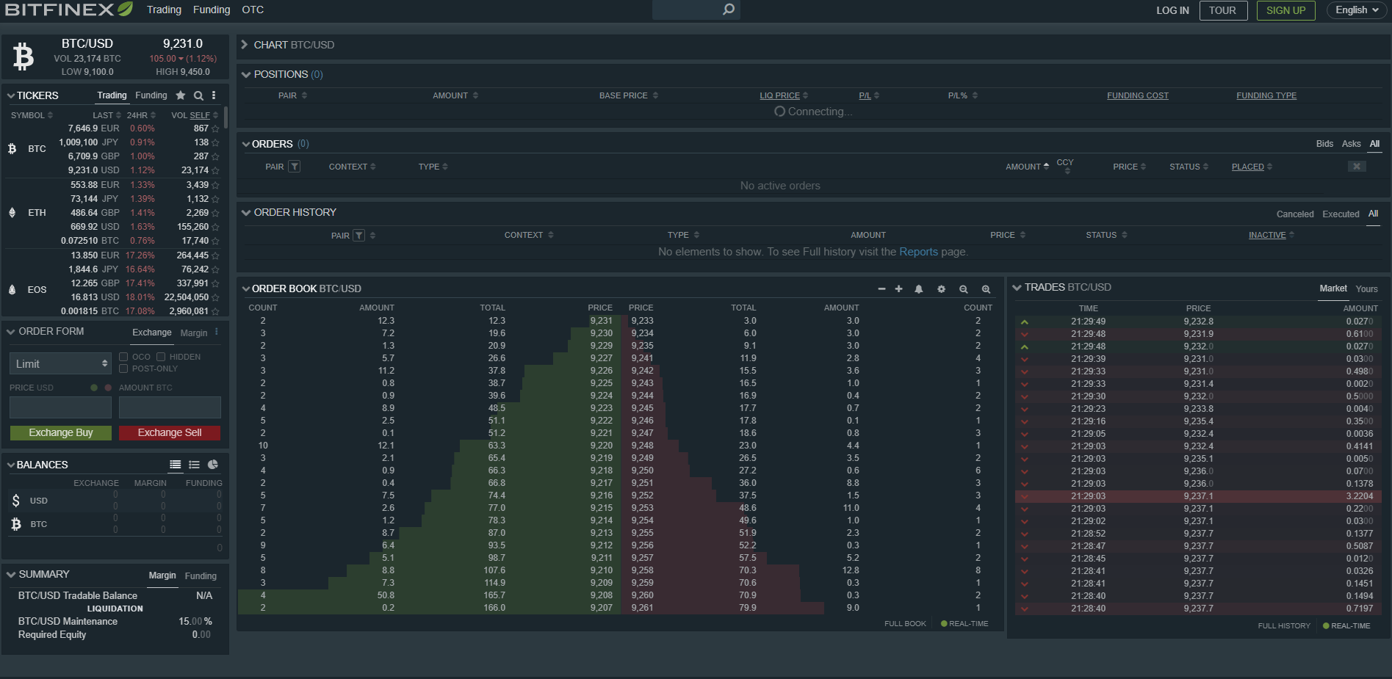
ACCESS
This year, in the first quarter of 2018, Deutsche Bank, Germany’s biggest bank and one of Europe’s leading financial institutions, recorded a profit of $146 million. Binance, the world’s biggest cryptocurrency exchange, recorded a profit of $200 million.
A startup with 200 employees beat out a banking giant with 100,000 employees.

Slide 13

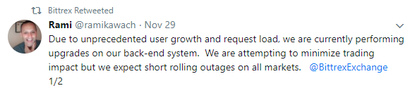
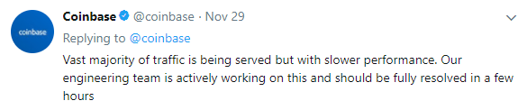
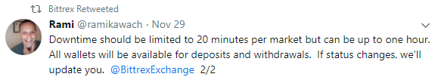


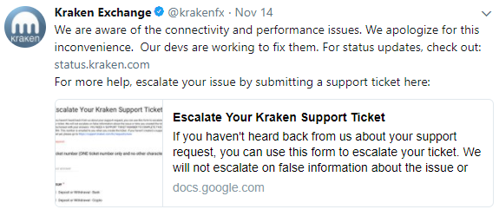



UNSTABLE CRYPTO EXCHANGES
However, some added more than 100’000 new investors daily.

Slide 14
REGULATIONS
Traditional Asset Class
Crypto Asset Class
Dodd–Frank Wall Street Reform and Consumer Protection Act (DFA)
European Markets and Infrastructure Regulation (EMIR)
Markets in Financial Instruments Directive (MiFID)
Payment Services Directive (PSD2)
General Data Protection Regulation (GDPR)
(KYC / AML)
?
?
?
?

Slide 15
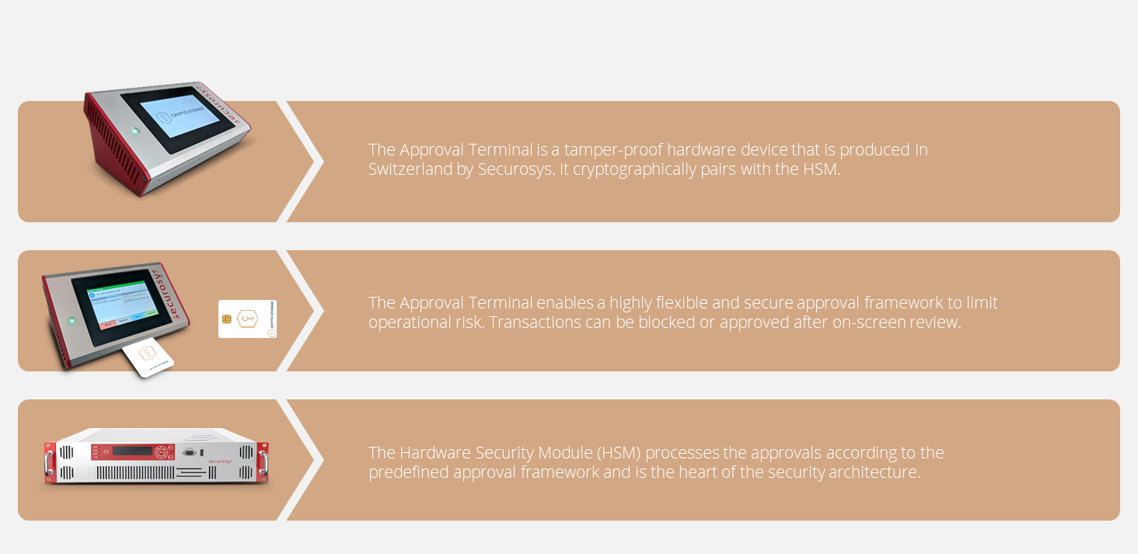
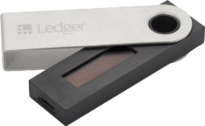



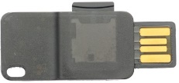


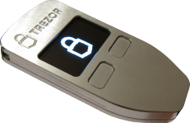

CUSTODY
Traditional Custody
Crypto Custody

Slide 16

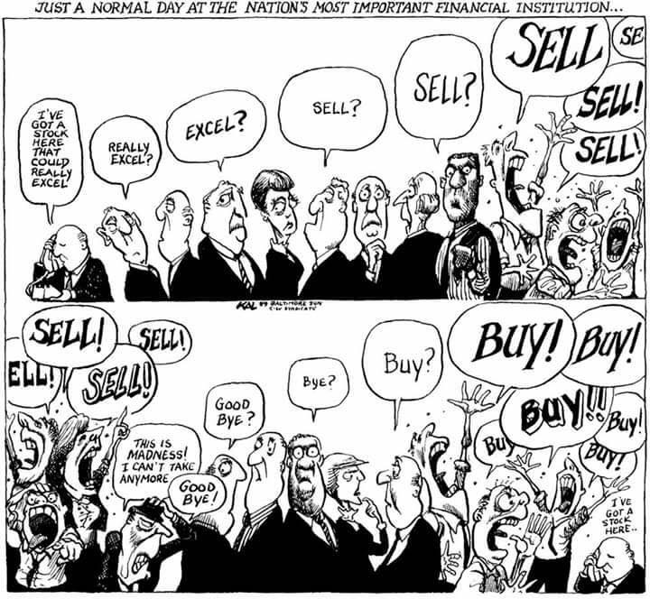
MARKET PARTICIPANTS
Institutional Investors
Retail Investors

Slide 17
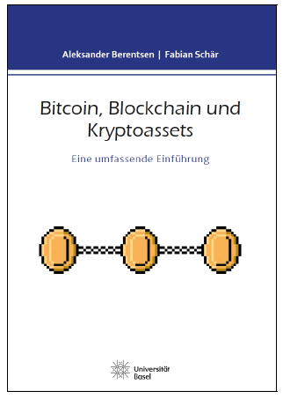
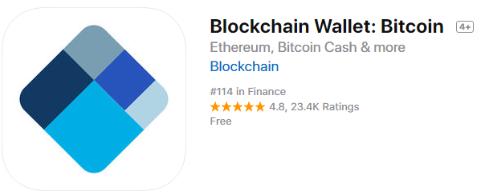
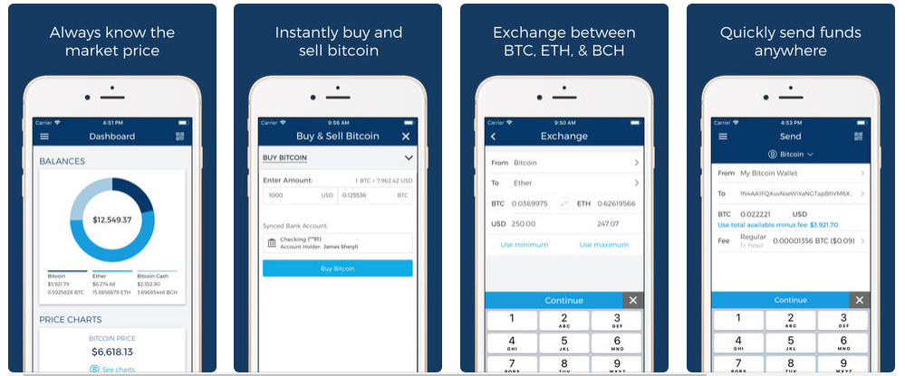
Do you want to dive further into this technology?
Bitcoins for free

Slide 18
DO
YOU HAVE
QUESTIONS?
Intrigued or would like to gain a deeper understanding regarding this emerging asset class, please feel free to reach us directly at the email displayed. You can also sign up for our newsletter on our webpage and follow us on social media for the latest news.

Slide 19
APPENDIX

Slide 20





YOUR CRYPTO INVESTMENT MANAGER
PRODUCT
SERVICE
INFRASTRUCTURE
Crypto Fund AG offers passive and active investment vehicles available for institutional and qualified investors
The Funds add diversification to a financial portfolio due to the fact that the broad crypto asset market is largely decoupled, and exhibits low correlations ⁽¹⁾ compared to traditional asset classes such as equities, fixed income, currencies and gold.
PASSIVE PRODUCTS
ACTIVE PRODUCT
The passive vehicles track the performance of the Crypto Market Index 10 ⁽²⁾ (the “Index” or the “CMI10”), which is calculated and maintained by the SIX Swiss Exchange AG. In line with the Index, the Funds are rebalanced quarterly and contain up to 10 crypto assets based on a rulebook process available online at SIX. The assets are weighted according to their market capitalization.
The Fund pursues a systematic, quantitative approach based on market prices of crypto assets. Investment decisions are made by means of generic, algorithmic filter analysis, which reduces the volatility of daily prices. The trend following strategies are stabilized by further quantitative methods. The model includes a variety of different technical methods, such as trend following and mean reversion.
Maximize returns, regardless of the overall market performance of crypto assets
Fully automated algorithm without subjective inputs from portfolio managers
Become the prevailing market benchmark
Investable vehicle for this asset class
Latest Indicative CMI10 Constituent Weights ⁽³⁾
CTA Market Size & Fund Attractiveness
CTA INDUSTRY AuM ⁽³⁾⁽⁴⁾
Considering the maturity level of the crypto asset space, this emerging asset class is affected by market inefficiencies.
Crypto Fund AG takes profit from such inefficiencies with an active product.
In billions US$
355
Be exposed to an investment manager that seeks a superior risk-adjusted performance.
5
1988
2017
Notes: (1) “Crypto Asset Market Overview” slide; (2) The objective of the Crypto Market Index 10 is to reliably measure the performance of up to 10 crypto assets based on a rulebook selection process available at the SIX Swiss Exchange website (open PDF); (3) CTA Industry Assets Under Management; and (4) Managed Futures AUM 1988-2018.
20

Slide 21






PRODUCT
SERVICE
INFRASTRUCTURE
CRYPTO BROKER AG YOUR CRYPTO ASSET TRADING & LIQUIDITY PROVIDER
Crypto Broker AG is a VQF regulated financial intermediary offering qualified investors a professional access to the crypto asset market. The trading infrastructure was developed and is maintained by a specialized team of trading, crypto and IT experts. The core-banking platform provides access to the worlds’ leading exchanges via a smart-algorithmic order management system.
Client orders can be placed via approved online channels, phone or via the automated order routing platform CAT (Crypto Asset Trader) providing in-time RFQ (request for quote) pricing. Automatic generation of tailor-made balance and trade reports are provided, based on client needs.
The purchased crypto assets can be either stored securely with Crypto Broker AG, or send immediately to the client’s wallet of choice.
PRIME BROKERAGE
^{Core Banking}
^{Bitstamp}
^{BANKS}
^{Bitfinex}
^{Order Capturing}
^{Report Engine}
^{Kraken}
^{INSTITU-TIONALS}
^{CRM DB}
^{Monitoring}
^{Quoinex}
^{Bitflyer}
^{Accounting}
^{Coinfloor}
^{HNWIs}
^{Binance}
^{FIAT/CRYPTO MANAGEMENT}
^{Coinbase Pro}
^{ICOs}
^{STORAGE}
^{OKEX}
^{CORRESPONDENT BANKS}
^{Zaif}
Daily Liquidity
Transparency
Convenience
Crypto Broker AG is highly liquid and provides in-time order execution.
Every fee, including exchange and brokerage fees, is disclosed, providing a maximum degree of transparency.
Using an aggregator simplifies investments into crypto assets. No onboarding for investors on several exchanges is needed.
Technology
Self-regulated Manager
Reliability
The highly developed trading infrastructure provides efficient access to the worlds’ leading crypto asset exchanges managed by an experienced trading and banking team.
Crypto Broker AG is a member of the VQF – a self-regulatory organization (SRO) in Switzerland, ensuring KYC and AML compliance.
Crypto Broker AG offers best execution principals aligned to MIFID II standards.

Slide 22
PRODUCT
SERVICE
INFRASTRUCTURE
CRYPTO STORAGE AG YOUR CRYPTO ASSETS SECURITY PROVIDER
Crypto Storage AG will allow for highly configurable access to your crypto assets with institutional-grade access control rules. The private keys never leave the hardware security module (HSM) and the HSM's right to sign a transaction is determined through approval from a configurable quorum within your institution and executed on tamper-proof approval clients.
The solution is highly adjustable to your internal processes and roles, while maintaining high security behind several layers of hardware protection.
We offer a unique security infrastructure that enables through distinct hardware, a secure governance framework and therefore lowers the operational risk for our clients substantially. The solution allows for a very flexible and multilayer approval framework that caters the corporate governance needs of small and mid-size entities as well as large corporates that operate in different locations across the globe.
Multitude of Crypto Assets
Swiss Engineering
Access Management
Crypto Storage AG supports 59 out of the top 100 market cap of crypto assets e.g. Bitcoin, Bitcoin Cash, Ripple, Litecoin, Ether, Ether Classic, Feathercoin, Stellar and all ERC 20 tokens.
The Hardware Security Module (HSM), the tamper-proof signing devices, as well as the tailored software solution are all developed by leading Swiss providers with vast experience in finance and IT-security.
The Storage Infrastructure is secured, both physically and digitally based on a high performance security architecture concept.
Insurance
Flexible Rule-Engine
Secure Approval Terminals
The technical infrastructure at Crypto Storage AG is insured and covers part of the client assets.
m of N multiple signers, a quorum of signers from several different groups, time delays that allow for a veto-period, are all supported natively.
The approval terminal hardware devices themselves adhere to a much higher security standard than the signing devices customary for crypto assets.
Cryptos
Reliability
Crypto Storage AGs in-house crypto asset expertise through Crypto Finance AG allows a strategically focused development to support new assets continuously.
Crypto Storage AG does not have any access to your crypto assets.

