Slide 1
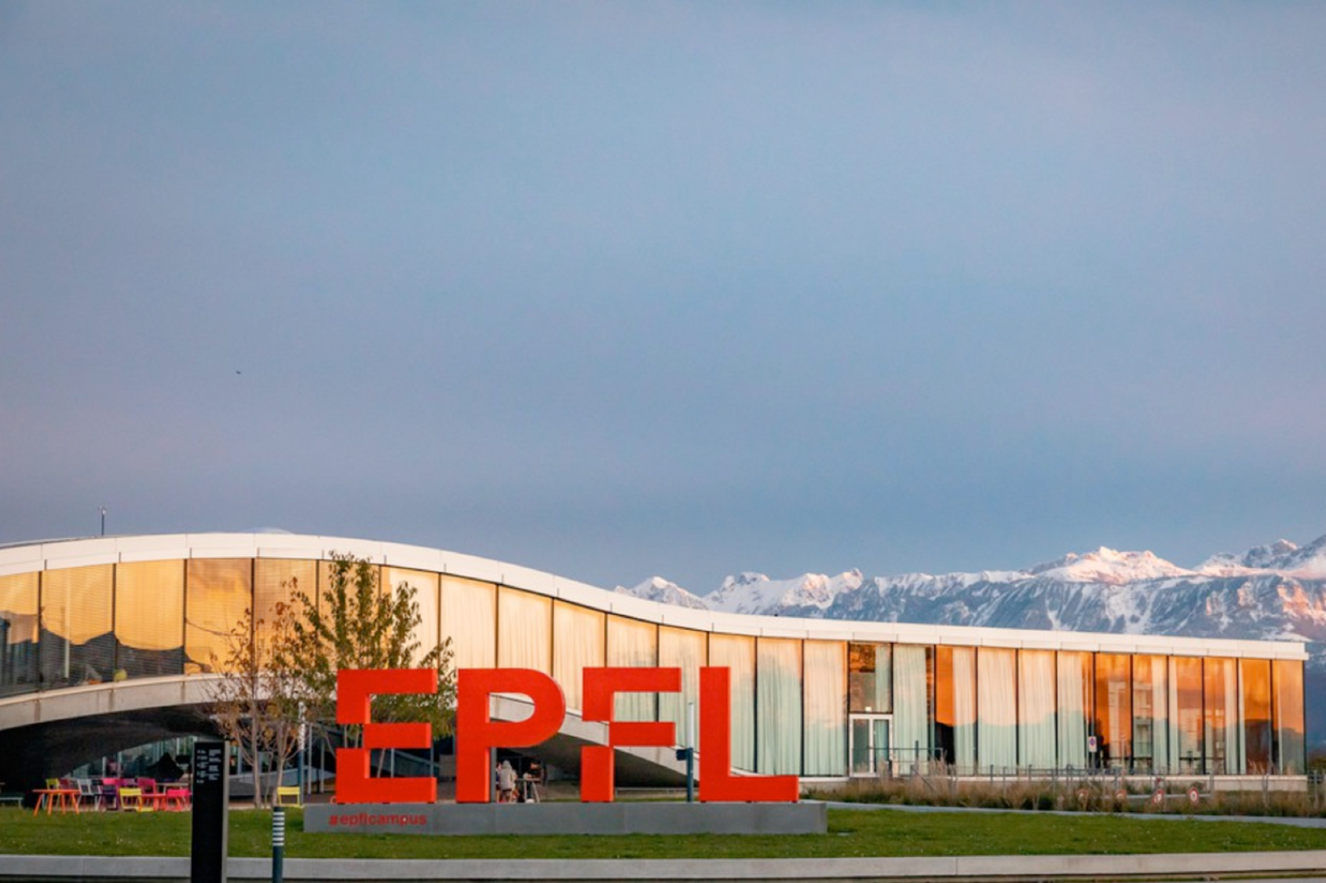




Slide 2
Our vision
„
We believe that science and technology allow us to understand our world
and contribute to make it better.
We inspire and guide future generations of leaders in order
to develop tangible solutions to shape a better world for all together.
This is achieved through promoting, sharing and transferring knowledge,
by training responsible leaders in technology and by developing
and supporting meaningful innovation.“

Slide 3
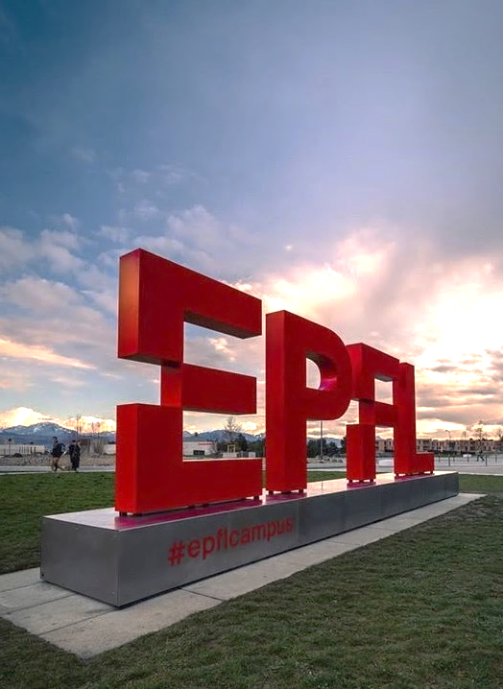





EPFL at glance
12’576
Students
366
Professors
20%
are women
+6’400
Employees (incl. Phd)
+130
Nationalities
Figures : 2022

Slide 4
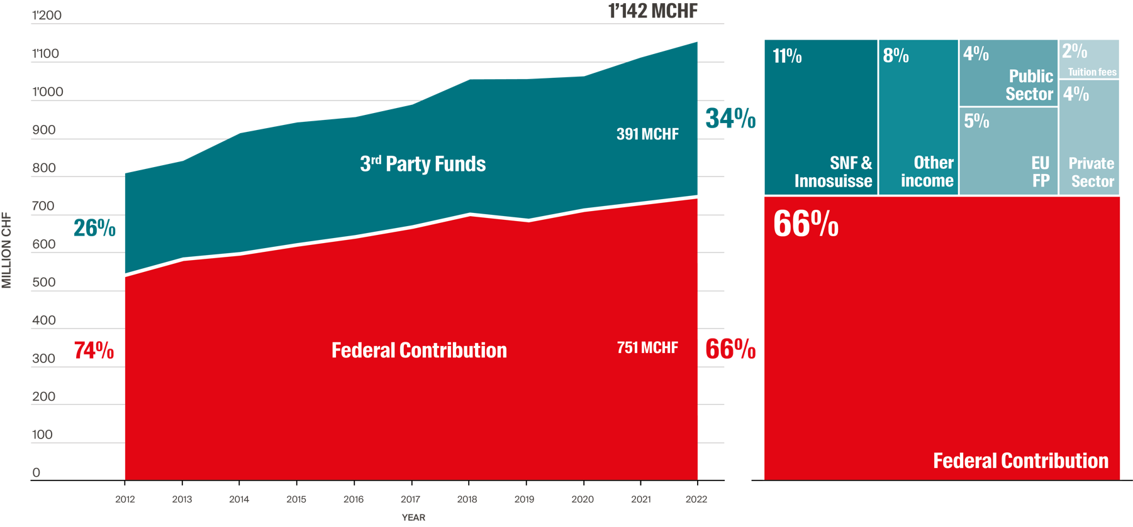
Funding 2022
66 % Federal contributions – 33% Third party funds

Slide 5
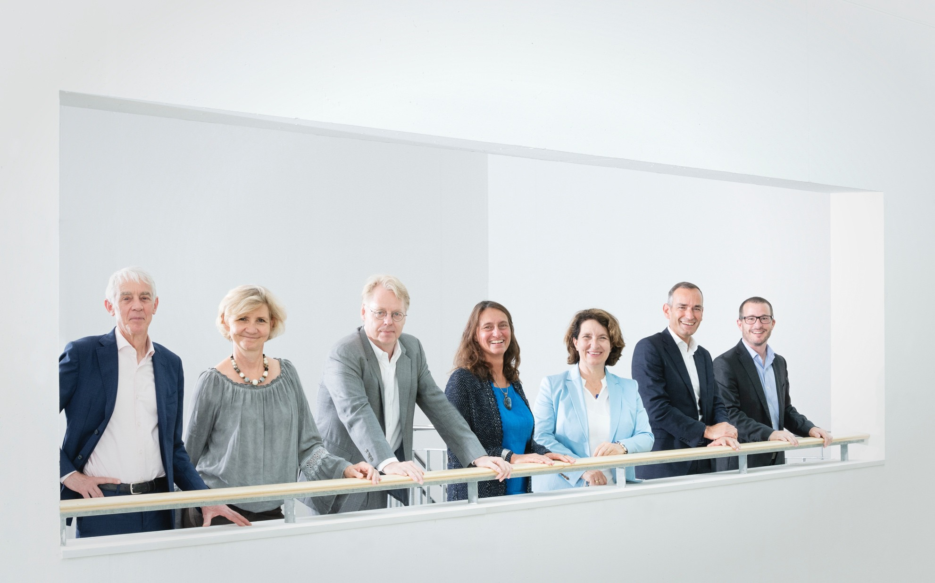

EPFL Management Team
6
Gisou van der Goot Vice-présidente pour la transformation responsable (VPT)
Martin Vetterli
Président de l’EPFL
Matthias Gäumann Vice-président
opérations (VPO)
Ursula Oesterle Vice-présidente pour l’innovation (VPI)
Tristan Maillard
Secrétaire Général
Françoise Bommensatt Vice-présidente pour les finances (VPF)
Jan S. Hesthaven Vice-président académique (VPA)

Slide 6







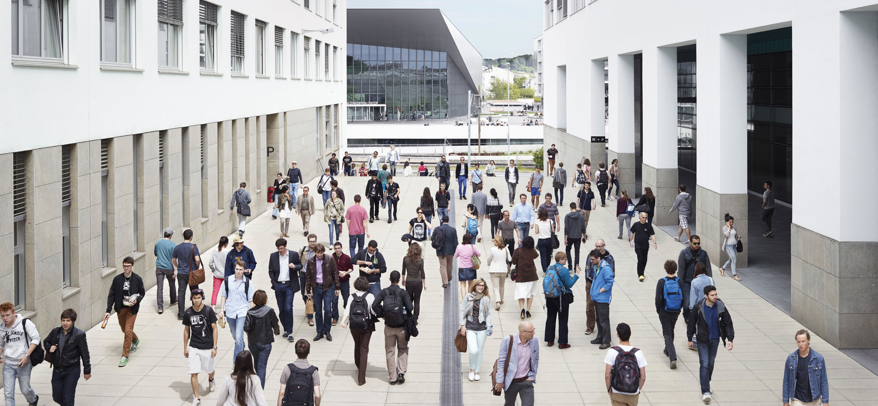
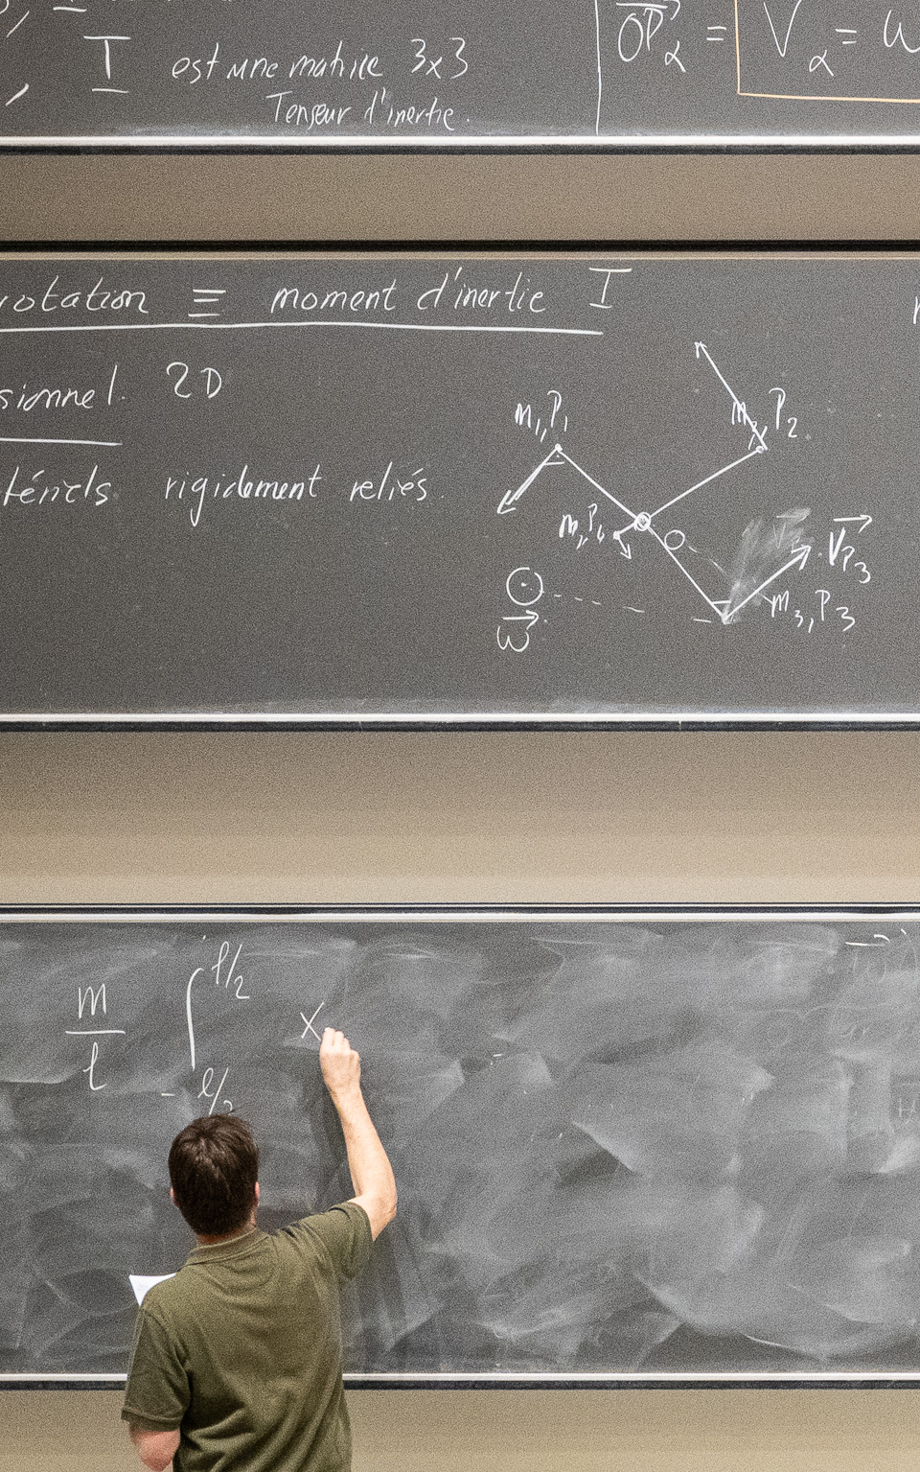

5 Schools and 2 Colleges
From Architecture, to Mathematics, to Chemistry, Life Sciences and Computer Science
School of Computer and Communication Sciences
School of Engineering
College of Management of Technology
School of Architecture, Civil and Environmental Engineering
School of Basic Sciences
School of Life Sciences
College of Humanities

Slide 7

Associated campuses in 4 cantons
Neuchâtel – Microcity
Microengineering and nanotechnologies; Advanced micro-manufacturing
Fribourg – Smart Living Lab
Building technology and sustainable architecture
Sion – Energypolis campus
Industrial energy / green chemistry; Environmental engineering; Biotechnology / bioengineering
Geneva – Campus Biotech
Bio- and neuroengineering (Wyss Center);
Blue Brain Project / Neuro-X Institute

Slide 8
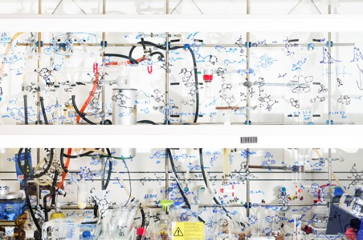


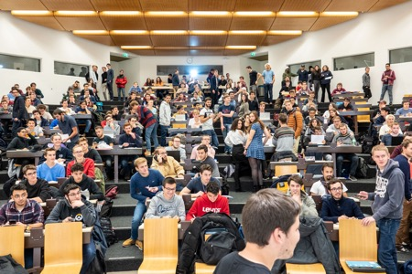


EPFL’s three missions according to the Federal Act
Education
Innovation
Research

Slide 9
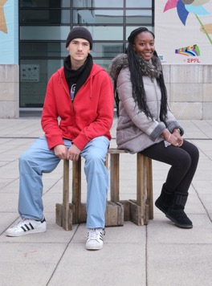
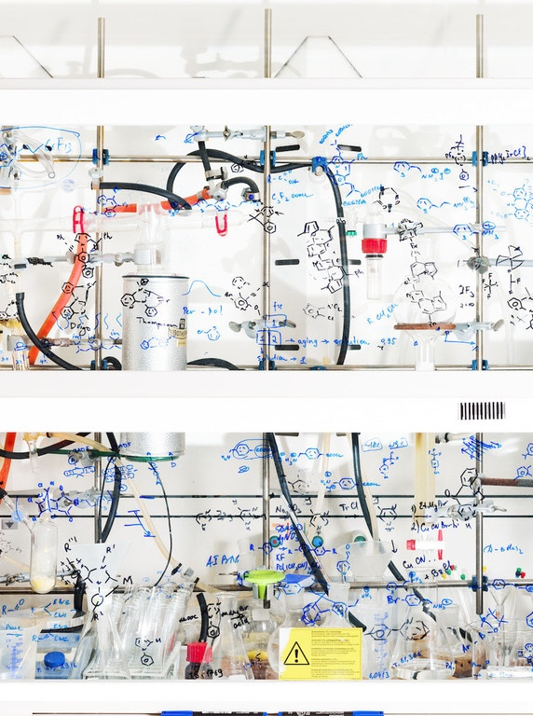
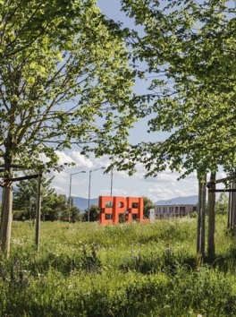
Three focus areas – Five priorities
COMMUNITY
SCIENCE
CLIMATE
Mission:
Further develop an inclusive and open culture at EPFL at all levels
Priority:
EPFL Culture
Mission:
Further establish EPFL as a leader in key strategic fields
Priority:
Fundamental Sciences
AI revolution
Health Sciences & Technology
Mission:
Address sustainability and climate crisis using our core strengths
Priority:
Solutions4Sustainability
Notes:
3 focus area -> 5 priorities
Rational:
Building on our strengths / momentum
Achievable
Taking our responsibilities as public institution towards society and the challenges it faces

Slide 10

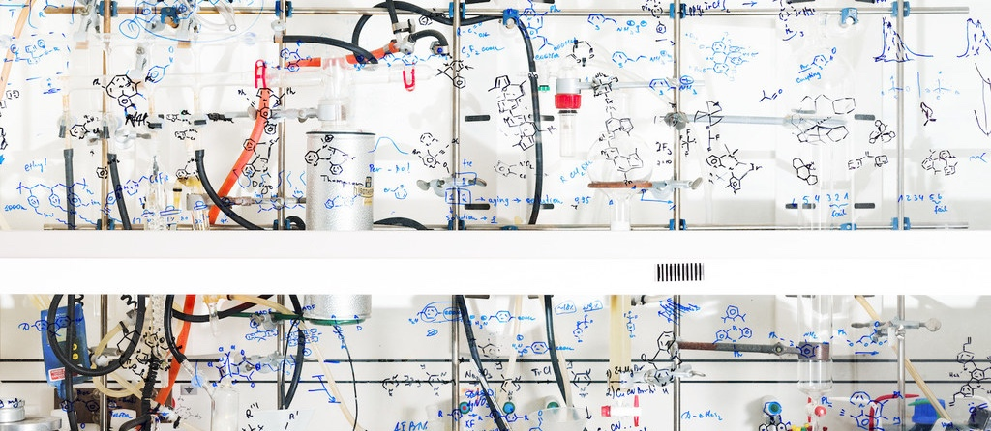
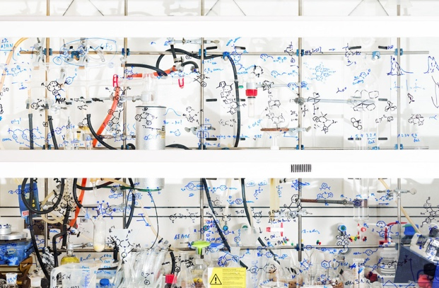
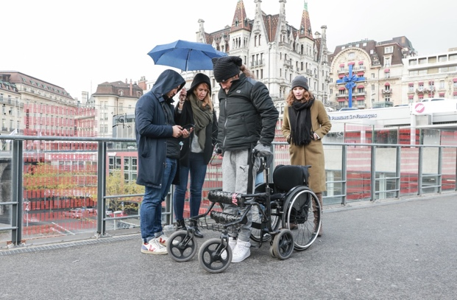
Further establish EPFL as a leader in key strategic fields
Strengthening
Fundamental Sciences
Achieving
the Potential of
Health Science
and Technology
Realizing the
AI Revolution

Slide 11
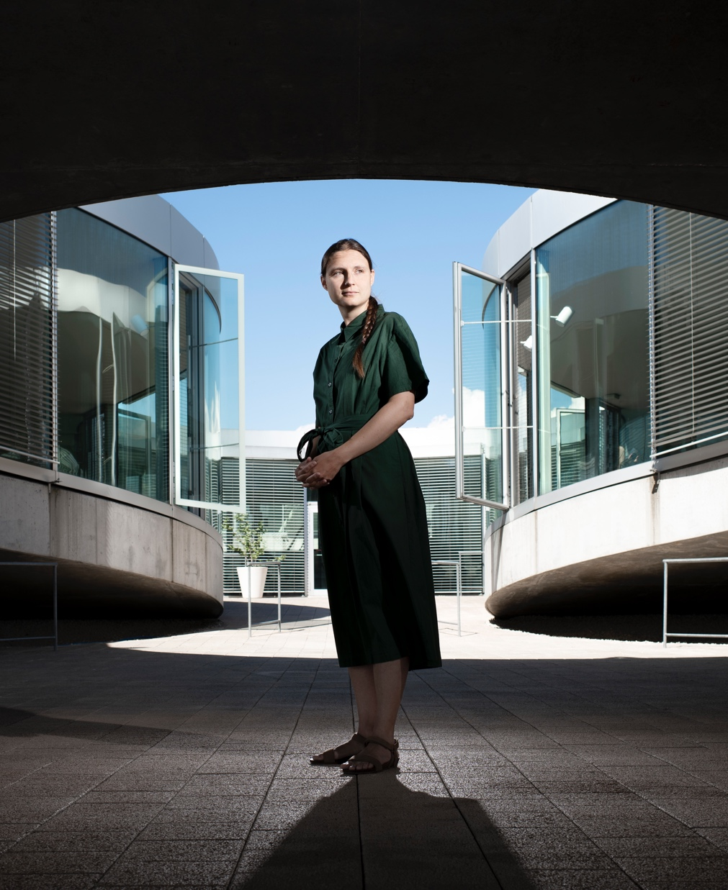
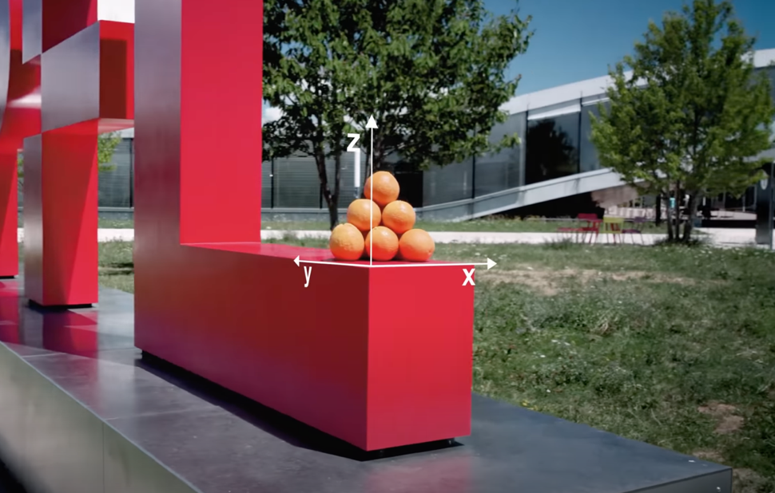
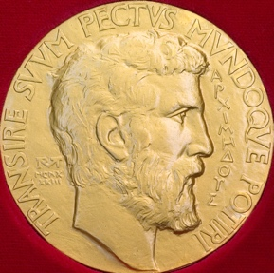

Maryna Viazovska has received a Fields Medal 2022
Notes:
EPFL had grown in reputation over the last years
With a major prize, we are playing in first league
for a yound university, this was not obvious
I would like to thank Maryna in the name of EPFL and in my name to allows us to play in the first league!

Slide 12

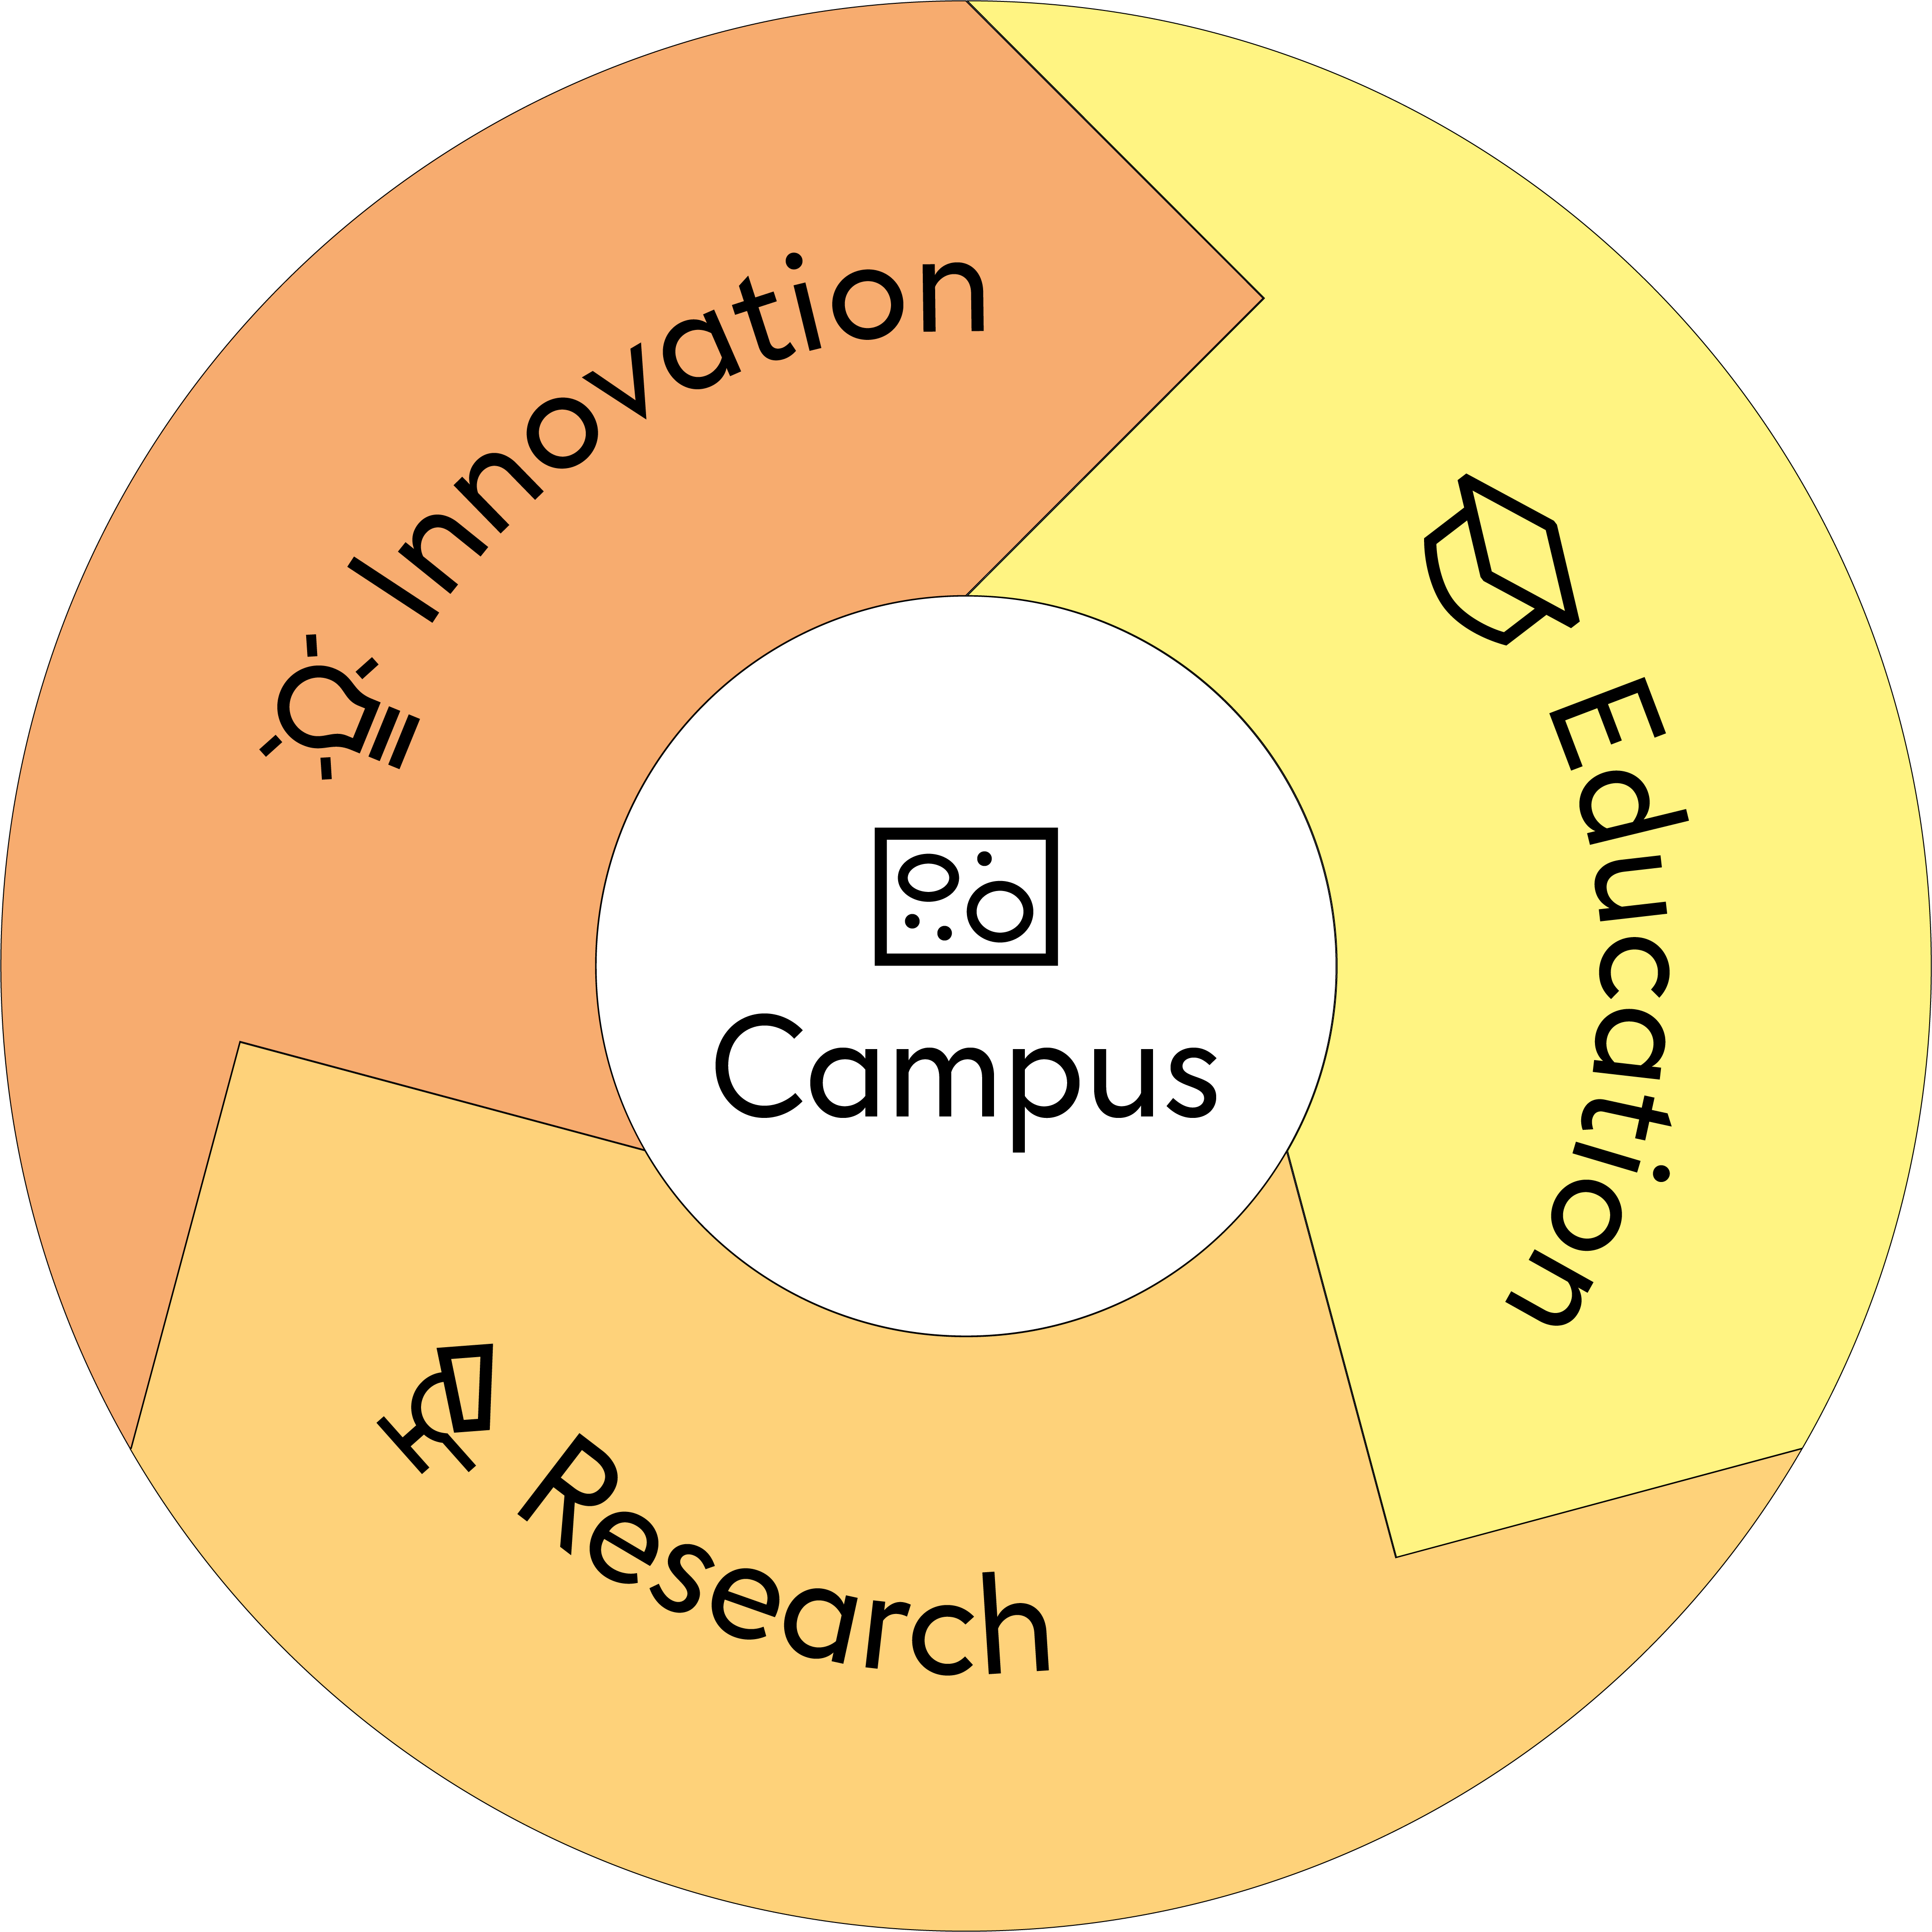
2030 Climate & Sustainability strategy
go.epfl.ch/sustainability_strategy
Interconnection between education, research, innovation and campus
operations
Released on February 23, 2023

Slide 13
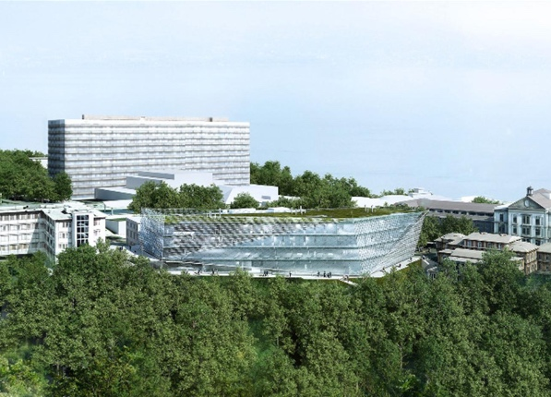
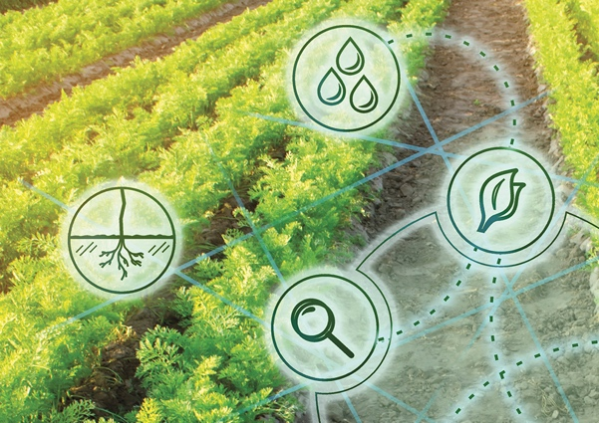


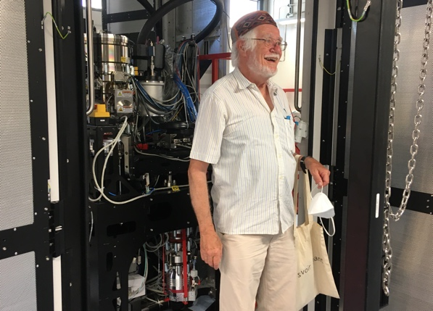

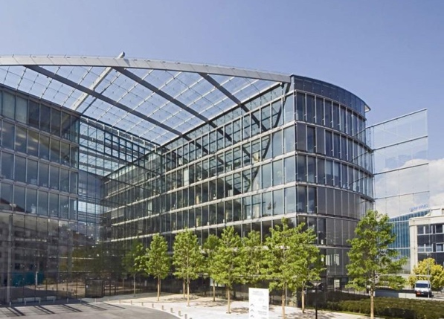











Dynamism through strengthened collaborations
Dubochet Center
for Imaging (DCI)

Slide 14
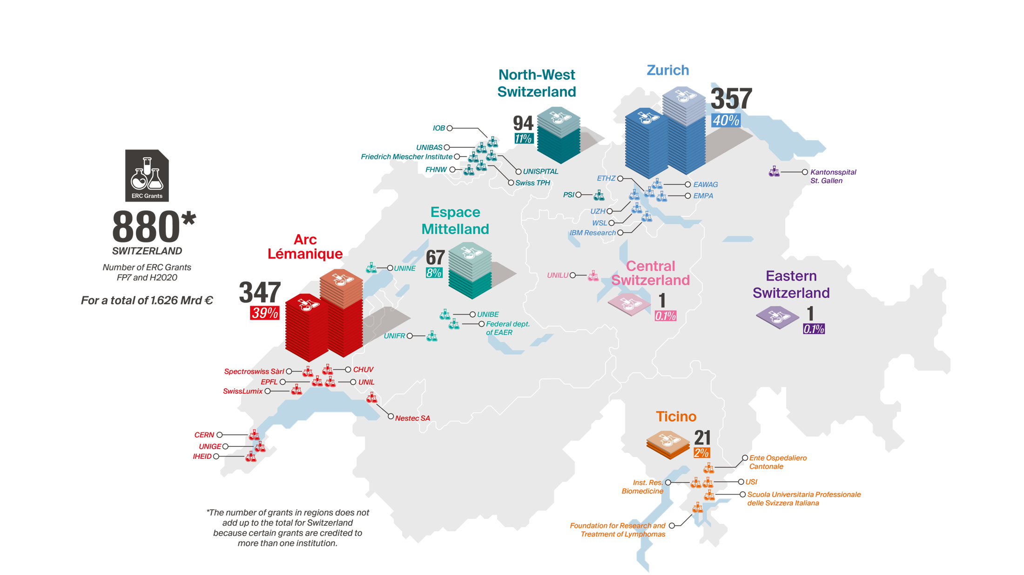

The Rise of Arc Lémanique
ERC (all signed ERC grants until 19/12/2022)
Source: Datahub of ERC funded projects
erc.easme-web.eu
Notes:
Period 2007 - now
ERC Arc lemanique impact at Zurich level of 350MCHF
All numbers based on host institution at time of application

Slide 15
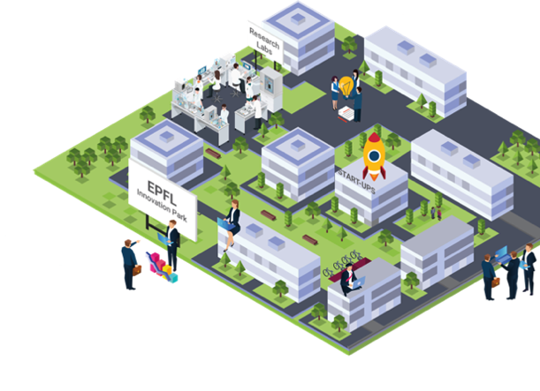



















EPFL Innovation Park
A rich variety of industries
INFORMATION TECHNOLOGY - FINANCE - COMPUTING
HEALTH - NUTRITION
And a community of
2’800 people
150 start-ups
20 service providers
ENGINEERING - TRANSPORT - ENERGY

Slide 16
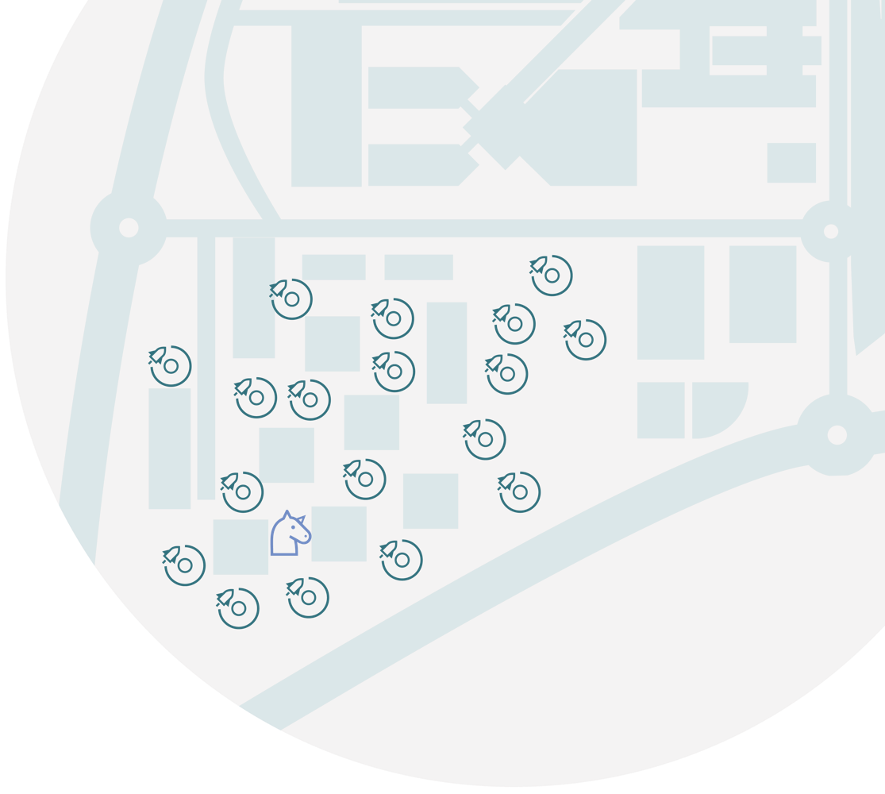





Innovation in 2022
100%
OCCUPANCY RATE AT EPFL INNOVATION PARK
21
NEW START-UPS CREATED in 2022
95
PATENTS FILED
457.5
MCHF RAISED BY
EPFL’ START-UPS
43
LICENCES SIGNED
144
INVENTIONS AND SOFTWARE
24.8
MCHF RAISED FROM INDUSTRIAL CONTRACTS (DIRECT FUNDING)
9.9
MCHF RAISED FROM INNOSUISSE PROJECTS

Slide 17
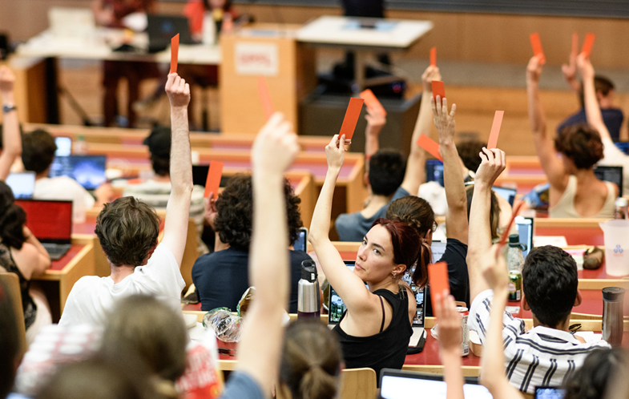
Thank you

Slide 18
Establishing EPFL as a leading school in the 21st century
 | 1993 |  | 2000 | 2001 | 2002 | 2003 |  | 2012 | 2016 | 2017 | 2018 | 2019 | 2020 | 2021
Collaboration
Digitalization
Attracting the best talents
Creating the right conditions
Innovation Park
School of Life Sciences
Extension School
Center LEARN
Dubochet Center for Imaging
Tenure Track System
Computational thinking
Center for Cyber Security**
Center Quantum Science & Engineer.
Doctoral School
Transfer of chemistry, mathematics & physics from UNIL to EPFL
1st MOOC (Programming in Scala)
Swiss Data Science Center (SDSC)*
E4S
Center for Digital Trust (C4DT)
Center for Intelligent Systems (CIS)
*with ETHZ & PSI
**with ETHZ

Slide 19
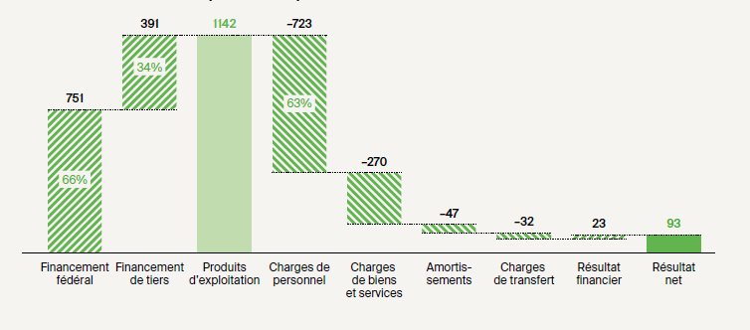
Financial accounting - Key figures
Revenues
Expenditures
Source : EPFL Comptes annuels consolidés 2022

Slide 20
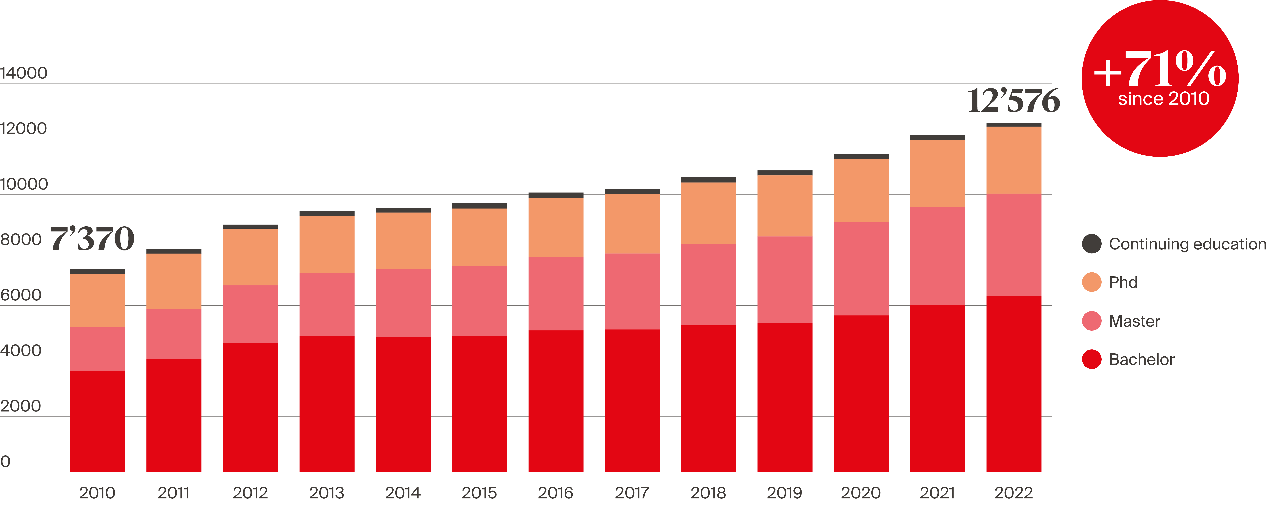
Growth of the EPFL student population
Notes:
Between 2010 and 2022, the bachelor-master population grew from 5’503 to 10’299 (87,2%)

Slide 21

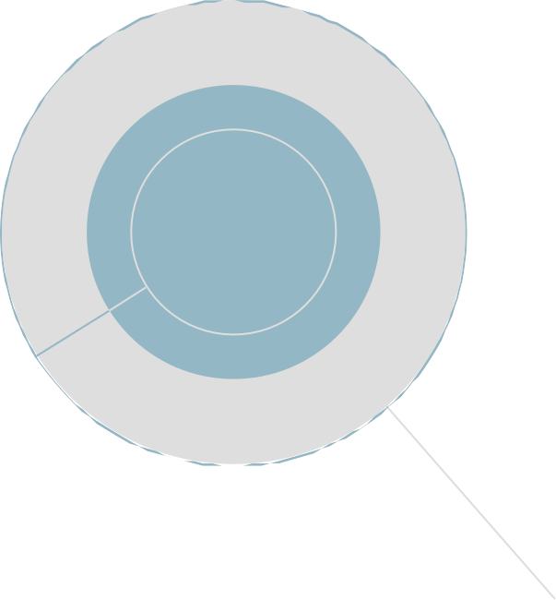



Financement durable grâce à une diversification ciblée
Financement fédéral
751
66%
Financement de base solide assuré par la Confédération
Environnement de plus en plus compétitif
Utilisation des fonds dans le cadre de leur mandat (loi sur les EPF, objectifs stratégiques).
L'assurance qualité rôle essentiel dans l'acquisition et la gestion des fonds de tiers provenant de divers donateurs.
Les projets de financement de la recherche sont de loin la composante la plus importante des fonds de tiers
Croissance des dons et des legs .
REVENU TOTAL ET COMPOSITION (EPFL, 2022)
En mio CHF,
(consolidé selon IPSAS)
1’142
Revenu total
34%
391
Fonds de tiers
7%
25%
3%
77
Revenus propres
283
Fonds de recherche
31
Dons et legs*
Recherche axée
sur l’économie
125
59
51
48
Fonds National de la recherche, Innosuisse et autres mandats de la Confédération
Programmes
cadres de recherche européens
Fonds de tiers liés à des projets
19 57
Taxes d’études, formation continue
Autres revenus*
* y compris les revenus des entités associées

Slide 22
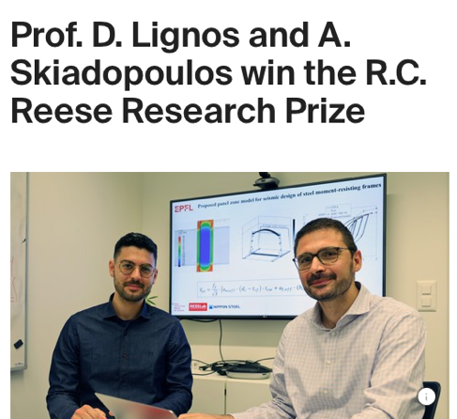



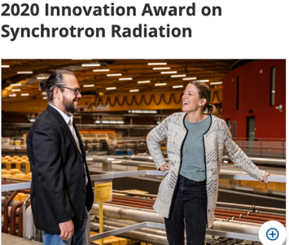
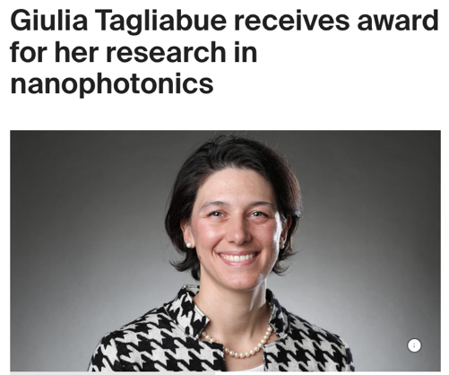




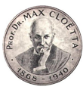



Striking achievements
Prof. Marianne Liebi
Prof. Kumar Varoon Agrawal
Prof. Thomas Rizzo
Prof. Bart Deplancke
Prof. Xile Hu
Prof. Michael Grätzel
Prof. Yimon Aye

Slide 23
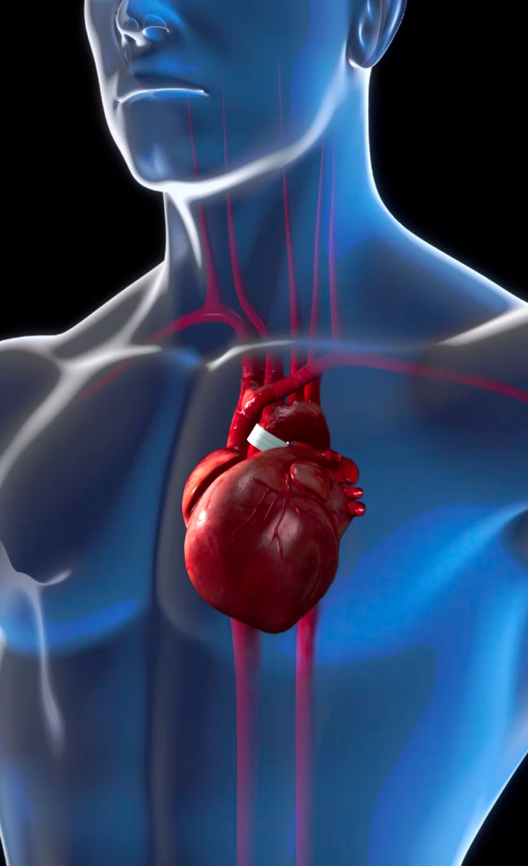
Science
Achieving the Potential of Health Science and Technology
Basic biomedical research
  Molecular and cellular biology, chemistry, -omics, cancer, neuroscience…
Bioengineering
  Microfluidics, imaging, biosensors, organoids, neuro-tech…
AI and data science for medicine
  Digital health, disease modeling, interpretable AI, digital twins…
Environmental surveillance and public health
  Wastewater surveillance, air pollution, healthy cities…
Notes:
Research in Health Science

