Slide 1


The Enterprise for Society Center –
Towards a sustainable, resilient and inclusive economy
May 2023
Prof. Jean-Pierre Danthine
Honorary Director

Slide 2
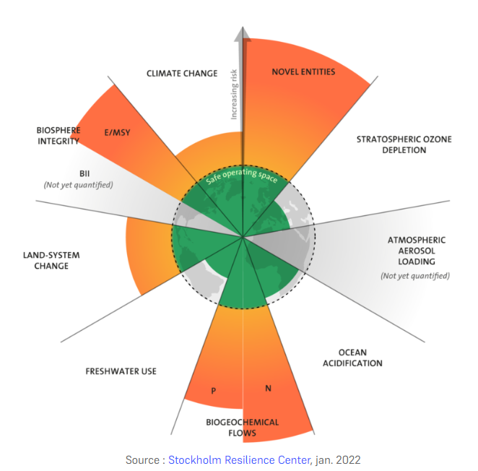
Addressing pressing challenges and embracing the opportunities
Learning to live within planetary boundaries: Green
Learning to prevent global systemic shocks: Resilient
Countering deeply negative structural trends that undermine support for our economic system and social cohesion: Inclusive
Harnessing the power of technology
despite growing mistrust of science and the disruptive and ethically problematic dimension of some recent and upcoming developments: consciously innovative

Slide 3

“Mea Culpa”: Academic institutions have to better assume their responsibility
The mission of academic institutions also requires focusing on today’s most pressing issues
Using the unique skill-set concentrated around the Lake Geneva region to guide business and society in this critical moment
UNIL, IMD and EPFL together:
The size of the challenge justifies it
Strengths are complementary
The whole is greater than the sum of the parts
In a start-up spirit = E4S
EPFL
UNIL
IMD

Slide 4

Our Mission
To inspire and activate the transition to a resilient and inclusive economy within planetary boundaries, mindful of the opportunities and challenges raised by scientific and technological change.

Slide 5
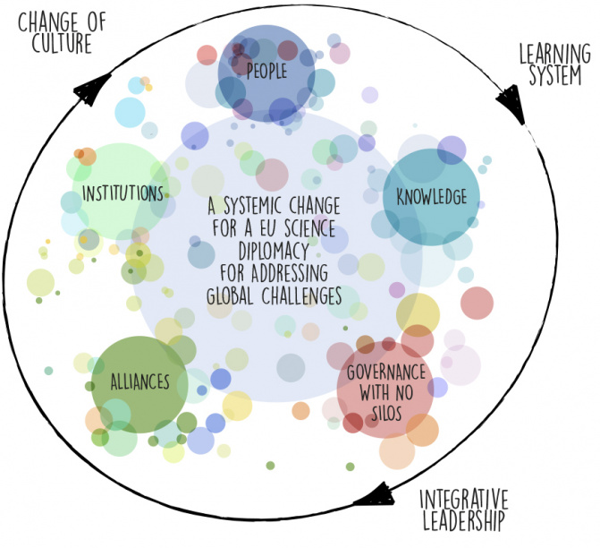
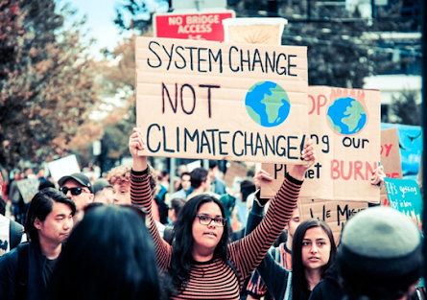
“Not an ivory tower project”
We are heading for radical changes and systemic transformation
For which we need a coalition of actors
An increased footprint of the collective/the state:
  The size and the ubiquity of externalities mean the “invisible hand” does not suffice.
  Technology and globalization have increased the need for redistribution
The challenge: not more state but “mieux d’état”
To avoid catastrophic pitfalls, the transition shall:
be guided by private sector knowledge (do not repeat the mistakes of the post-2008 financial regulation)
be completed / modulated, in a spirit of self-regulation, by a reform of the business world: towards a world of "corporations with purpose."
Source/credit: S4D4C.EU

Slide 6




Training the next generation of leaders, inspiring economic and social transformation, and activating change by strengthening start-ups and driving innovation.
Education
Research
Innovation
We train the next generation of leaders to integrate environmental and societal concerns into their business models while resolutely exploiting the promises of new technologies.
> Master in Sustainable Management and Technology
We inspire economic and social transformation by producing, collecting and disseminating frontier research and science-backed evidence, with a view of helping enterprises and society develop practices, strategies and policies consistent with rising to the “grand challenges”.
> Centre of interdisciplinary excellence
We activate change by leveraging science and technology for societal impact, strengthening the local innovation ecosystem, and establishing a collaborative network between start-ups, SME, large corporations and students.

Slide 7
Education
New, two-year Master in Sustainable Management & Technology (SMT)
Objective: to train the next generation of entrepreneurs and intra-entrepreneurs to conduct business for the benefit of their organization, the environment and society in general.
⇢ combine better economic governance with thoughtful and innovative technology
Main axes:
Technological → data science and latest technological developments
Analytical economics & management → reconsideration of managerial functions in light of the "big challenges"
"Transferable skills and team projects“
Sustainability imperative: cross-cutting the entire program
Sustainability
Economics & Management
Technology & Innovation

Slide 8
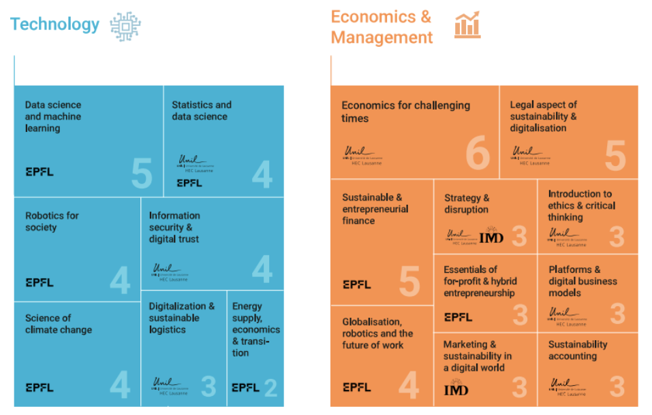

Slide 9
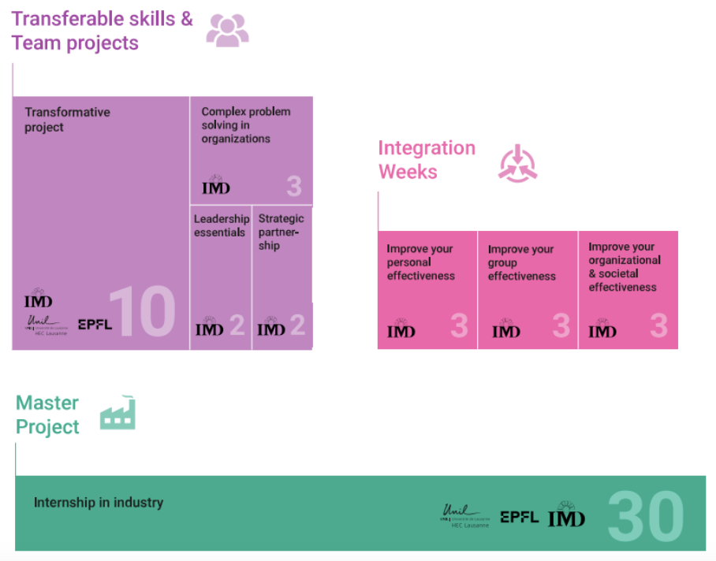

Slide 10
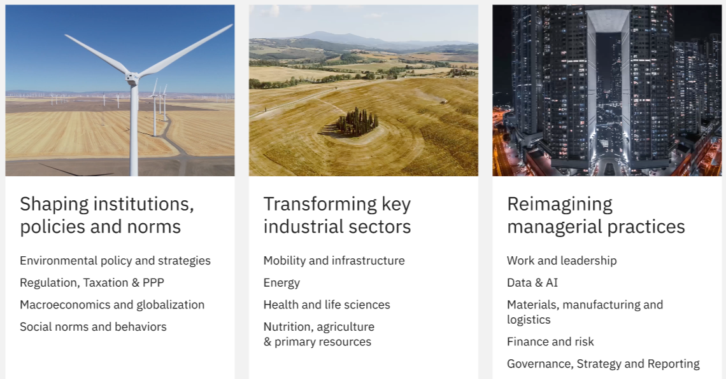
Research focus areas

Slide 11
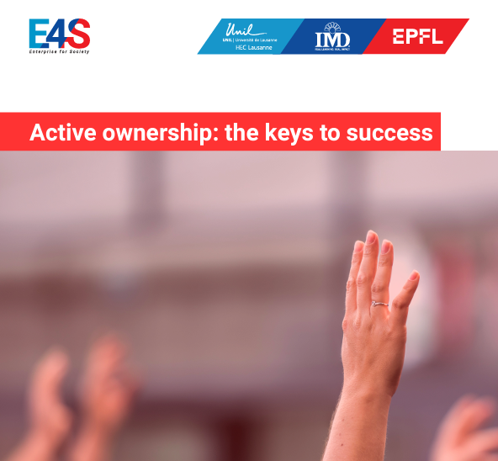
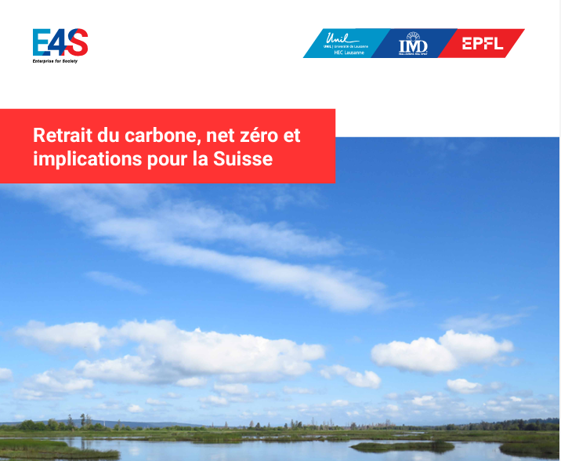
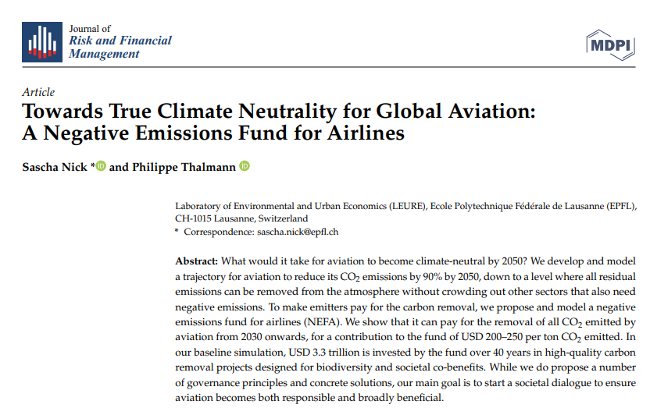


Latest Research (selected publications)

Slide 12
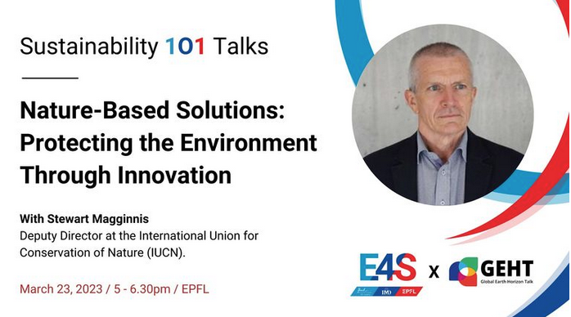
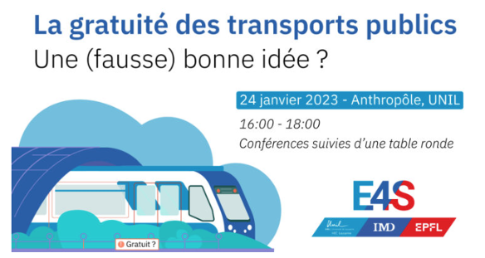
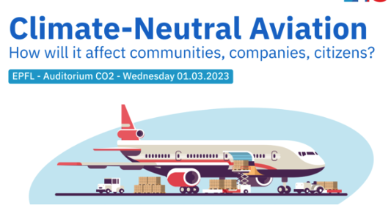
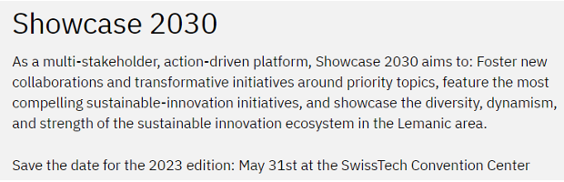

Events & workshops

Slide 13
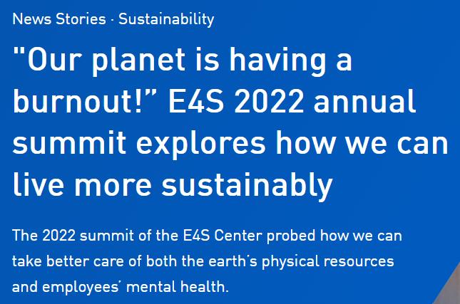
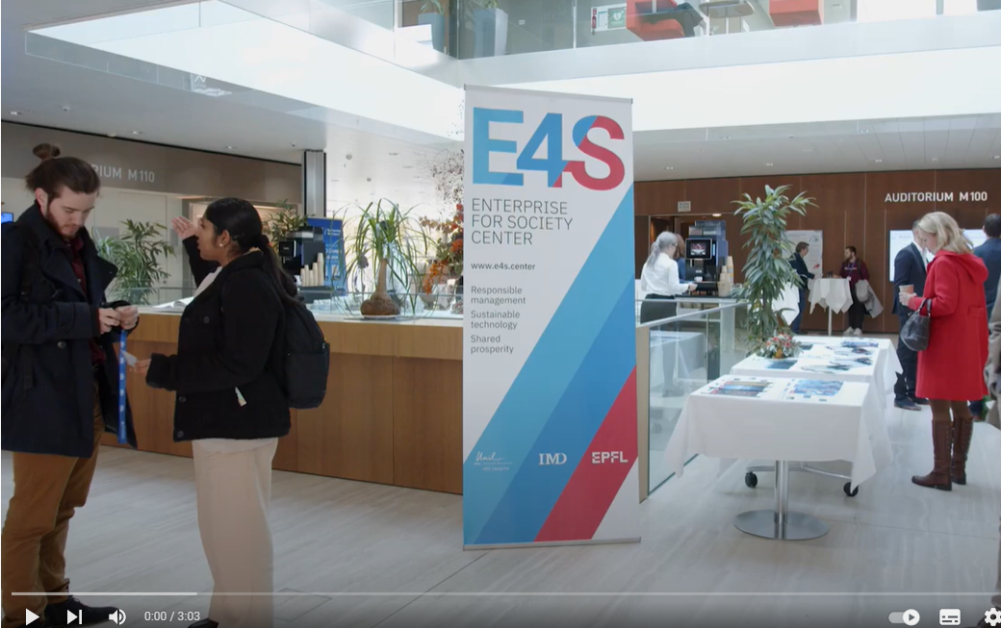
2022 Annual Summit Highlights
Summary report here
Summit highlights video here

Slide 14
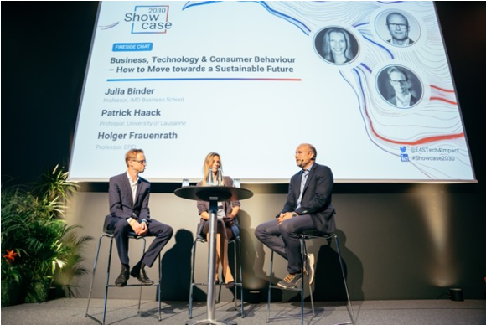
Innovation
Activating change by fostering an ecosystem of sustainable innovation
Translating research into impact
We support the spin-off of high-impact projects from our platforms and institutions
→ Levo Framework
→ Swiss Negative Emisssions Fund (SNEF)
→ Luxury Traceability Index
Notes:
TBD if Add Sust Map, PD

Slide 15
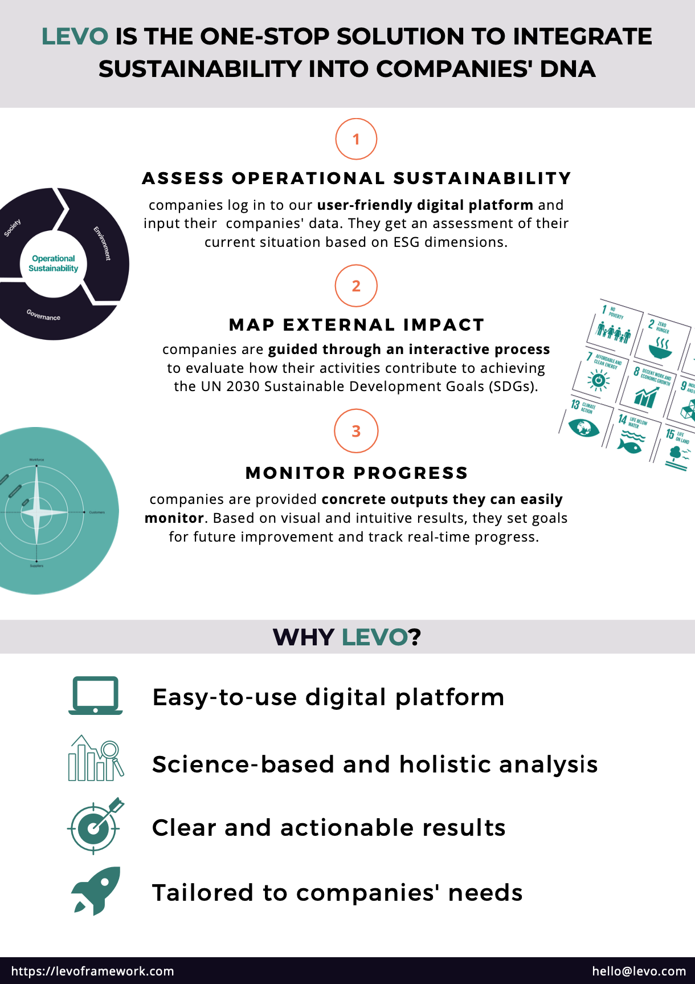
> Levo
Mission:
Levo empowers companies to grow into sustainable businesses
Methodology:
Levo builds on years of research to provide tools and processes to help companies assess, monitor and continuously improve the operational sustainability and external impact of their business
Impact:
Companies get concrete, actionable recommendations to start future-proofing their business

Slide 16


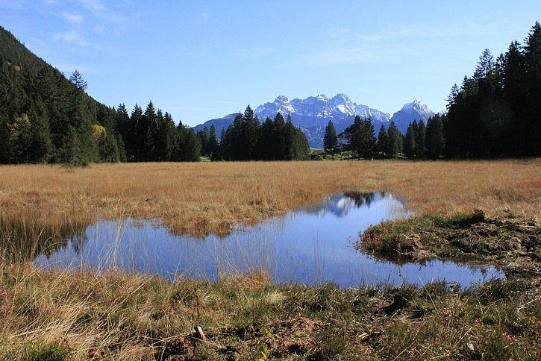

> Swiss Negative Emissions Fund
A fund to build and govern negative emissions for the benefit of society and biodiversity, accelerate deep decarbonization, and reach net zero in a fair, effective and affordable way.
Open to public and private institutions.
Governed by 3 independent panels:
- membership panel to supervise contributions
- asset management panel to supervise placement of funds
- project panel to select negative emission projects and
monitor their impacts
Based on polluter-pay principle.
Voluntary pilot fund covering 1% or Swiss emissions.
Investment in a diversified portfolio of projects
Renaturing wetlands protects biodiversity and creates local jobs
Photo credit: WSL

Slide 17
Innovation
Activating change by fostering an ecosystem of sustainable innovation
Translating research into impact
We support the spin-off of high-impact projects from our platforms and institutions
→ Levo Framework
→ Swiss Negative Emisssions Fund (SNEF)
→ Luxury Traceability Index
Fostering systemic innovation
We engage our interdisciplinary community to address systemic challenges
→ Observatoire Romand de la Décarbonation with Romande Energie
→ Renewable Energy as a Service with BASE
→ Action Labs on Green Bonds & True Cost of Food
Notes:
TBD if Add Sust Map, PD

Slide 18
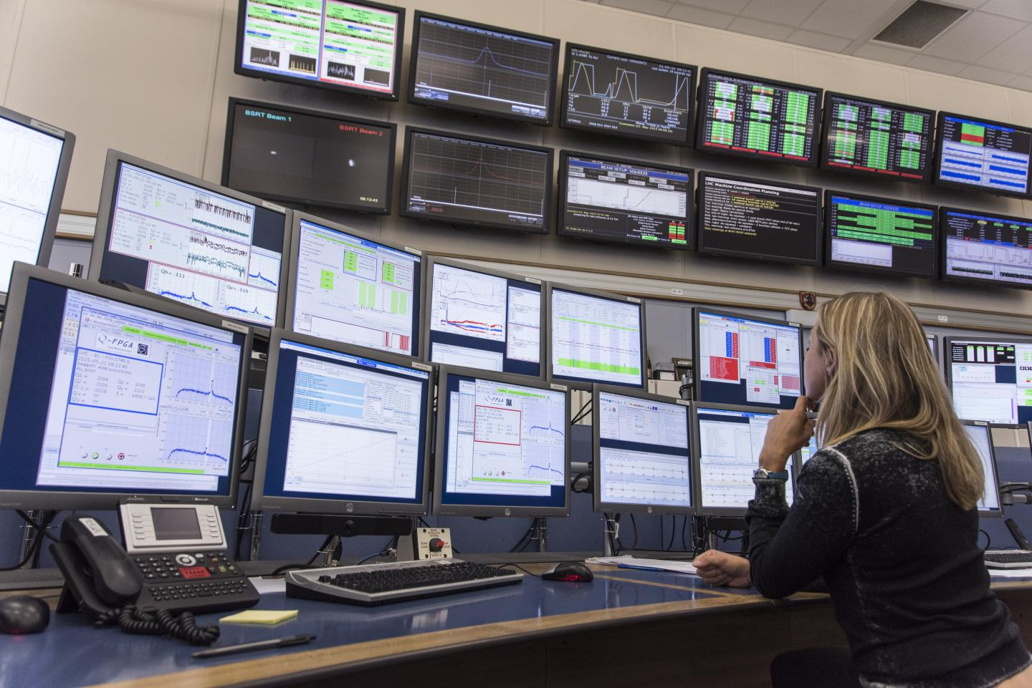
> Observatoire Romand de la Décarbonation
Working Group
Action Lab Workshop (June)
February
2023
June
2024
Stakeholder Engagement
Implementation
& Scaling up
Provides accountability, centralized information and standard-setting
"What's measured improves" [Peter F. Drucker]
Open to public and private institutions.
In collaboration with Romande Energie
"Oil & Gas sector reports ⅓ of their real emissions"
[Al Gore, carbontrace.org, WEF 2023]
A neutral, public resource center for businesses and institutions
- Collects quantitative and qualitative data related to GHG emissions
- Shares standards and best practices

Slide 19

> Renewable Energy as a Service
Accelerating decarbonisation in Switzerland through business model innovation, supporting the government’s objective to reach net-zero by 2050
In collaboration with the Basel Agency for Renewable Energy (BASE), SET Alliance, and Fondation Valery
Design, implement and scale up the model of servitisation in Switzerland, focusing on Renewable Energy (Solar Panels)
Market
Assessment
Stakeholder Engagement
Scaling up
February
2023
June
2024
Design of Mechanims
Implementation
& Testing

Slide 20
Innovation
Activating change by fostering an ecosystem of sustainable innovation
Translating research into impact
We support the spin-off of high-impact projects from our platforms and institutions
→ Levo Framework
→ Swiss Negative Emisssions Fund (SNEF)
→ Luxury Traceability Index
Fostering systemic innovation
We engage our interdisciplinary community to address systemic challenges
→ Observatoire Romand de la Décarbonation with Romande Energie
→ Renewable Energy as a Service with BASE
→ Action Labs on Green Bonds & True Cost of Food
Catalyzing the power of multistakeholder action
We build and strengthen collaboration among actors
→ Showcase 2030 (31 May 2023)
→ Reversed Boards
Notes:
TBD if Add Sust Map, PD

Slide 21
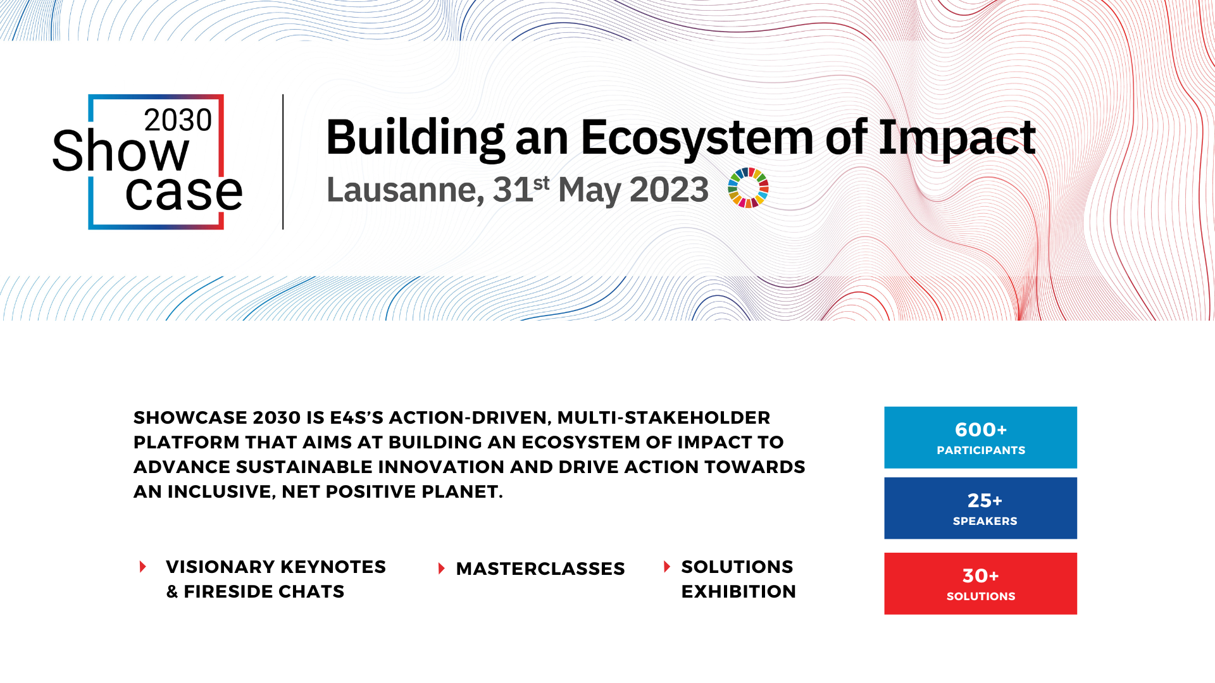

Slide 22
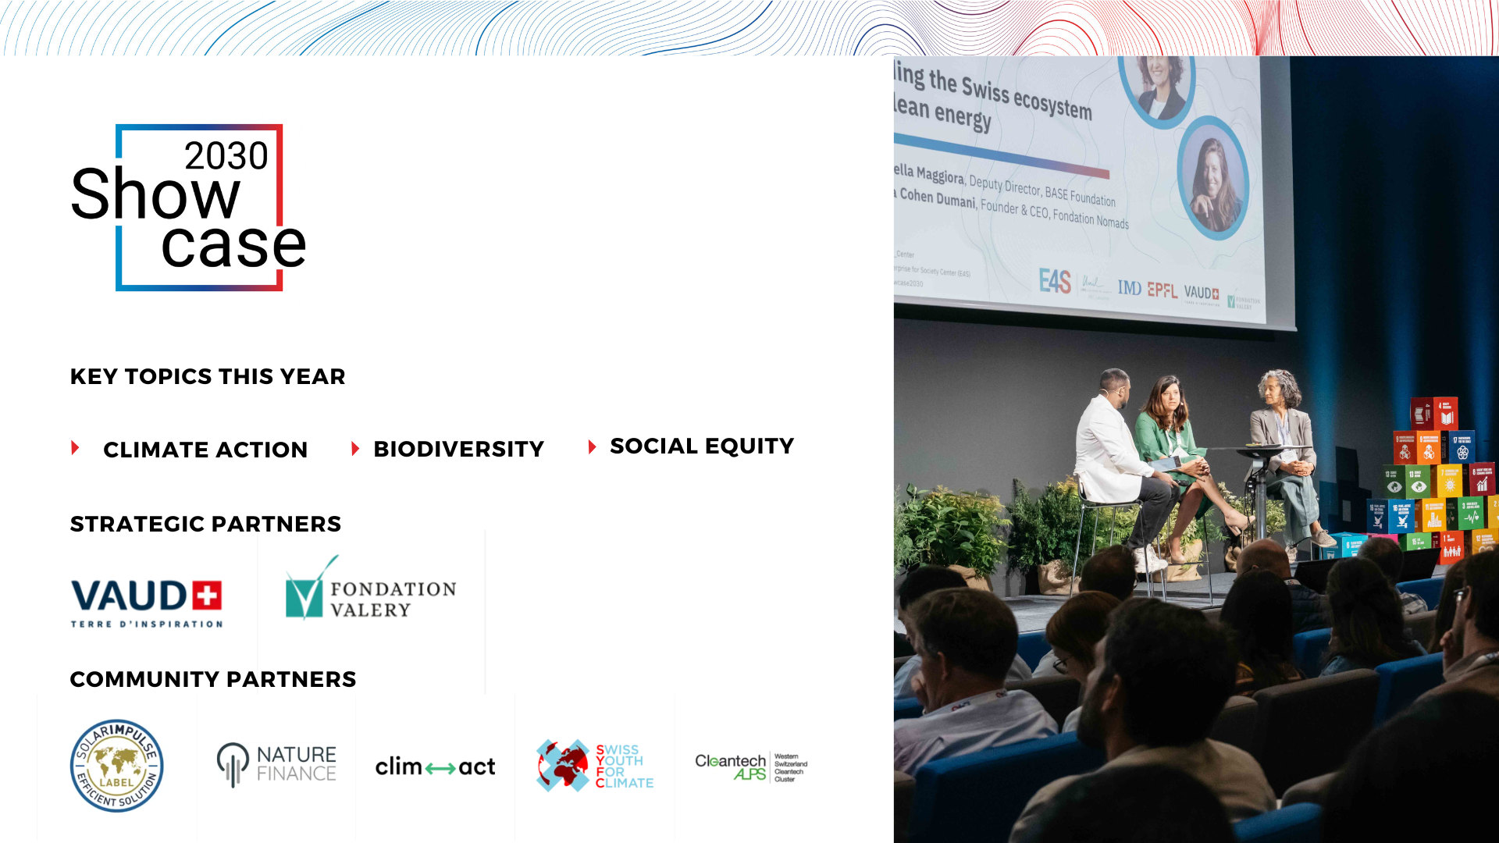

Slide 23













A Coalition of Leading Actors
EPFL
UNIL
IMD

Slide 24
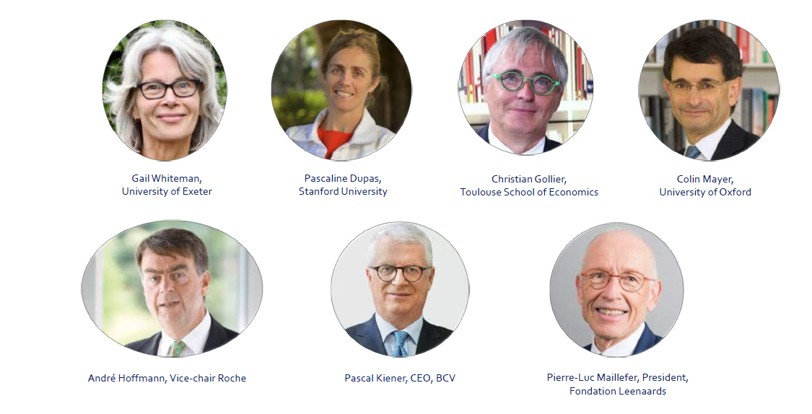
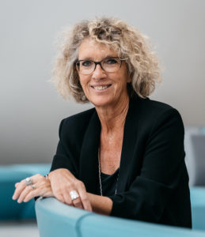
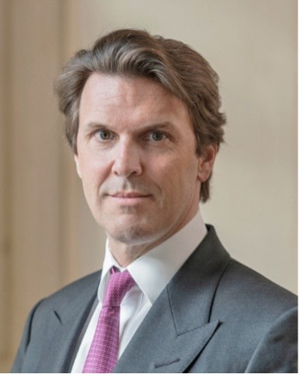
Our Strategic Advisory Board
Brigitte Rorive Feytmans, President
Fondation Leenaards
Hubert Keller, Managing Partner
Lombard Odier

Slide 25
Responsible management
Sustainable technology
Shared prosperity
Get in touch with us:
www.e4s.center
Prof. Jean-Pierre Danthine, Managing Director
jean-pierre.danthine@epfl.ch
Dr. Dominik Breitinger, Head, Strategic Projects & Partnerships
dominik.Breitinger@imd.org

