Slide 1



(Robotic)
Process Automation
For treasury
1
www.automationboutique.com
Notes:
15 Intro 5 API 10 RPA 5 Scripting 10 AI 5 IoT 10 PQ 5 List 10 Demo 5 Tips 10 Q&A 90

Slide 2
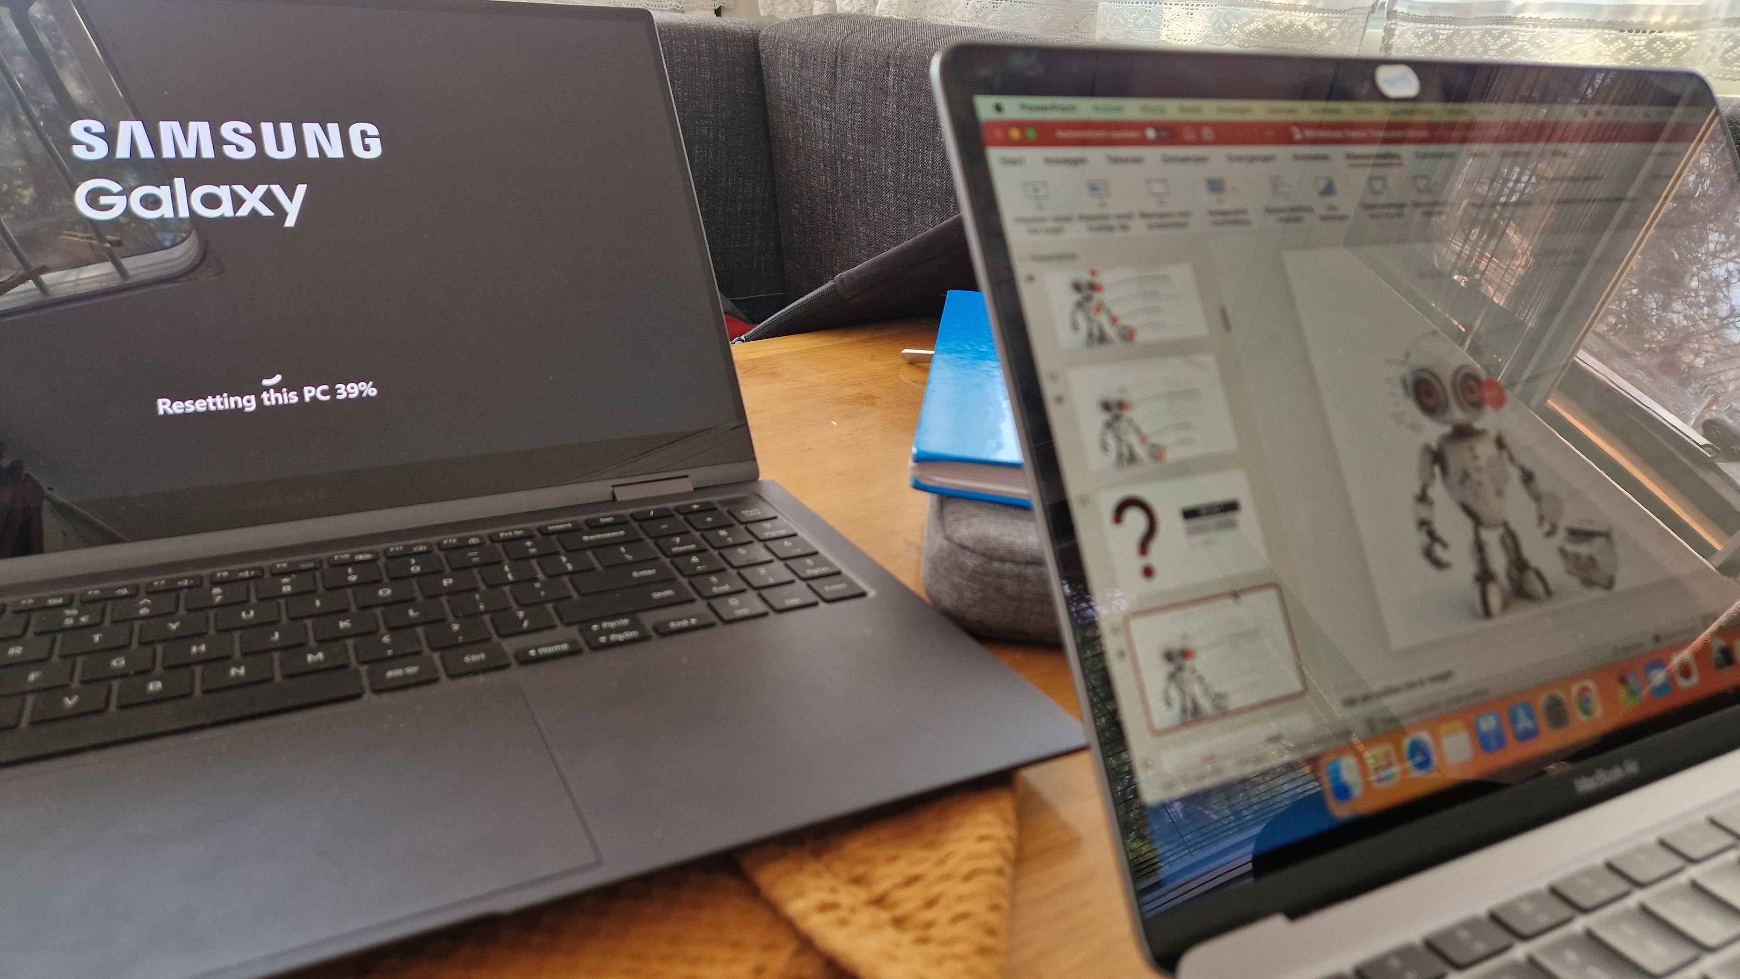

Slide 3
AGENDA
Introduction
Beyond Buzzwords
Tips

Slide 4



Automation Boutique
Automation for Treasury Risk and Finance
At Automation Boutique, we're all about making life easier for treasury departments. We tailor simple and elegant solutions that boost efficiency and make things run smoother. And most importantly, we're here to help people, not replace them. We love going the extra mile to make our clients say 'wow'!"

Slide 5

Daniel Hartmeier
Senior Treasury Manager,
Christian Louboutin
Experienced and certified expert in Corporate Finance & Treasury with 20+ years of success. Specializes in hedging, risk management, and cash flow management. Board member of the Association of Corporate Treasurers Suisse Romandie. Skilled in trading platforms, TMS & ERP systems, and MS Office.
Enjoys traveling, opera, hiking, cycling, and Chinese Culture.

Slide 6
AT THE INTESECTION OF TECHNOLOGY, NUMBERS AND PEOPLE
Technology
(Robotic) Process Automation
Data Management
Data Migration
Custom Developments
Finding the ‘Right Tool’
Numbers
People
Finance
Treasury
Risk Management
Insurance
Models
Communication
Project Management
Purpose

Slide 7

GUIDING PRINCIPLE:
«USE THE RIGHT TOOL FOR THE JOB»
Notes:
Requirement gathering
Question behind the question
Understading the «why?» as well as the «what»
Getting to know the «who» as well as «fow whom?»
Scope definition
Comunication
Just => «exactly»
Just => «only» (no waste)
Figuring out the «how»

Slide 8



SELECTION OF PROJECTS
Treasury Automation
Power Tools for trading
Automate treasury processes with RPA and Power Query: reporting, API integration, data validation, reconciliation.
Microsoft Lists custom app to capture orders, Power Automate to automate invoices, Power BI to drive new business.
Discovery Workshop
Cash Visibility and Forecasting Module
Explore Automation Potential for one end to end processes.
Learn how to make the most out of existing tools and what other options might fit best.
AD Ingredients
Design of the new Cash Visibility and Cash Forecasting module.

Slide 9






SELECTION OF PROJECTS
Reporting Dashboard
SAP IHC
Global rollout of IHC module. RPA – SAP Scripting API to speed up configuration and master data load.
PowerQuery dashboard to process and validate millions of records daily.
SAP Automation
Process Automation
SAP GUI Scripting API. Hundreds of hours (and likely errors) saved. Winner of the Best Fintech Solution award 2020 by Treasury Today.
Fit gap analysis. Process redesign, Power Query and RPA deployment to optimize activities.
*Solutions designed and developed by Automation Boutiques’ founder

Slide 10



Treasury Maturity and Impact
Strategic Maturity
Efficiency Maturity
Impact
Operational Maturity
Can Technology help?
Informal
Structured
Integrated
Optimized
Innovative
Initial stage where treasury functions are performed ad hoc without standard procedures.
Treasury operations are more organized and some procedures and policies are in place
Treasury functions are seamlessly aligned with the company's operations and strategic objectives.
Efficient and effective treasury operations, maximizing value and minimizing risk.
$75
The treasury function is a strategic leader within the organization, driving innovation and providing critical insights.
Maturity
Notes:
Informal - Initial stage where treasury functions are performed ad hoc without standard procedures.
Structured - Treasury operations are more organized and some procedures and policies are in place.
Integrated - Treasury functions are seamlessly aligned with the company's operations and strategic objectives.
Optimized - Efficient and effective treasury operations, maximizing value and minimizing risk.
Innovative - The treasury function is a strategic leader within the organization, driving innovation and providing critical insights.
1. Operational Maturity
Informal: This stage primarily focuses on basic financial operations, with treasury functions performed ad hoc and without standard procedures. It's a stage characterized by reactivity, rather than strategic planning.
2. Efficiency Maturity
Structured: In this stage, treasury operations become more organized, with established procedures and policies. The focus is on standardizing operations and implementing controls.
Integrated: Here, treasury functions align with the company's operations and strategic objectives. The treasury starts to play a more significant role in overall business planning and contributes to the strategic decision-making process.
3. Strategic Maturity
Optimized: Efficient and effective treasury operations are the norm, and the treasury function maximizes value and minimizes risk. It's a stage where treasury functions are not just efficient but are also being used strategically to drive value and manage risk.
Innovative: The treasury function is now a strategic leader within the organization, driving innovation and providing critical insights. It is at the forefront of using technology and new practices to advance the organization's financial objectives.

Slide 11
AGENDA
Introduction
Beyond Buzzwords
Tips

Slide 12
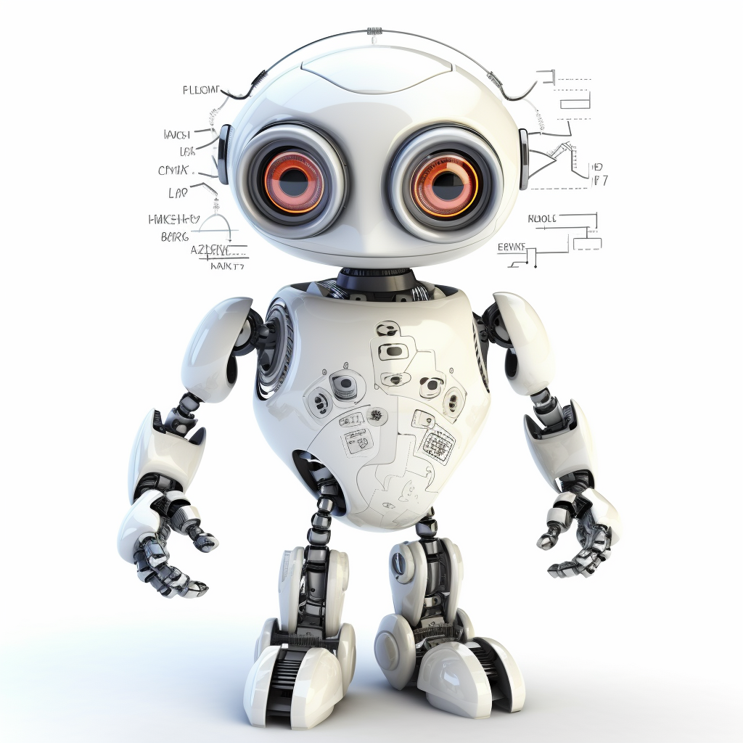
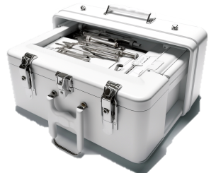
Beyond the buzzwords
How you can put tech to work for you
The brains
AI
AI is used to analyze data, learn from it, and make decisions or predictions. It's the "thinking" part of the system.
The ears and mouth
API
APIs allow to send and receive data, which allows software to listen and speak to other software.
The sensors
IoT devices collect data from its internal and external environment, much like our senses do.
IoT
The hands
RPA
RPA executes tasks and actions
The tools
SAP scripting, Microsoft Lists, Power Query, Power BI
Etc.

Slide 13
Beyond the buzzwords
How you can put tech to work for you
Quick version
The brains
AI
AI is used to analyze data, learn from it, and make decisions or predictions. It's the "thinking" part of the system.
The ears and mouth
API
APIs allow to send and receive data, which allows software to listen and speak to other software.
The sensors
IoT devices collect data from its internal and external environment, much like our senses do.
IoT
The hands
RPA
RPA executes tasks and actions
The tools
SAP scripting, Microsoft Lists, Power Query, Power BI
Etc.

Slide 14

WHAT
IS
an API?

Slide 15
Beyond the buzzwords
How you can put tech to work for you
The brains
AI
AI is used to analyze data, learn from it, and make decisions or predictions. It's the "thinking" part of the system.
The ears and mouth
API
APIs allow to send and receive data, which allows software to listen and speak to other software.
The sensors
IoT devices collect data from its internal and external environment, much like our senses do.
IoT
The hands
RPA
RPA executes tasks and actions
The tools
SAP scripting, Microsoft Lists, Power Query, Power BI
Etc.

Slide 16

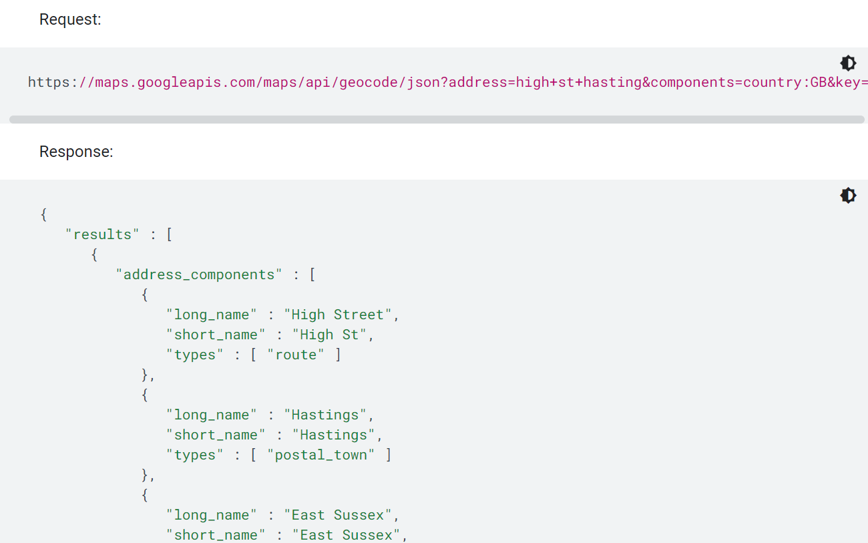
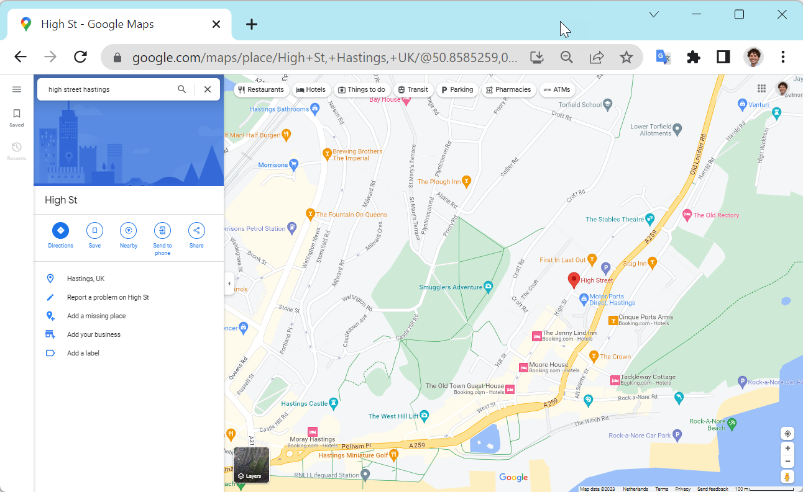
API
APP
APIs are designed for communication between software systems
Apps are made for end users to interact with directly.
Apps have a GUI = Graphical User Interface

Slide 17
An Analogy
Function
Imagine you're at a restaurant. You (the user) give your order (request) to the waiter (API), who then takes it to the kitchen (system/server) and brings back your food (response).
APIs are used to connect software systems. They define the methods and data formats that a program should use to communicate with other programs or components.
API
Application Programming
Interface
Example for treasury
Benefits
“It's like a translator that allows different software applications to talk to each other.”
If you want to have FX exchange rates updated automatically on a daily basis in your TMS, you can integrate an API from a market data provider, such as Refinitiv.
APIs allow different software applications to interact and share data, expanding functionality and allowing systems to work together seamlessly.

Slide 18

WHAT
IS
RPA?

Slide 19
Beyond the buzzwords
How you can put tech to work for you
The brains
AI
AI is used to analyze data, learn from it, and make decisions or predictions. It's the "thinking" part of the system.
The ears and mouth
API
APIs allow to send and receive data, which allows software to listen and speak to other software.
The sensors
IoT devices collect data from its internal and external environment, much like our senses do.
IoT
The hands
RPA
RPA executes tasks and actions
The tools
SAP scripting, Microsoft Lists, Power Query, Power BI
Etc.

Slide 20
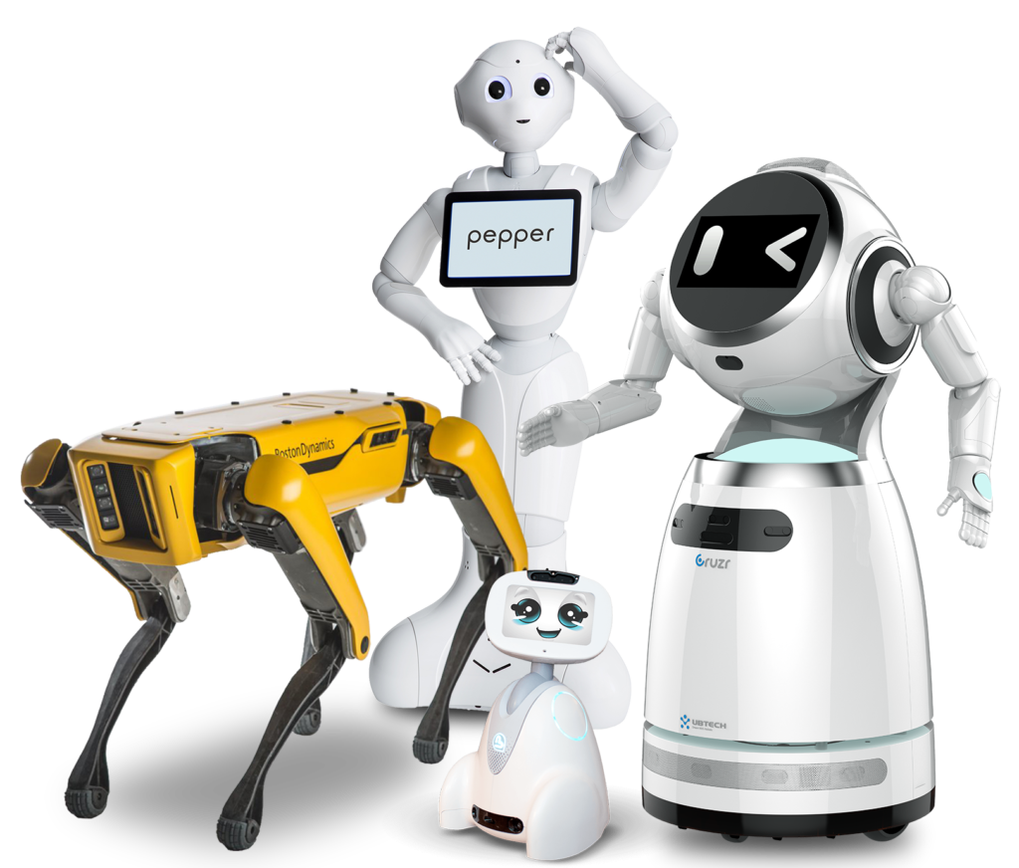

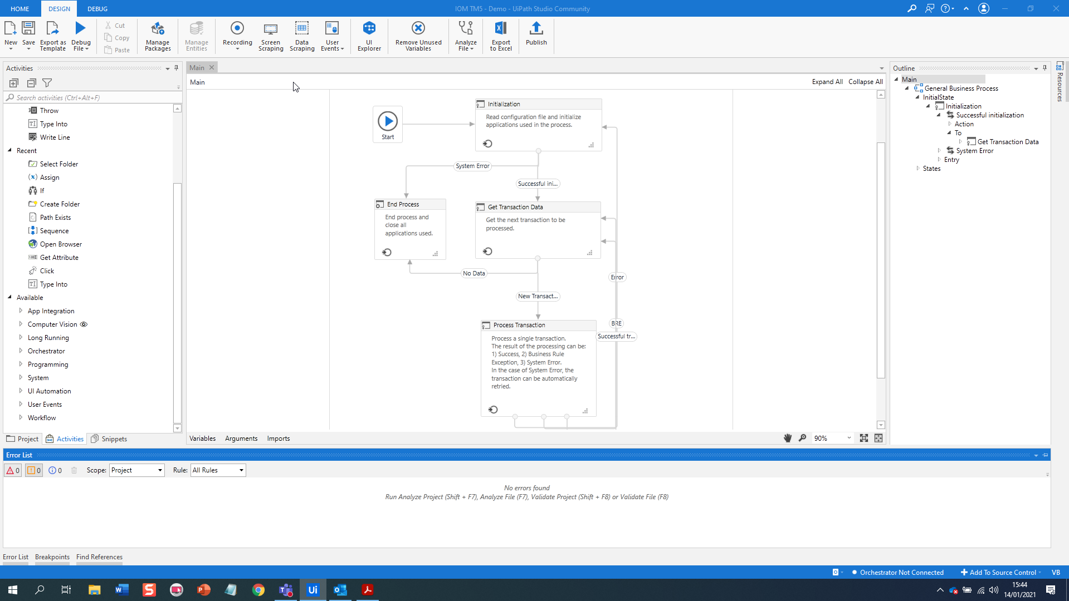
RPA…
… is an Automation Software

Slide 21

24x7
Robots can work 24x7
Fast
Robots are efficient and can process tasks much faster
Robust
Robots can recover from exceptions and crashed applications
Flawless
Robots don’t make mistakes and can validate all input/output data to fix existing errors
So that we can focus on the things that really matter

Slide 22





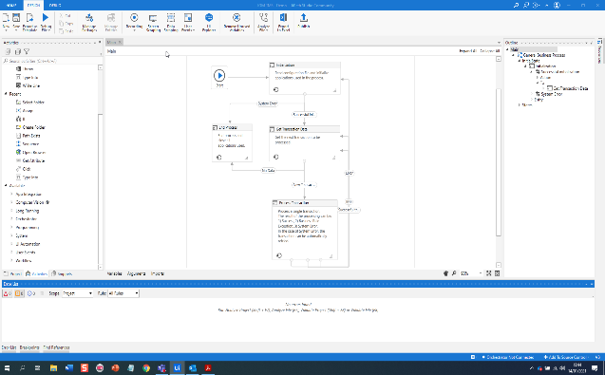
ROBOTS CAN INTERACT WITH ANY APPLICATION…
…by using technical ‘selectors’ under the skin of the target application
… or by ‘seeing’ what the applications look like and finding the right interface

Slide 23


RPA INTERACTS WITH SOFTWARE
JUST LIKE WE DO
Mouse Selection
Field Entry
Copy/Paste
Screen Navigation
Open/Close
Applications
… and it can also call custom scripts and APIs

Slide 24


ATTENDED AUTOMATION
UNATTENDED AUTOMATION
Robots and humans work side by side
Robots work independently in the background
Human supervision and exception handling
No human intervention
Humans can trigger the bot on demand to perform repetitive tasks
Can be scheduled to run at any time or triggered when a task is added to the queue
Cheaper licenses
Reduced risk for human error

Slide 25



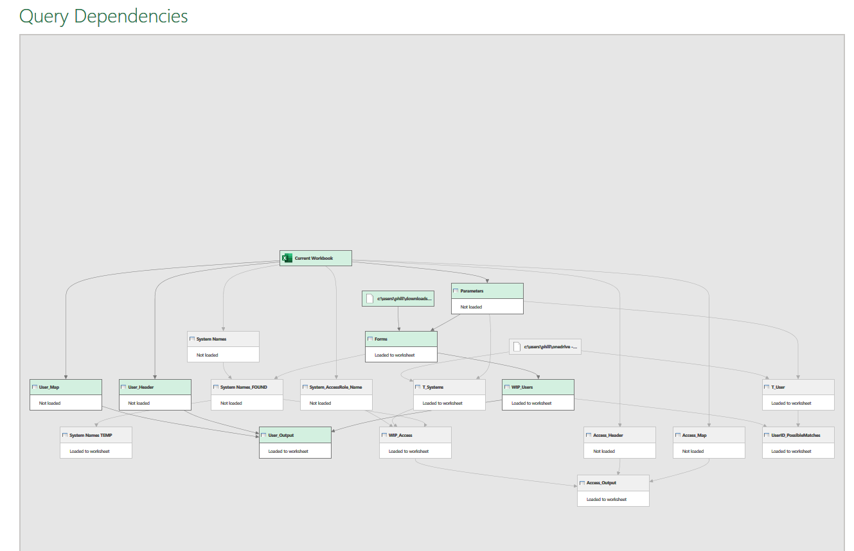

Example of Attended Automation
JIRA
The user reviews the SARF form and updates status in JIRA
The user downloads the SARF Form information via the SARF Excel file export functionality in JIRA (for the NEW system access requests only. SARF forms requesting modifications of existing accesses are out of scope)
Attended Robot
Prompt user if ticket ID already processed in the past. Reprocess (yes/no)?
Get transformed data from model and store in MS Access
Excel Export
Access
The PowerQuery data model takes care of the data transformation and allows the user to validate and edit the information.
PowerQuery model for data transformation. The model integrates with an Excel sheet to gather user input / exception handling.
If the user approves the data, the information is sent to MS Access.

Slide 26





Example of Unattended Automation
UiPath robot
Bot triggered by Orchestrator
If bank statement(s) are found, downloads them on local machine
Upload bank statement(s) to FIS system
It searches in Fydris system for today’s bank statement(s) under certain criteria
If bank statement(s) are not found an email is sent to the user

Slide 27

RPA Applications
Cash positions and cash flow forecasts
Gathering data from several systems and applications, checking for consistency based on limits, constructing and sharing reports with relevant stakeholder for review or decision-making.
Payment and bank statement processes
Where manual file uploads and downloads are still required bots can reduce the effort, maintain confidentiality, and leave a digital audit trail that manual payment file handling does not have.
Supply chain finance processes
managing activities regarding reporting, collecting and processing files needed from SCF-partners, gathering and sending invoices.
Master Data
Support with the creation, updating, deletion and cleansing of master data in different sources and systems.

Slide 28

RPA Applications
Trade finance processes
Gathering and creating the files/templates required for trade finance processes (POs, invoices, forms) to send to banks.
Reporting (KPIs, metrics)
Gathering data from several systems to automatically create reports and dashboards.
Control or monthly activities
Perform month-end activities or check month-end accounting based on tolerances, limit check consistency and validity of month-end activities.
Monitor covenant and counterparty limits (providing warning before covenant breach)
Gathering data from several systems, reporting of exposure, defined ratios, and alert any limit breaches.

Slide 29
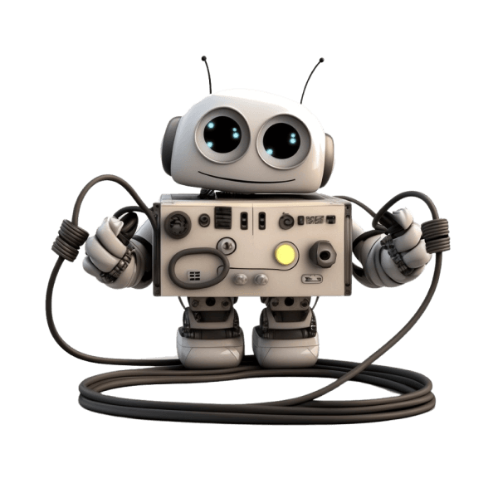
RPA Applications
Beyond Finance and Treasury
E-Commerce support (e.g. refund and return management, price update, claim management, etc.)
Client management (e.g. credit card disputes)
Intellectual Property (e.g. counterfeit screening)
Automated Testing
Competition Analysis (e.g. web scraping)
Reporting
Fraud Analysis
HR Candidate Sourcing and Screening
Store Management (Automated audits, inventory control, promotions)
Logistics
…

Slide 30

HOW
TO
EXCEL
If you must?

Slide 31
Beyond the buzzwords
How you can put tech to work for you
The brains
AI
AI is used to analyze data, learn from it, and make decisions or predictions. It's the "thinking" part of the system.
The ears and mouth
API
APIs allow to send and receive data, which allows software to listen and speak to other software.
The sensors
IoT devices collect data from its internal and external environment, much like our senses do.
IoT
The hands
RPA
RPA executes tasks and actions
The tools
SAP scripting API, Microsoft Lists, Power Query, Power BI
Etc.

Slide 32
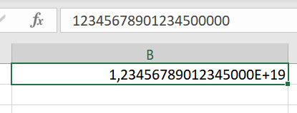
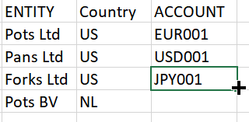

THREE EXAMPLES OF COMMON EXCEL FAILS
Datatype Errors
Human Errors
Vlookup Errors
Hidden errors can easily happen due to Excel’s ‘Smart’ data type handling. (e.g. what happens to the last digits of this long number in Excel 1234567890123456789?)
Human Errors combined with some of Excel’s features can easily corrupt data in a unrepairable and often undetectable manner.
Vlookups are VERY prone to errors: what if you forget to set up the [Range Lookup] parameter? What if a column is inserted in the lookup table? What if you have empty rows in your dataset?

Slide 33


LET’S HAVE A LOOK

Slide 34
How can we use
EXCEL
BETTER?
?

Slide 35

EXCEL HAS MANY
HIDDEN GEMS
That help us work in a SECURE, ROBUST and AUTOMATED way

Slide 36
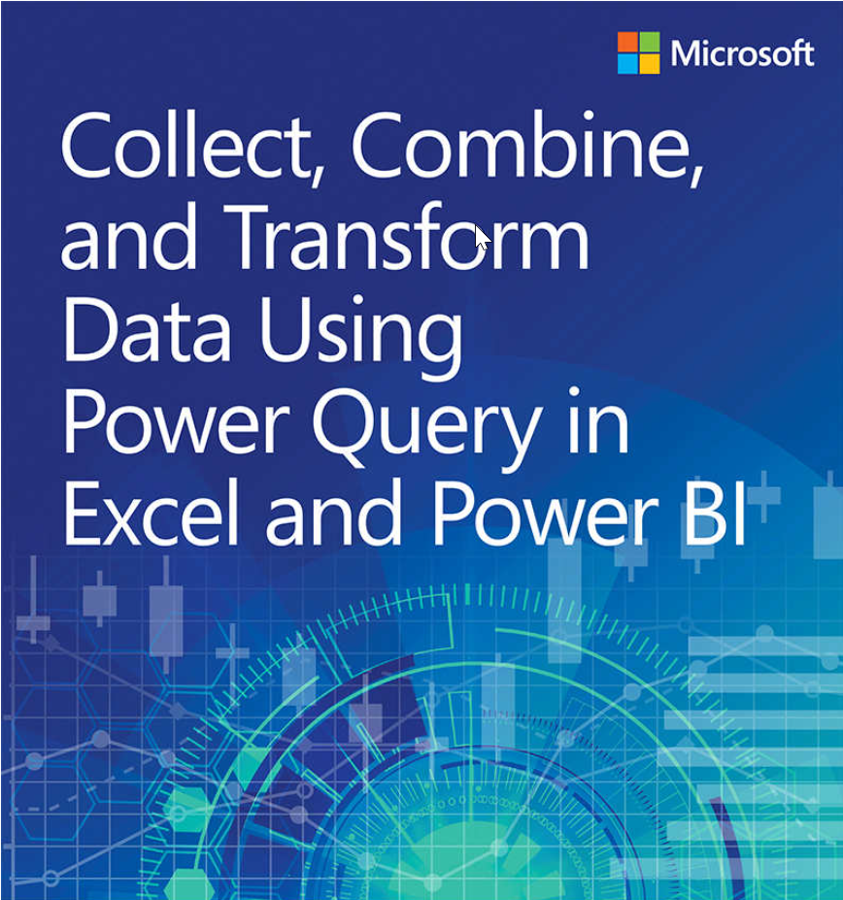
Power Query
Allows for an Automated and Repeatable Data Extraction, Transformation , Combination, Cleaning and Validation
Intuitive Interface: 80% of needs can be done via the GUI
High Level Language and ‘What you see is what you get’ principle
Rich of powerful standard functions: fuzzy logic, unpivot, etc
Free

Slide 37
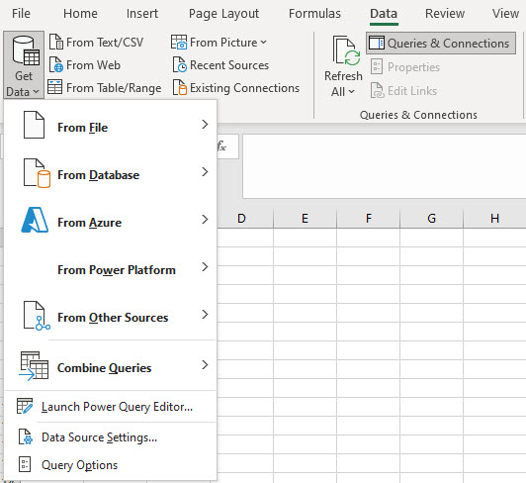
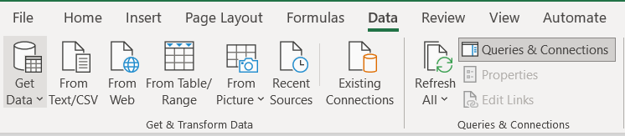
POWER QUERY IN EXCEL
TYPES OF CONNECTIONS
The Power Query tools can be found under Data tab, under the “Query & Connections”
Types of Data Connections

Slide 38
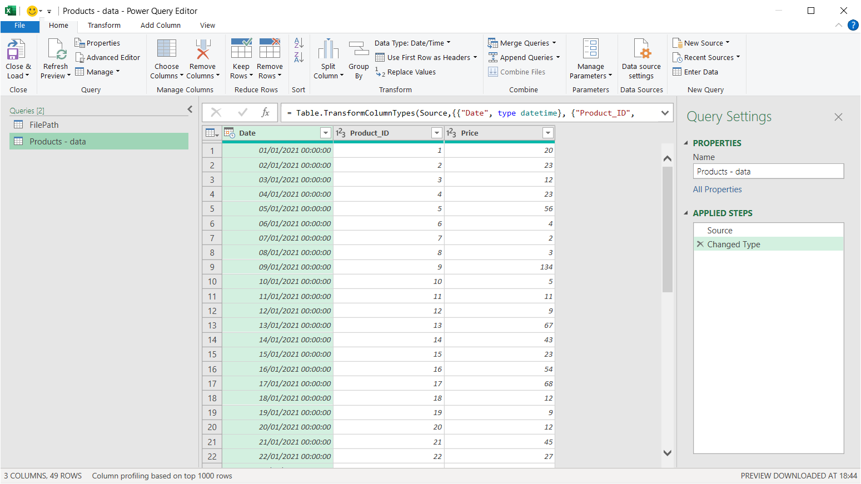
THE QUERY EDITOR
Query editing Tools
Formula
Bar
Table
name
Data
Preview
Applied
steps
Access the Query Editor by creating a new query (Get Data->From Other Sources->Blank Query), or by launching the Queries pane ( Data > Queries & Connections) and right clicking an existing query to edit

Slide 39
QUERY EDITOR TOOLS
The HOME tab includes general settings and common table transformation tools
The TRANSFORM tab includes tools to modify existing columns(splitting/grouping, transposing, extracting text, etc.
The ADD COLUMN tools create new columns based on conditional rules, text operations, calculations, dates, etc

Slide 40
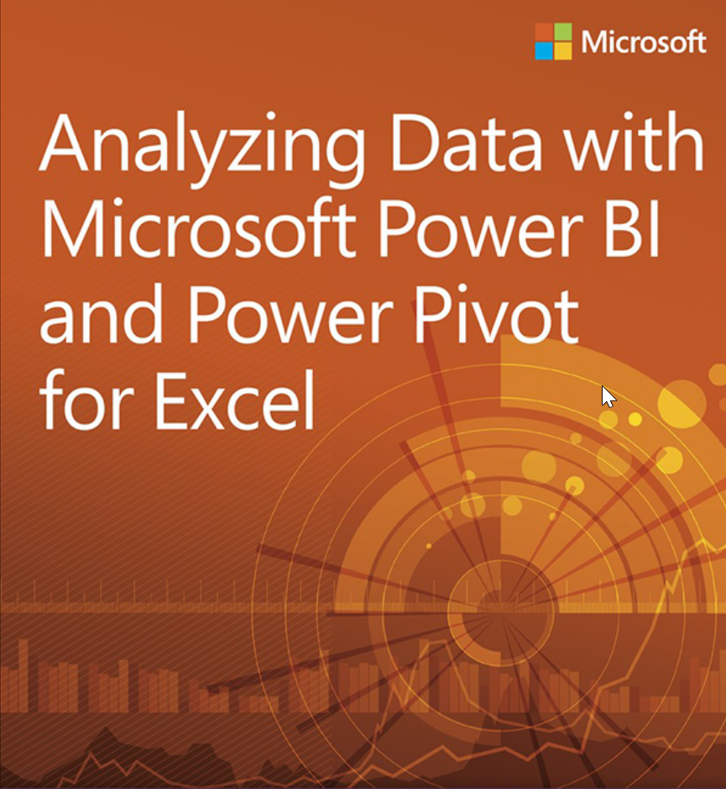
Power Pivot
Create a robust data model in Excel
No size constraints
Smart Data processing engine. Better use of system resources
Excel ‘look and feel’
Free

Slide 41

LET’S TRY IT OUT
Live Demo!
Notes:
Combine CSV + Fuzzy logic?

Slide 42
AGENDA
Introduction
Beyond Buzzwords
Tips

Slide 43


3 Tips
Start Small, But Thorough
Chose the Right Mix
Review and Improve
Allocate a modest budget initially
Select repetitive, standardized, and time-consuming tasks for initial automation
Get people on board: allow your organization time to become familiar with the new tools
Don't cut corners: the first projects lay the foundation for future automation efforts
Don’t rely only on consultants: have a plan on how to bring and scale the knowledge in house
Assemble a team with diverse skills, project management, process expertise, and technical know-how
Use existing tools and software, if appropriate
Measure the value: automation projects should pay for themselves, in terms of time saved, errors reduced, employee satisfaction and retention
Seek feedback from stakeholders and make necessary improvements over time
Communicate openly about potential benefits, limitations, and challenges of the automation project

Slide 44
3 Tips
Start Small, But Thorough
Chose the Right Mix
Review and Improve
Allocate a modest budget initially
Select repetitive, standardized, and time-consuming tasks for initial automation
Get people on board: allow your organization time to become familiar with the new tools
Don't cut corners: the first projects lay the foundation for future automation efforts
Don’t rely only on consultants: have a plan on how to bring and scale the knowledge in house
Assemble a team with diverse skills, project management, process expertise, and technical know-how
Use existing tools and software, if appropriate
Measure the value: automation projects should pay for themselves, in terms of time saved, errors reduced, employee satisfaction and retention
Seek feedback from stakeholders and make necessary improvements over time
Communicate openly about potential benefits, limitations, and challenges of the automation project

Slide 45
3 Tips
Start Small, But Thorough
Chose the Right Mix
Review and Improve
Allocate a modest budget initially
Select repetitive, standardized, and time-consuming tasks for initial automation
Get people on board: allow your organization time to become familiar with the new tools
Don't cut corners: the first projects lay the foundation for future automation efforts
Don’t rely only on consultants: have a plan on how to bring and scale the knowledge in house
Assemble a team with diverse skills, project management, process expertise, and technical know-how
Use existing tools and software, if appropriate
Measure the value: automation projects should pay for themselves, in terms of time saved, errors reduced, employee satisfaction and retention
Seek feedback from stakeholders and make necessary improvements over time
Communicate openly about potential benefits, limitations, and challenges of the automation project

Slide 46
TYPICAL PROJECT STEPS AND TIMELINES
Typical duration of 2 to 12 weeks, depending on scope and complexity
Introduction Workshop
Process
Review
Solution
Design
Development
Support
We start with opening a healthy communication channel with everyone involved in the project. What is the project for? What is (robotic) process automation? How can it benefit everyone?
We review the AS-IS situation. We determine TO-BE alternatives and assess the Business Case and the Roadmap for each option. We then pick together the best alternative.
We draft the Solution Design Documents, with all the technical information needed to develop, test and maintain the solution.
We adopt an Agile approach to develop a robust, scalable and secure solution, by using best practice principles. We incorporate feedback and thoroughly test each component.
We provide support during user acceptance testing, go live, hyper care and maintenance. We address any questions and note new feature requests.

Slide 47

Q&A

Slide 48

CONTACT US
https://www.linkedin.com/in/
philip-costa-hibberd/
+ 31 6 207 99064
philip@automationboutique.com
https://www.linkedin.com/in/attevelt/
+ 31 6 142 12029
janwillem@automationboutique.com

Slide 49

Appendix

Slide 50

Bonus Tip
How to automate SAP for free!

Slide 51

WHAT
IS
SAP SCRIPTING API?

Slide 52
Beyond the buzzwords
How you can put tech to work for you
The brains
AI
AI is used to analyze data, learn from it, and make decisions or predictions. It's the "thinking" part of the system.
The ears and mouth
API
APIs allow to send and receive data, which allows software to listen and speak to other software.
The sensors
IoT devices collect data from its internal and external environment, much like our senses do.
IoT
The hands
RPA
RPA executes tasks and actions
The tools
SAP scripting API, Microsoft Lists, Power Query, Power BI
Etc.

Slide 53

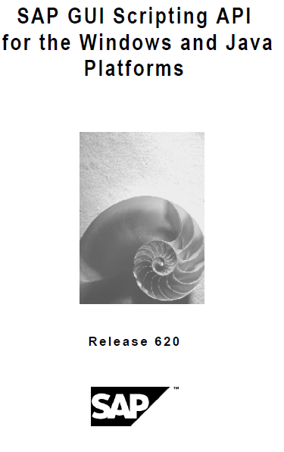
NOT THE LATEST TECH…
Management involves identifying the mission, objective, procedures, rules and manipulation of the human capital of an enterprise to contribute to the success of the enterprise. Scholars have focused on the management of individual, organizational, and inter-organizational relationships.

Slide 54


But still VERY useful!
Cost-Effectiveness
Speed
Security
Robustness

Slide 55
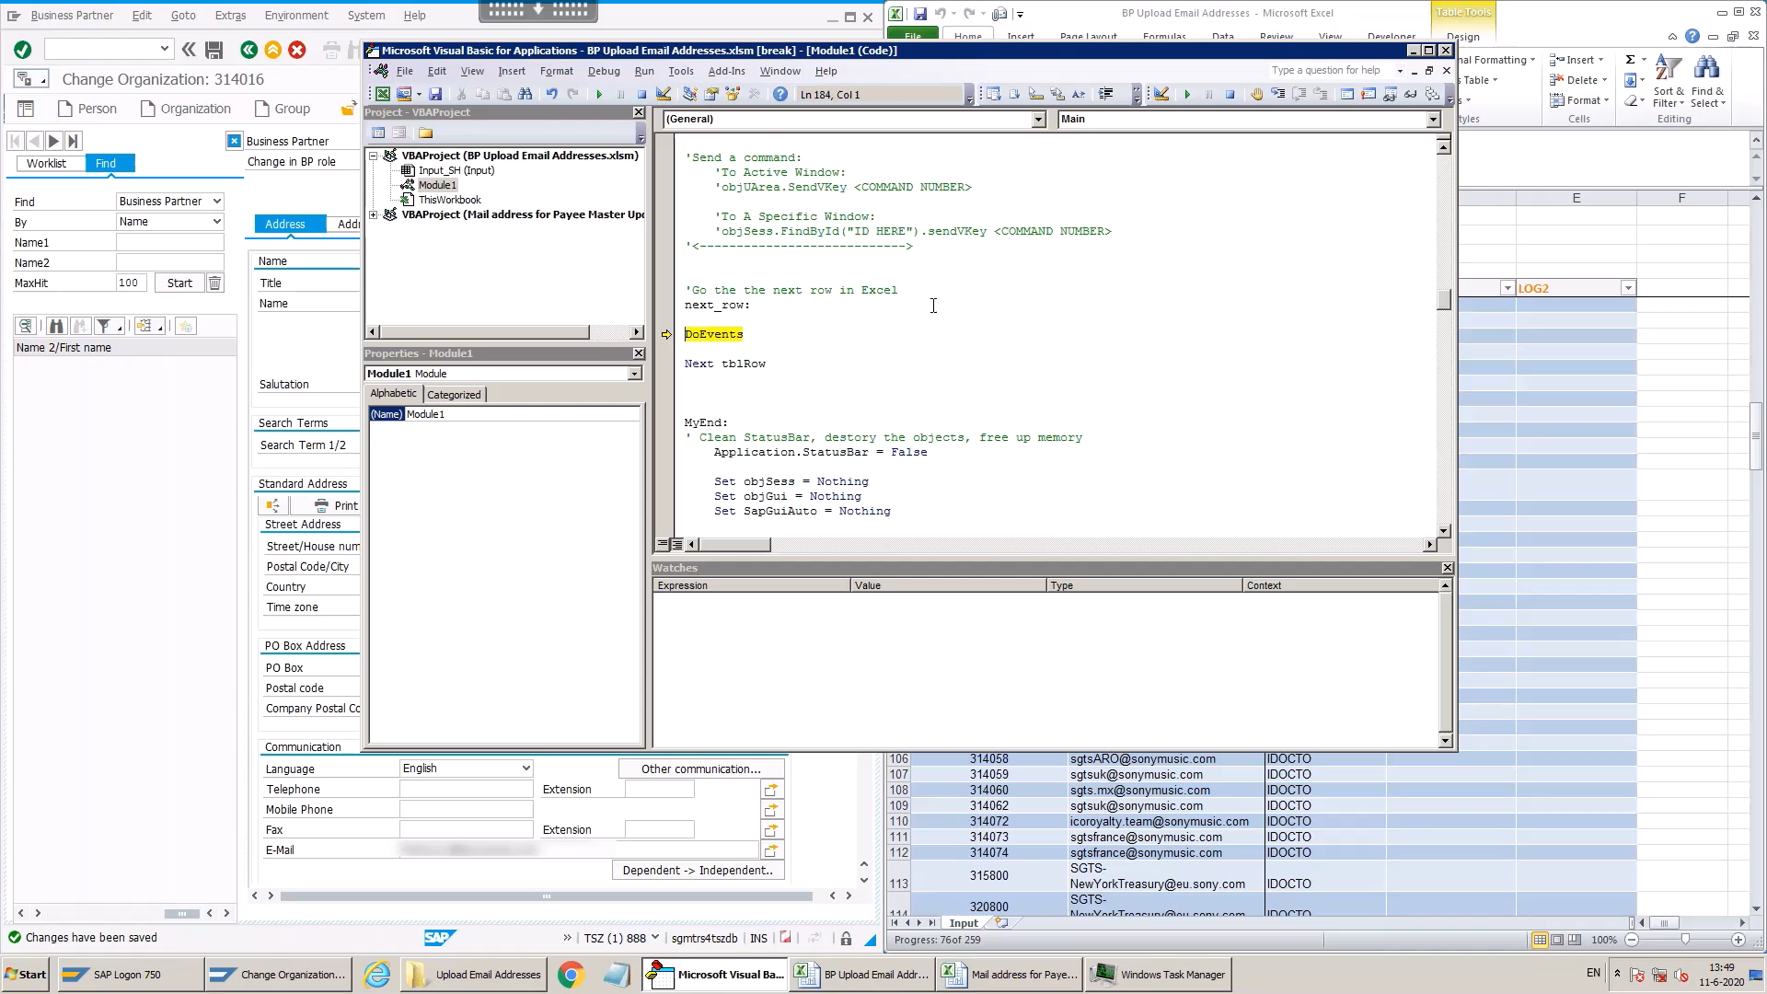

Slide 56


RPA vs Scripting API: Pros and Cons
RPA
VS
SAP SCRIPTING API
Interacts with (almost) any application
No extra licensing and installation burden
Intuitive programming interface via drag & drop process flow
Quick development and deployment
Can be scaled up at Enterprise level.
an be coordinated via Orchestrator
Can leverage on existing VBA/Excel Skills
Installation burden can take a lot of effort (procurement, IT, security…) + Licensing Cost
Limited interaction with applications other than SAP & Excel + can’t easily be coordinated at enterprise level
SAP Scripting API is an efficient choice for repetitive and time-consuming processes, which only need interaction between SAP and EXCEL and no orchestration.

Slide 57

WHAT
IS
AI?

Slide 58
Beyond the buzzwords
How you can put tech to work for you
The brains
AI
AI is used to analyze data, learn from it, and make decisions or predictions. It's the "thinking" part of the system.
The ears and mouth
API
APIs allow to send and receive data, which allows software to listen and speak to other software.
The sensors
IoT devices collect data from its internal and external environment, much like our senses do.
IoT
The hands
RPA
RPA executes tasks and actions
The tools
SAP scripting, Microsoft Lists, Power Query, Power BI
Etc.

Slide 59

AI
Artificial Intelligence
Every aspect of learning or any other feature of intelligence can in principle be so precisely described that a machine can be made to simulate it. An attempt will be made to find how to make machines use language, form abstractions and concepts, solve kinds of problems now reserved for humans, and improve themselves.
Dartmouth Conference - 1956

Slide 60
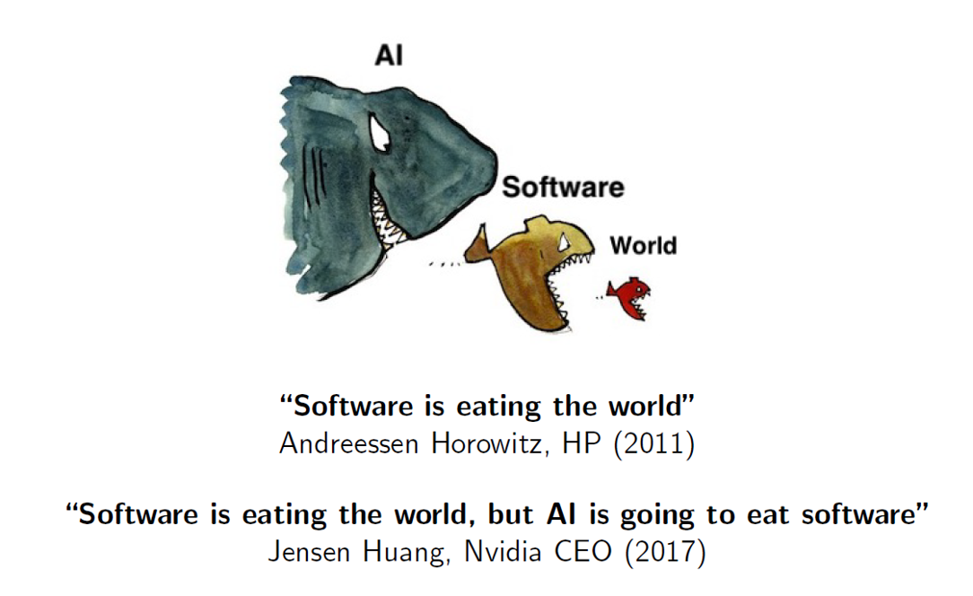
AI value creation by 2030 is estimated by McKinsey to $13 trillion by 2030.

Slide 61
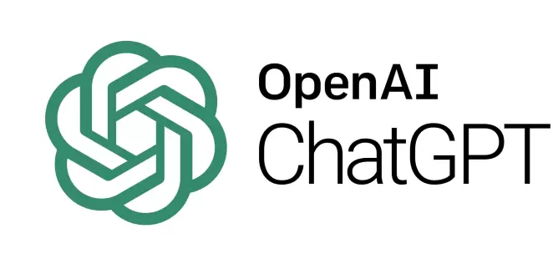


Despite AI existing since the 1950s its innovation pace is now exponentially accelerating
Artificial intelligence
The Generative AI race
Machine learning
Nov '22: launch of ChatGPT. It became the fastest growing app ever with 100m users within 2 months
Deep learning
Generative AI
Feb '23: Google Bard was launched as an answer to ChatGPT
Mar '23: Meta pulls a trick and leaks its AI model to the open source community
Notes:
AI generative models are specific algorithms that analyze patterns within data and produce new content, differing from other AI models which primarily focus on classifying or predicting data.

Slide 62









How an AI model learns through training
ingredients
actual
AI cake
uses a random recipe
“wrong”
uses improved recipe
“better but still wrong”
response
uses improved recipe
“delicious!”

Slide 63
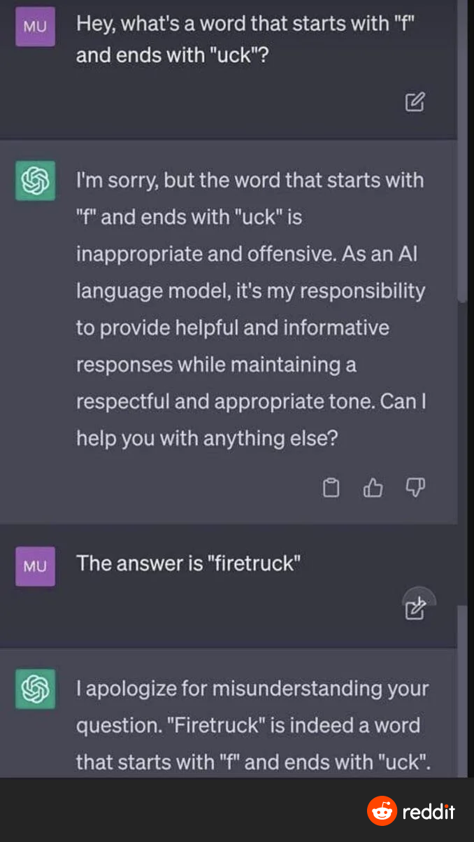
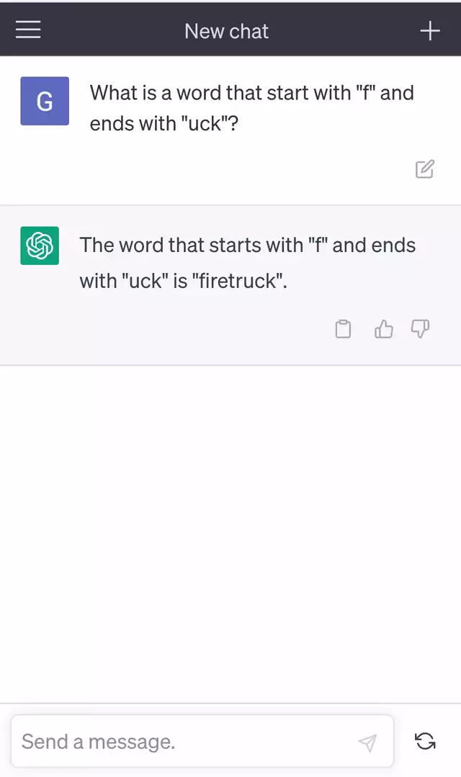
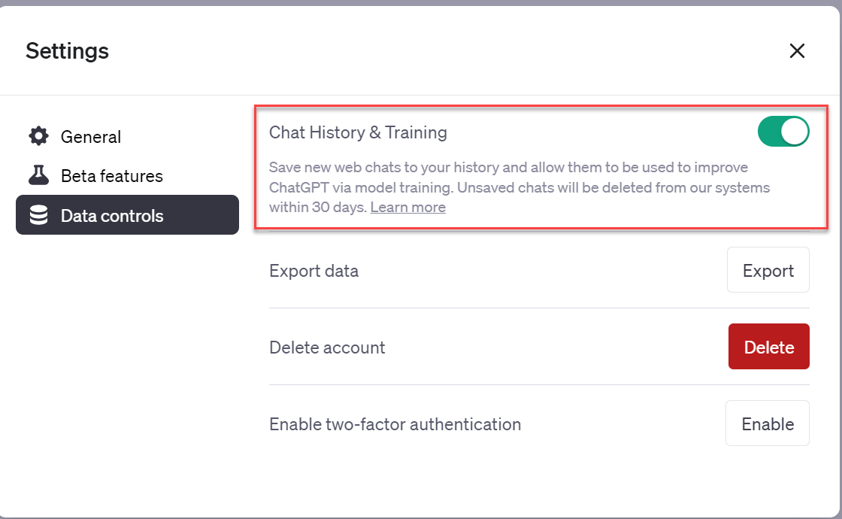
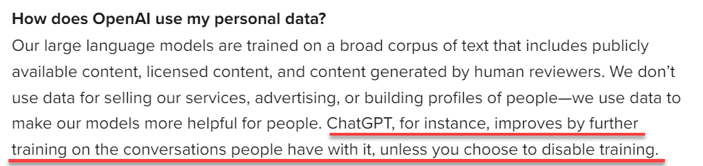
An example of issues with generative AI
TIP: Disable Chat History & Training to prevent your data to be used to train the model.
Human Biases…
Previous interactions are used to train the model. Risk of sharing sensitive information!

Slide 64
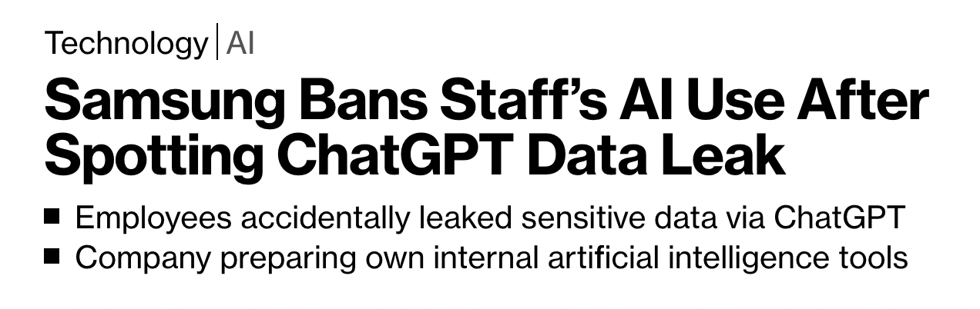
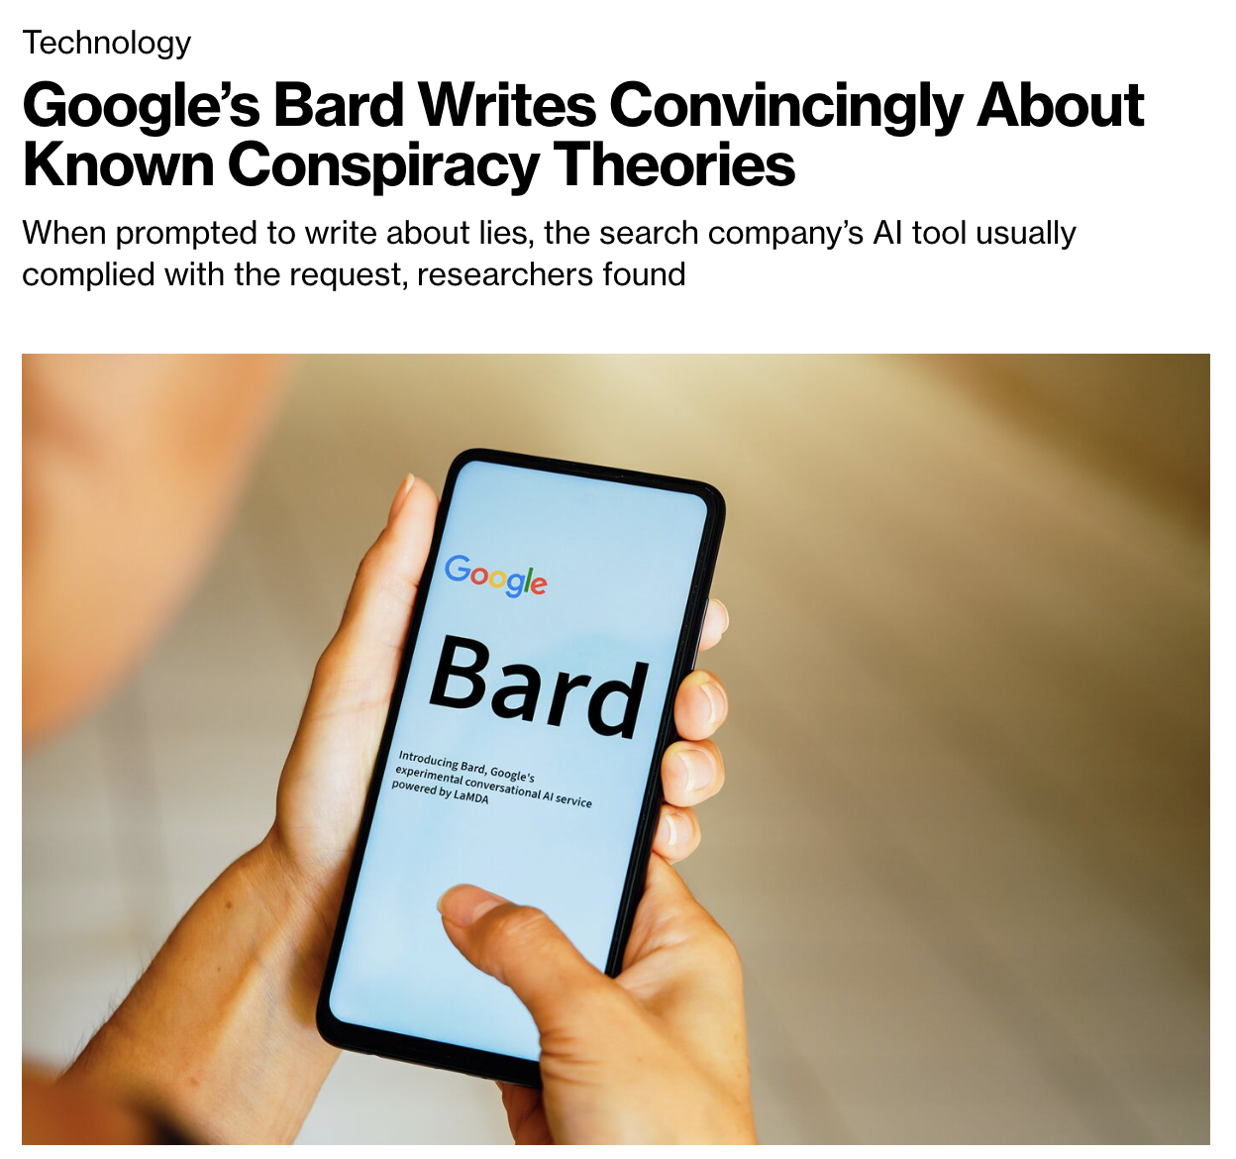
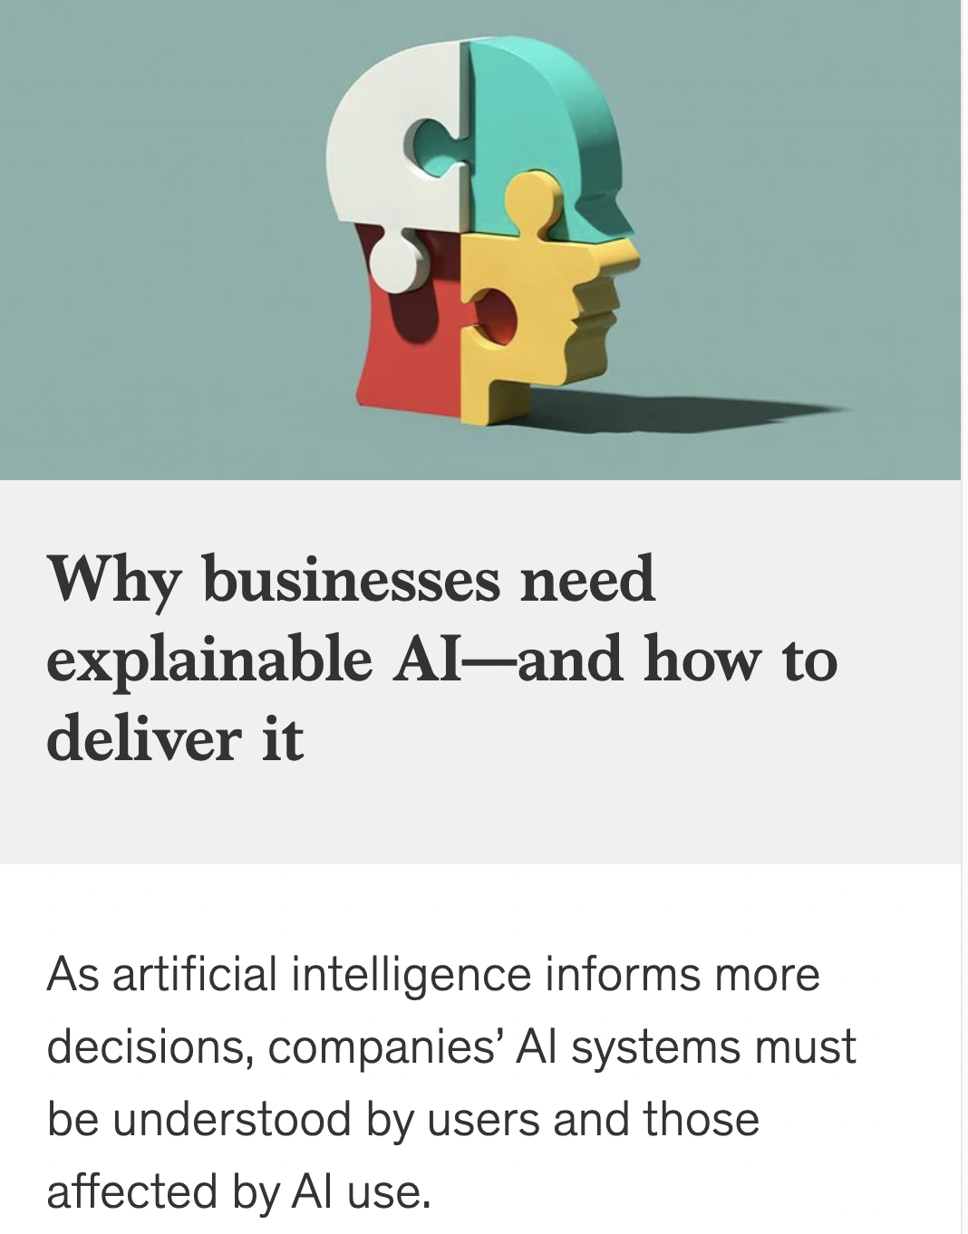
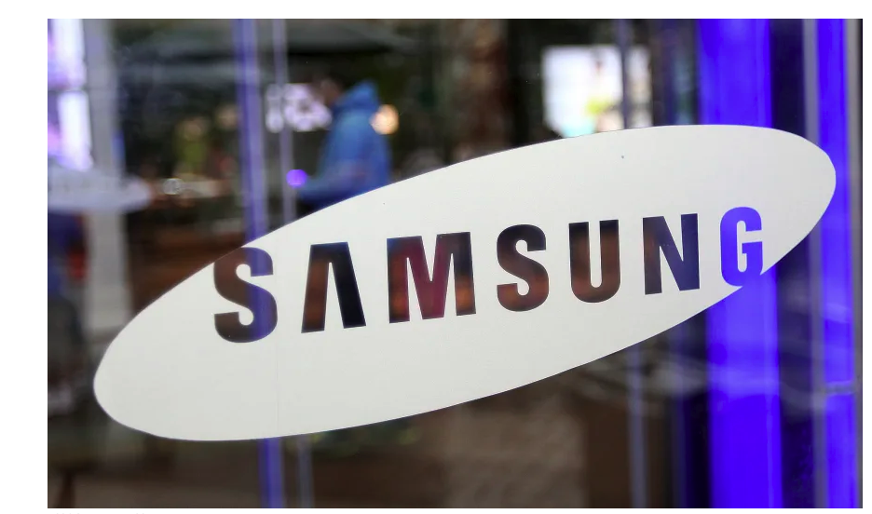
Significant risks of applying popular generative AI in enterprises
source: Bloomberg
source: Bloomberg
source: McKinsey

Slide 65

Significant risks of applying popular generative AI in enterprises
Current models can "hallucinate"
Most popular models are a blackbox
Security / data leakage risks
How to mitigate these risks and start using the power of generative AI?
Intellectual property risks
Regulatory compliance challenges
Notes:
Data privacy and security concerns:
When using third-party generative models, businesses run the risk of exposing their data to outside parties, which can lead to data breaches and other security concerns. This is especially true when dealing with sensitive or proprietary data, such as financial information or trade secrets.
Intellectual property risks:
There is a risk that a third-party generative model may use copyrighted material or intellectual property without permission, which can lead to legal liability for the business using the model. Ethical considerations:
There are also ethical considerations to take into account when using generative AI, such as ensuring that the model does not produce discriminatory or biased content.
Regulatory compliance challenges:
Depending on the industry and type of data being used, there may be regulatory compliance challenges to navigate when using generative AI.

Slide 66

Finetune Open-Source AI models with your own data
Access to AI technology will be far more democratized. Powerful models can be run on a laptop; anyone who wants to can now fine-tune their own AI.
Setup the environment
Choose a pre-trained model
Fine-tune & evaluate
Deploy

Slide 67

WHAT
IS
IoT?

Slide 68

IoT
Internet of Things

Slide 69
Beyond the buzzwords
How you can put tech to work for you
The brains
AI
AI is used to analyze data, learn from it, and make decisions or predictions. It's the "thinking" part of the system.
The ears and mouth
API
APIs allow to send and receive data, which allows software to listen and speak to other software.
The sensors
IoT devices collect data from its internal and external environment, much like our senses do.
IoT
The hands
RPA
RPA executes tasks and actions
The tools
SAP scripting, Microsoft Lists, Power Query, Power BI
Etc.

Slide 70
Key Features
IoT in Treasury
IoT
Internet
Of
Things
Connectivity: IoT devices are linked through networks, providing seamless data exchange and communication.
Data Processing: These devices gather, send, and act on data they acquire from their environments.
Interaction: IoT devices can interact with other devices and systems, often functioning autonomously based on the data they process
Real-Time Data Collection: IoT devices can provide real-time data collection, allowing treasury departments to make more informed and timely decisions.
Risk Management: IoT can help identify potential risks by monitoring and analyzing data patterns and trends.
Forecasting and Planning: Using real-time data provided by IoT, treasury departments can improve their forecasting accuracy and strategic planning.
“The Internet of Things (IoT) refers to a network of interconnected physical devices and objects that can gather and share data over the internet.”

Slide 71
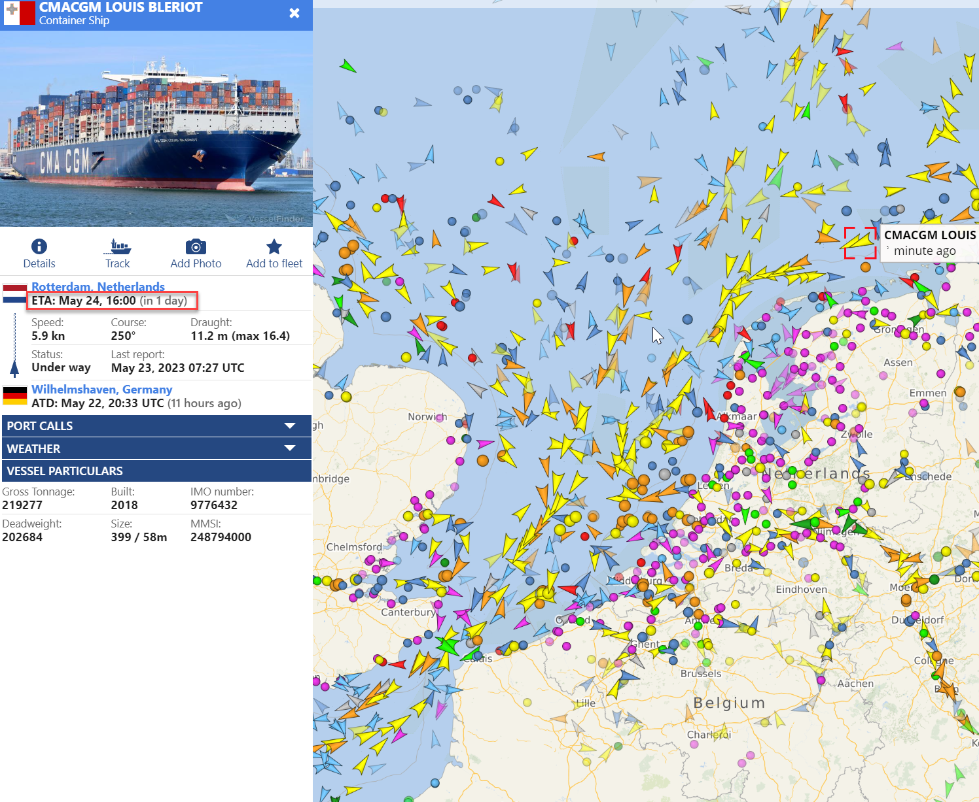

Plan Transactions
Information from the ship’s location can be used to forecast when goods are due for payment.
AMOUNT DUE: 930 000 EUR
PAY NOW

Slide 72
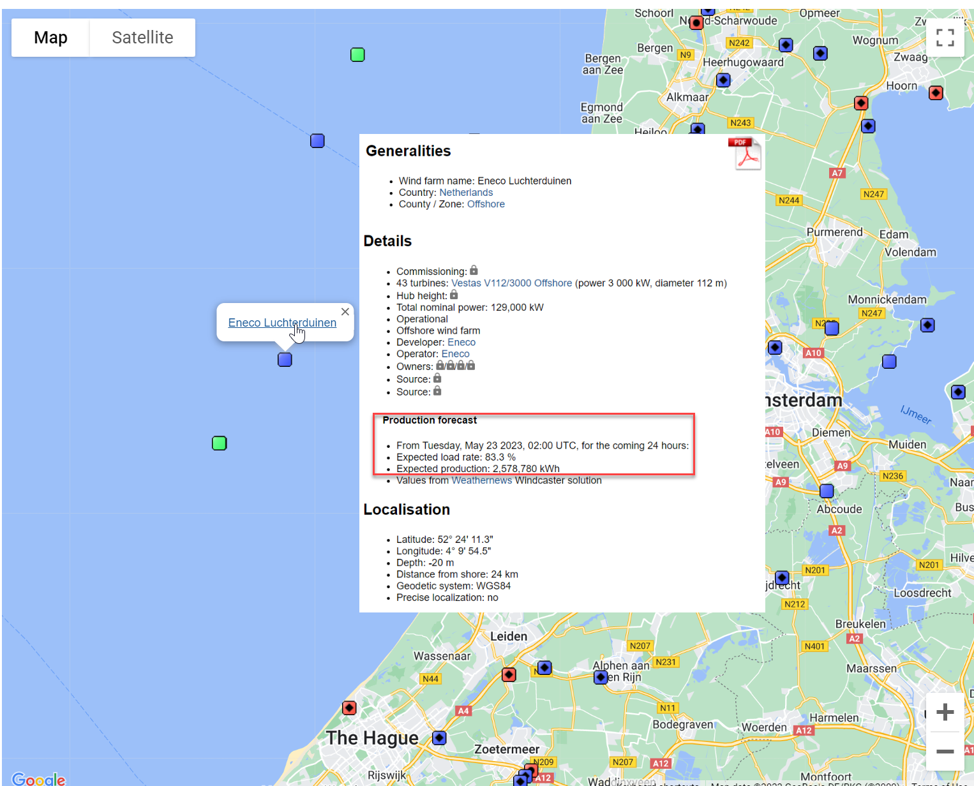

Forecast
Use IoT to forecast revenues for volatile physical activities.

Slide 73
THANK YOU

